Slide 2
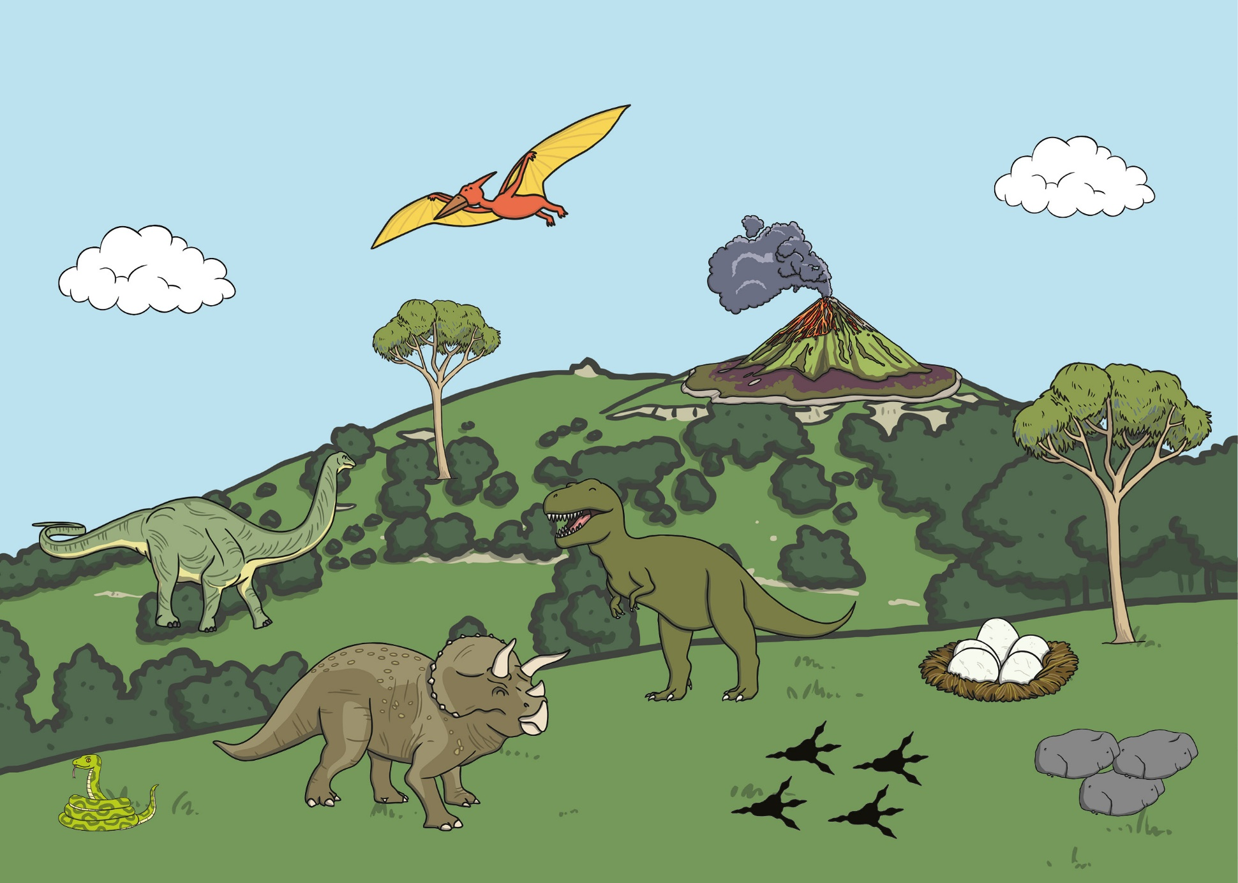

Slide 3


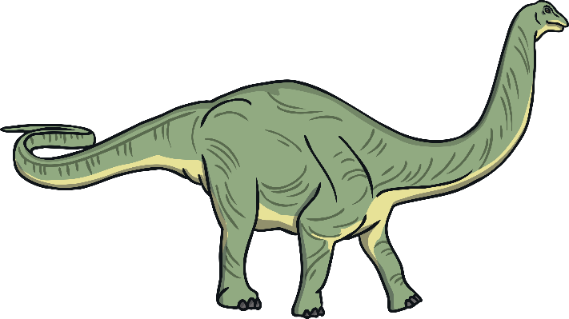
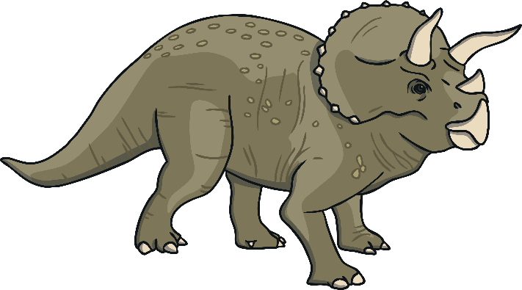
back to the picture
next

Slide 4

back to the picture
next

Slide 5

back to the picture
next

Slide 6

back to the picture
next

Slide 7

back to the picture
next

Slide 8

back to the picture
next

Slide 9

back to the picture
end

