Slide 2
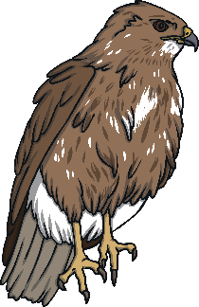

Hello there!
My name is Davina Attenburg.
I am a biologist and I love to study all kinds of animals. Today I am doing a minibeast hunt in the woods.
Unfortunately, the creatures keep crawling away and making me all confused as I try to count them!
Will you please help me to count them before they wander off?

Slide 3
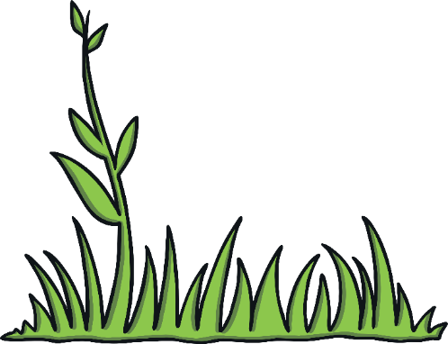
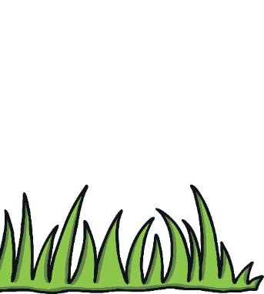

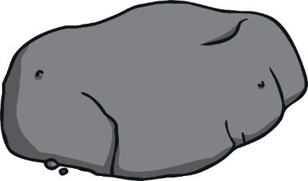
Let’s have a look and see what is hiding under this rock!

Slide 4

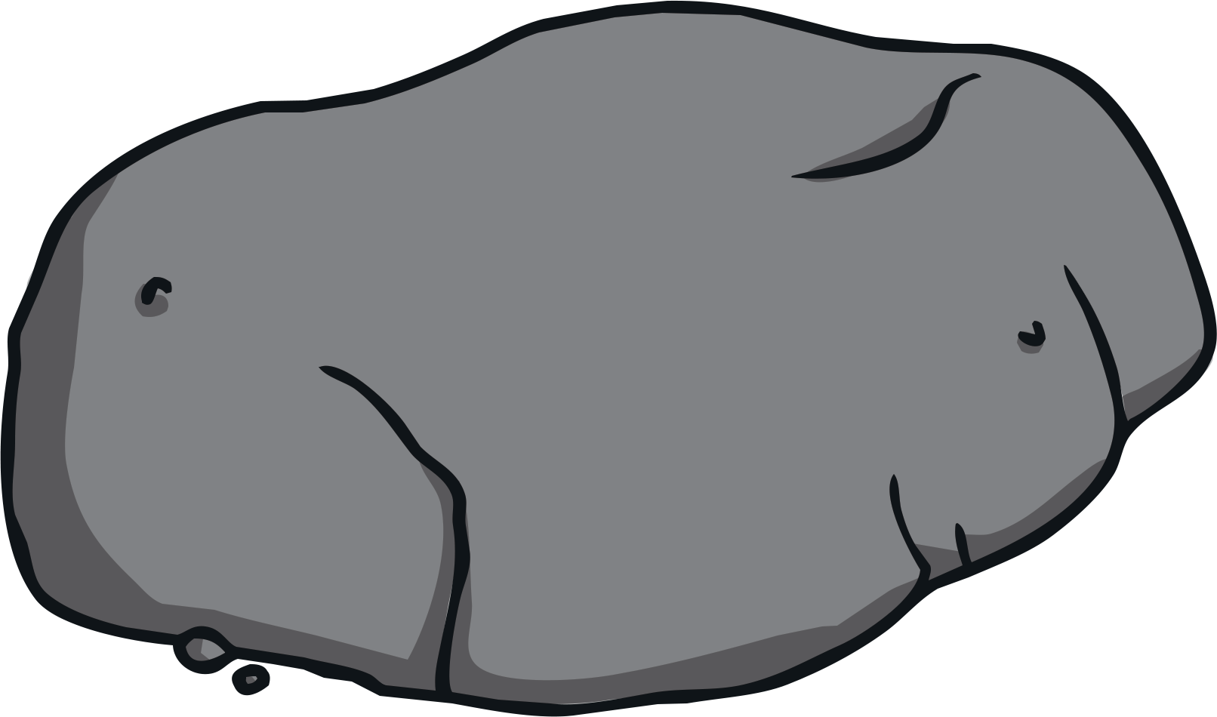
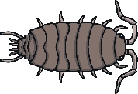
Can you help Davina to count all the woodlice?
How many woodlice are there altogether?
There are 10 woodlice altogether.

Slide 5

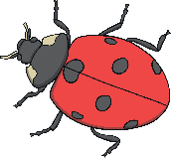
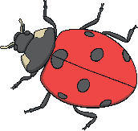
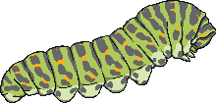
What is hiding under this leaf?
I’ve found 9 ladybirds. How many caterpillars are there?
Are there still 10 minibeasts in total?
What is hiding under this leaf?
There are 9 ladybirds and 1 caterpillar.
There are 10 minibeasts in total.

Slide 6
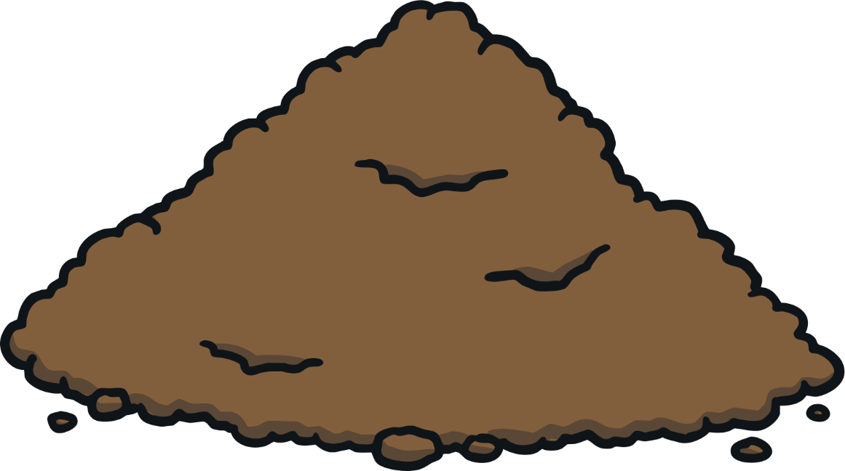


I’ve found 7 worms but how many ants are there?
How many minibeasts are there altogether?
This time, I’ve been digging in the soil!
There are 7 worms and 3 ants.
There are 10 minibeasts in total.

Slide 7


A good scientist always keeps records!
Can you help me complete the number sentence?
Click on the missing number.
8
+
=
10
1
2
4

Slide 8


Can you complete the number sentence to show
what we’ve found in the soil?
Click on the missing number.
+
7
=
10
6
5
3

Slide 9


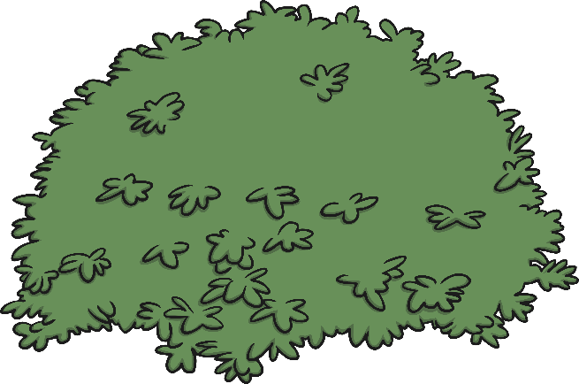
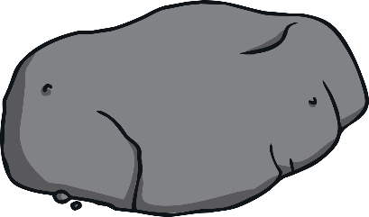
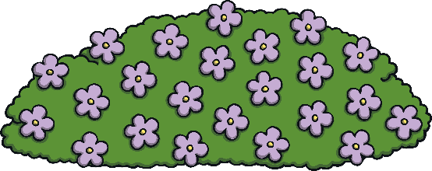


Oh no! The ladybirds have flown off!
Find the missing ladybirds hidden in this picture and click them to add them to the two ten-frames.
+
6
=
10
5
4
7

Slide 10

Oh no! The worms have wriggled off!
Find the missing worms hidden in this picture and click them to add them to the two ten-frames.
+
5
=
10
2
5
9

Slide 11

Oh no! Now the ants have crawled off!
Find the missing ants hidden in this picture and click them to add them to the two ten-frames.
1
+
=
10
1
5
9

Slide 12
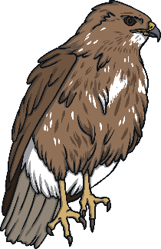
Well done my fellow wildlife-lovers! You helped me to count those restless minibeasts!

