Slide 2
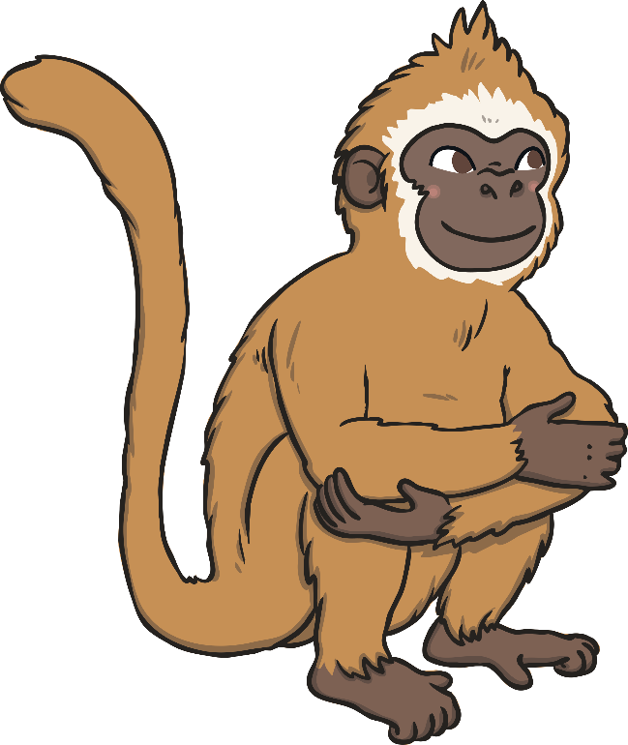

Every time the zookeeper arrives at an animal enclosure and counts the animals, the ‘less than’ monkey removes one.
Can you help the zookeeper work out what one less will be?
Today, the zookeeper is trying to count the animals in each enclosure but the cheeky ‘less than’ monkey is there.

Slide 3
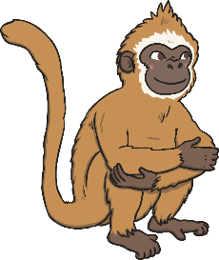




How many lions are there?
Oh no! The ‘less than’ monkey is going to take one away.
What is one less than 3?
0
1
2
3
4
5
6
7
8
9
10
One less than 3 is 2.

Slide 4



How many elephants are there?
Oh no! The ‘less than’ monkey is going to take one away.
What is one less than 5?
0
1
2
3
4
5
6
7
8
9
10
One less than 5 is 4.

Slide 5



How many frogs are there?
Oh no! The ‘less than’ monkey is going to take one away.
What is one less than 8?
0
1
2
3
4
5
6
7
8
9
10
One less than 8 is 7.

Slide 6



How many snakes are there?
Oh no! The ‘less than’ monkey is going to take one away.
What is one less than 6?
0
1
2
3
4
5
6
7
8
9
10
One less than 6 is 5.

Slide 7
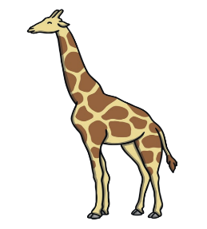
How many giraffes are there?
Oh no! The ‘less than’ monkey is going to take one away.
What is one less than 4?
0
1
2
3
4
5
6
7
8
9
10
One less than 4 is 3.

Slide 8



How many birds are there?
Oh no! The ‘less than’ monkey is going to take one away.
What is one less than 10?
0
1
2
3
4
5
6
7
8
9
10
One less than 10 is 9.

Slide 9

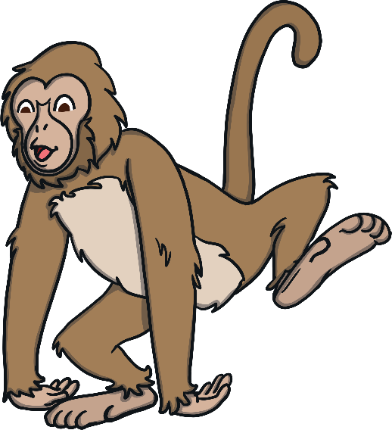
The cheeky ‘less than’ monkey has taken one away from himself.
What’s one less than 1?
One less than 1 is 0.
The cheeky ‘less than’ monkey is in trouble with Mummy monkey for confusing the
zookeeper… Oh dear, ‘less than’ monkey!

