Slide 1
Children’s Mental Health Week
Children’s Mental Health Week | Express Yourself

Slide 3
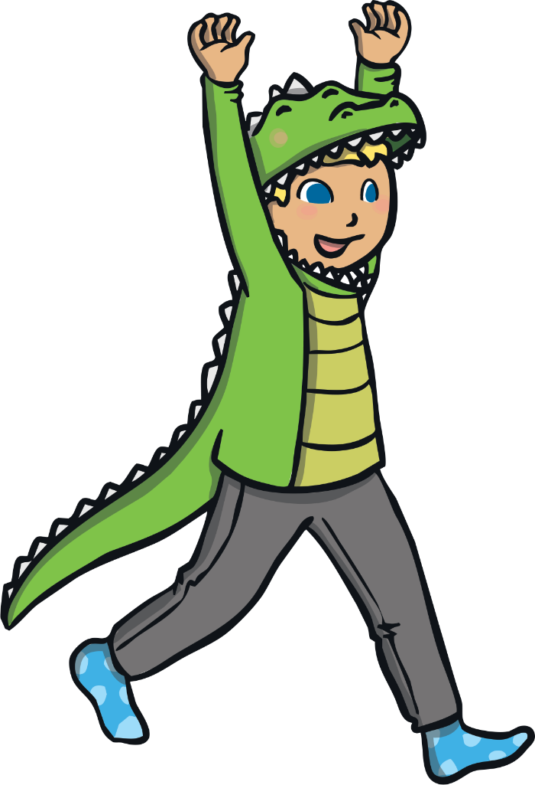
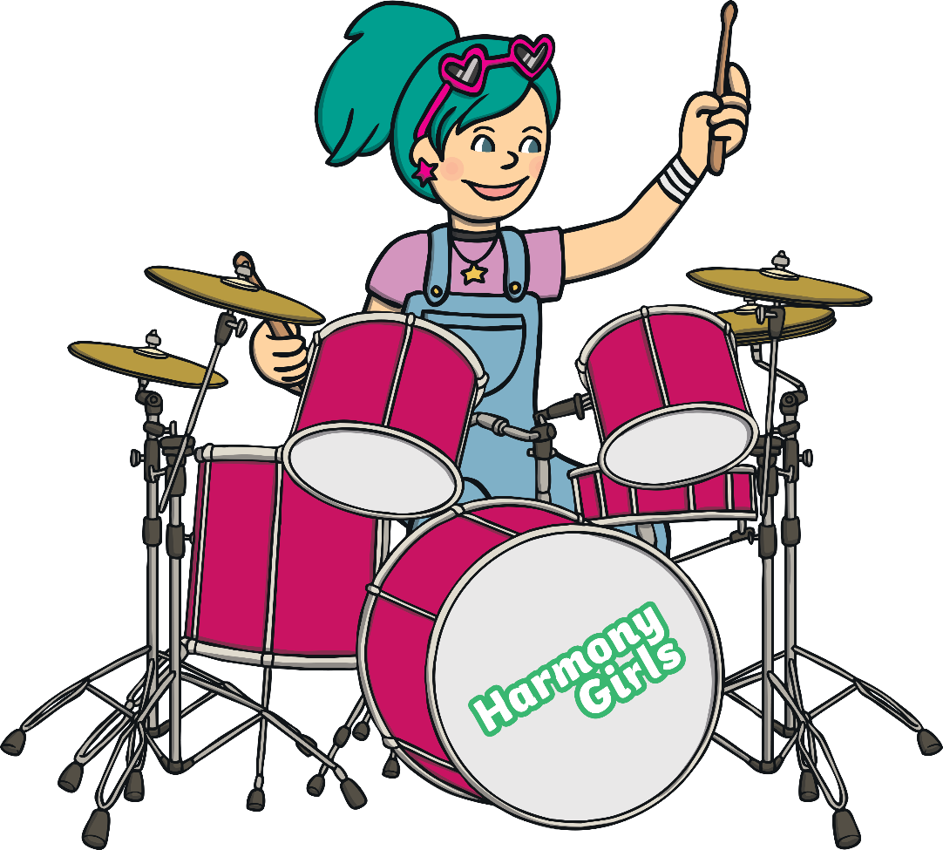
Aim
To explore the different ways that individuals can express themselves.
To think about the ways in which expressing ourselves can help us.

Slide 4

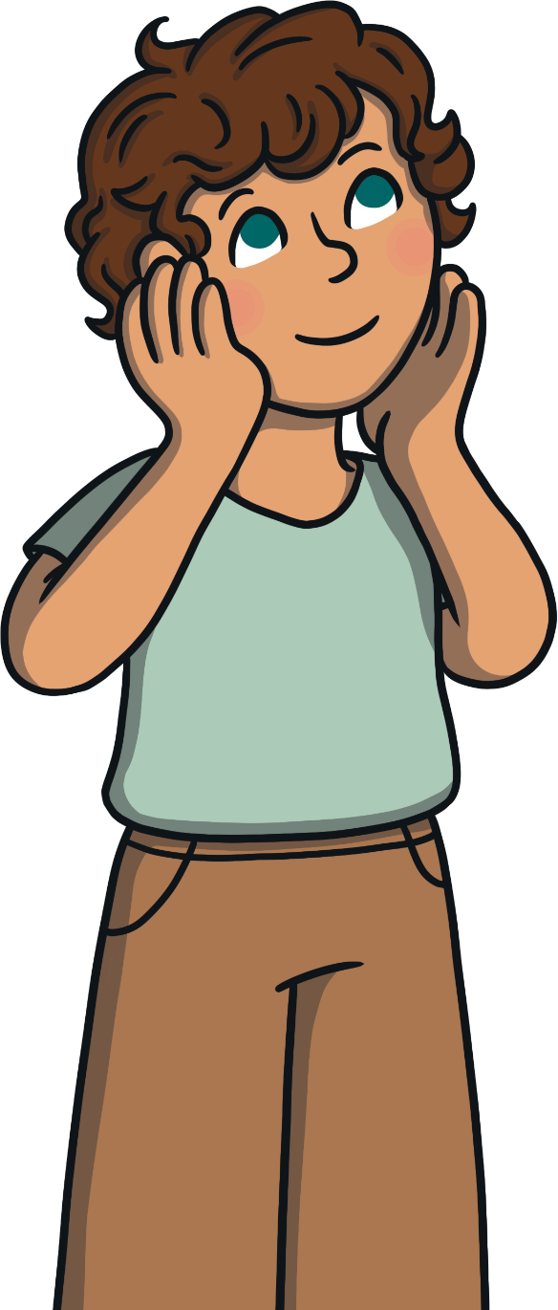
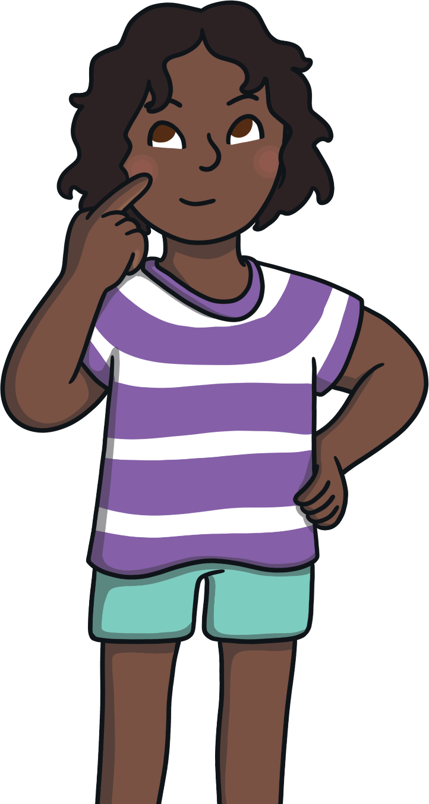

This Is Me!
What makes you, you?
It might include the things you enjoy doing, the things you believe in and what you’re like as a person.

Slide 5
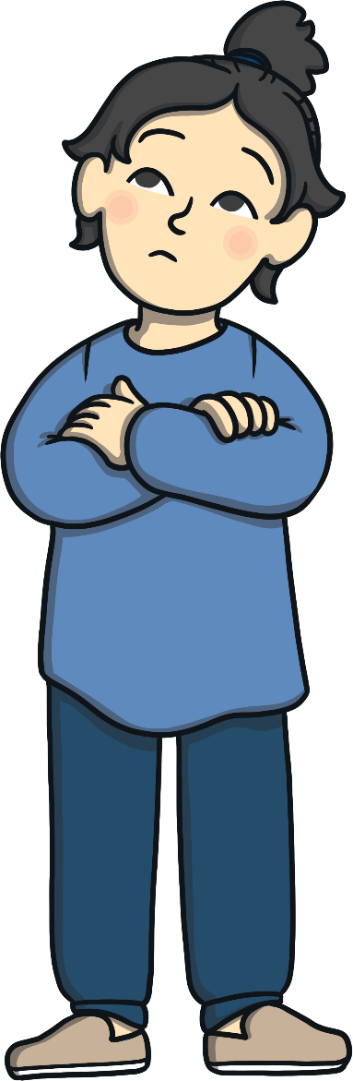
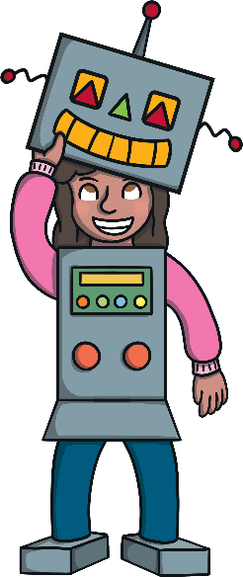
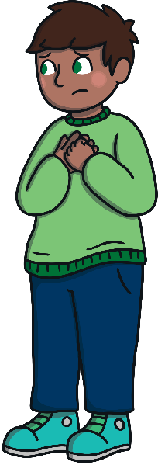
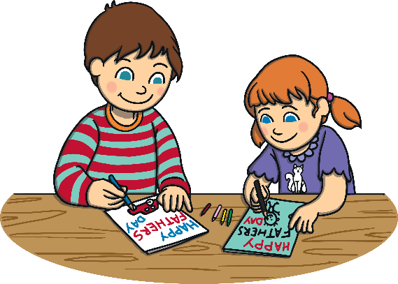
Expressing Yourself
It can be great for our mental health!
What does it mean to express yourself?
Expressing yourself means letting others see who you are as a person.
It means letting your feelings and emotions out and sharing them with others.
It means doing something you love – something that makes you feel good.

Slide 6



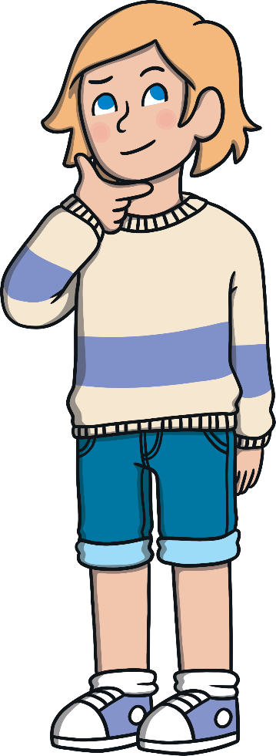
Expressing Yourself
We can all express ourselves in different ways.

Slide 7
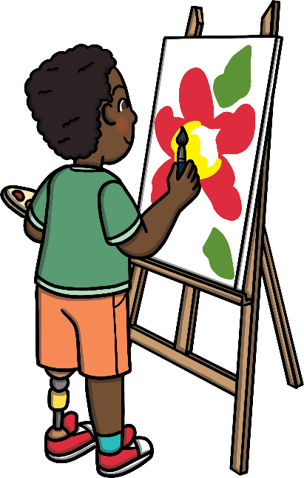

Expressing Yourself
Lots of people express themselves through drawing or painting. The colours they use and the things they draw reflect how they are feeling.
Some people express themselves through music. This could be singing, playing an instrument or dancing. They often find that this helps them to feel happy or calm.

Slide 8
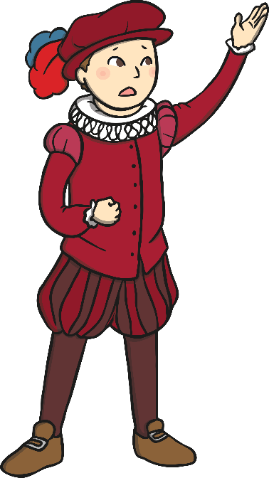
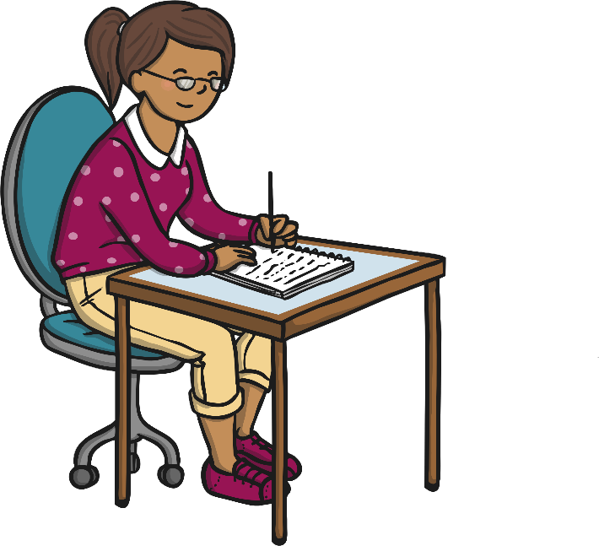
Expressing Yourself
You can also express yourself through acting and drama. Some people like to dress up, pretend to be someone else or perform on a stage.
Others express themselves through writing. It could be writing your feelings down in a diary or a letter. It could be expressing creative ideas through stories or poems.

Slide 9

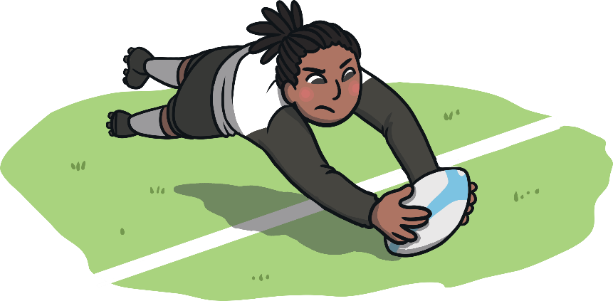
Expressing Yourself
You can also express yourself through the clothes you wear or the way you style your hair. Some people like to get really creative with their appearance!
You can even express yourself through your hobbies. This could be anything from chess to rugby!

Slide 10
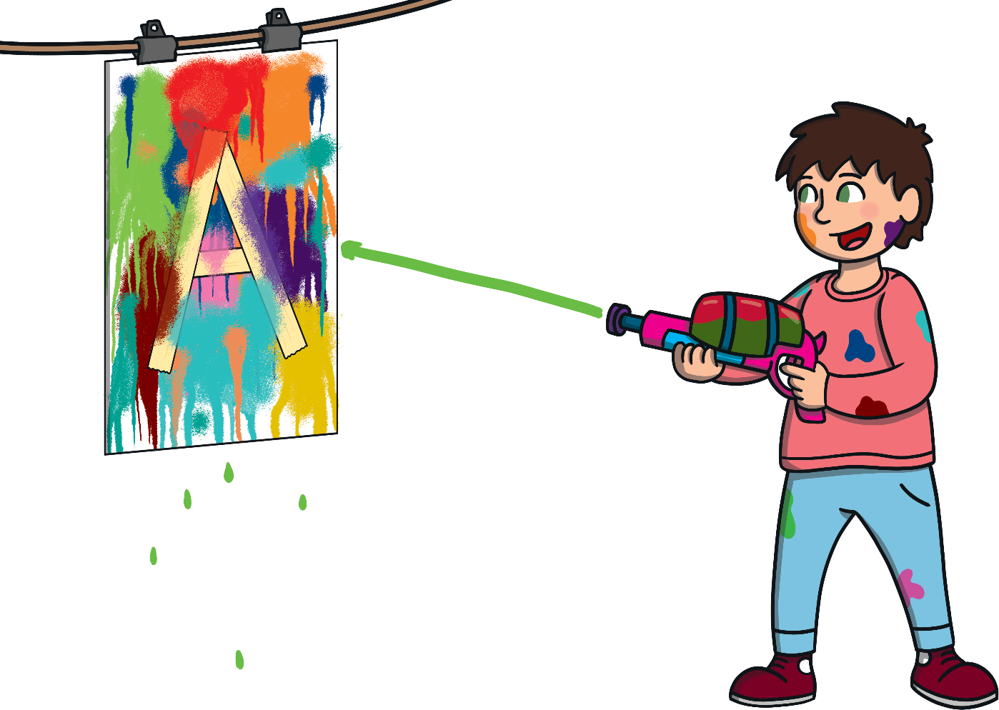

Expressing Yourself
How do you like to express yourself?
Remember, expressing yourself creatively doesn’t mean being really good at something or having to perform for others. It’s about doing something that makes you feel good.

Slide 11
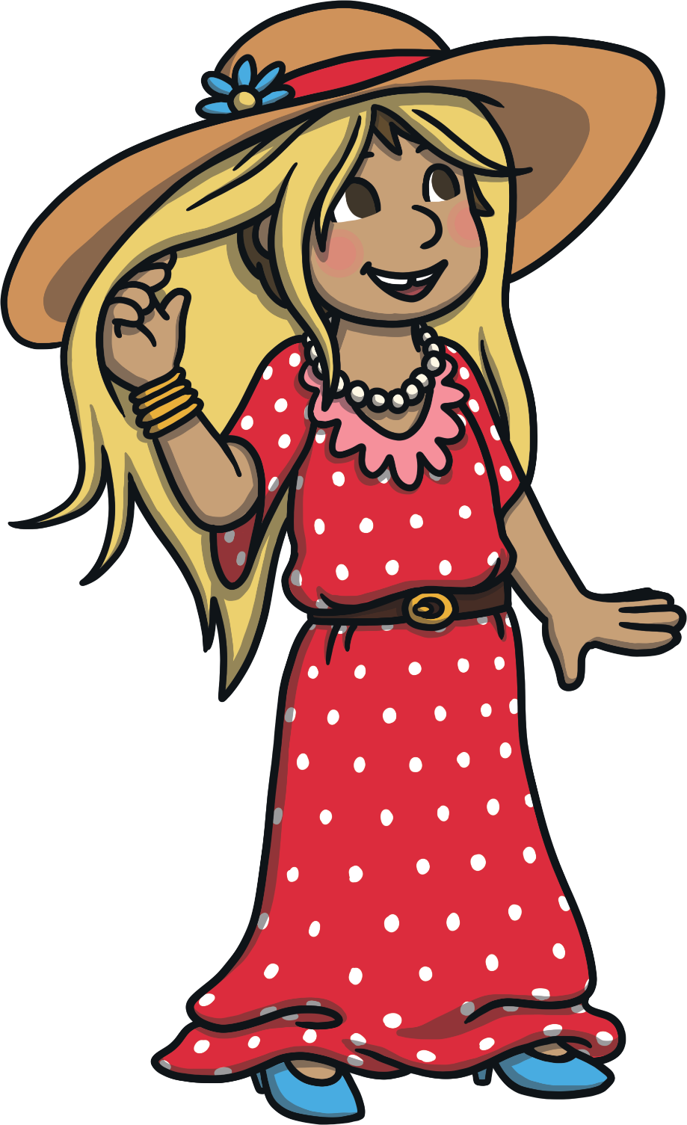
Good to Be Me!
How does it feel when you are expressing yourself?
Hopefully, it feels good!

Slide 12


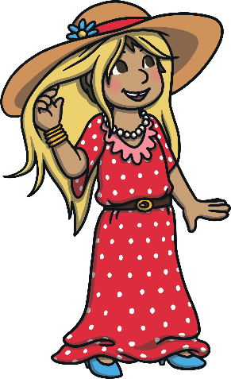




Good to Be Me!
How does it feel when you are expressing yourself?
It doesn’t matter what others think of us when we’re singing, dancing, acting or painting.
What matters is that we have the freedom to be who we want to be.

Slide 13

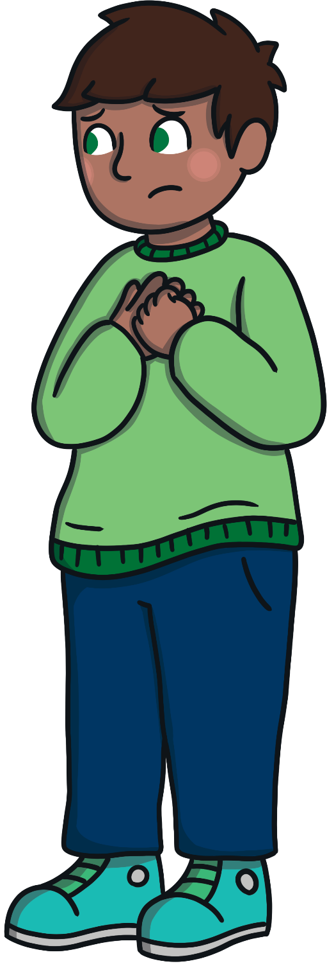

Good to Be Me!
Isn’t it wonderful that we can all express ourselves in different ways that suit us?
It feels good to express yourself. It also feels good to support and encourage others.
How could you inspire others
to express themselves?

Slide 14
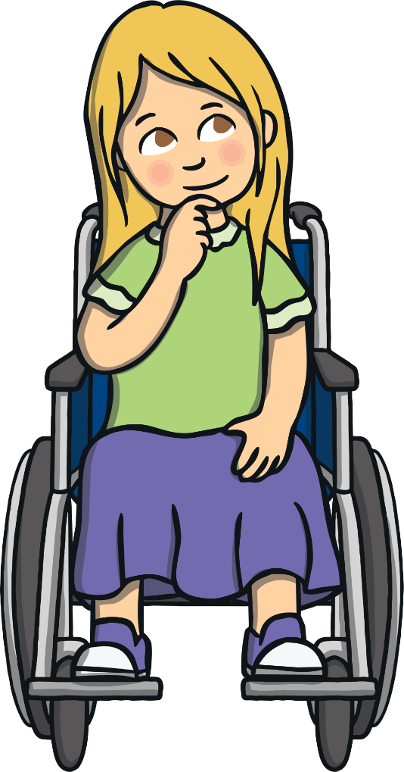
Reflection
In this moment of quiet, think about:
what makes you who you are and all the things you enjoy;
the ways in which you can express your personality, thoughts and feelings
to others;
how you can learn about others when they express themselves to you and how we can all celebrate our individuality.

