Slide 1


RE
Caring for Others
Year One
RE | Year 1 | Caring for Others | Be My Guest | Lesson 5

Slide 2
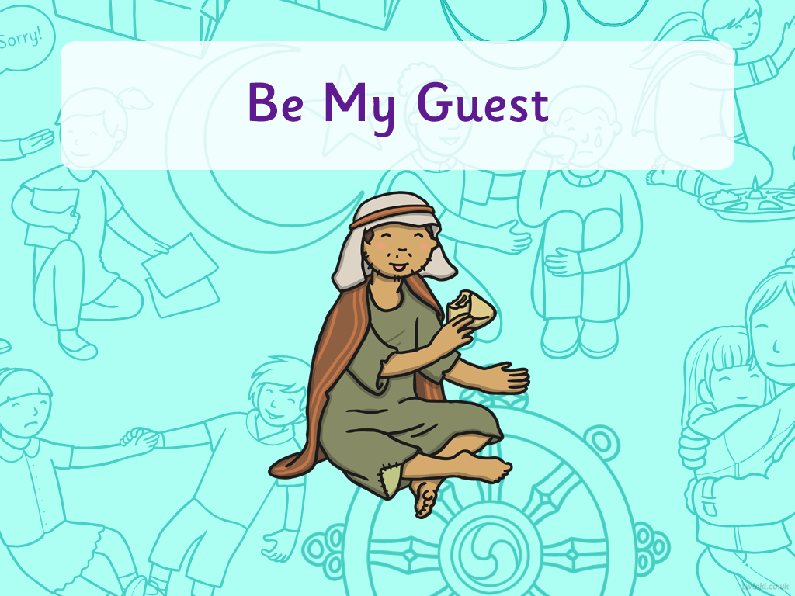


Title slide (themed) here

Slide 3
Aim
I can explain the message in the story Be My Guest.
Success Criteria
I can tell you what making a sacrifice for someone means.
I can tell you why it’s important to think of others, before yourself.
I can say how the story can help me in my own life.

Slide 4

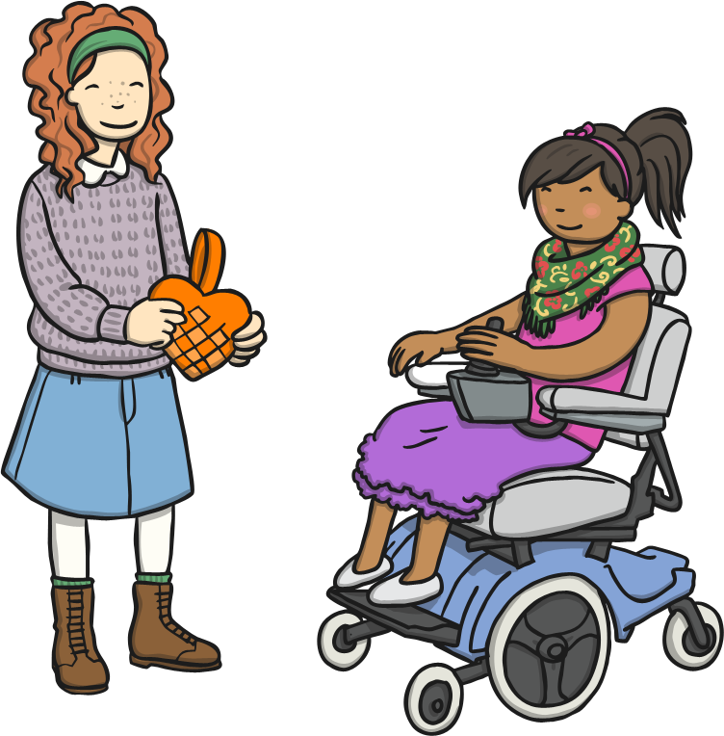
Putting Others First
Have you ever given someone else your last sweet or chocolate, even though you really wanted to eat it?
Have you ever let someone else have a turn with a toy, even though you really wanted a turn yourself?
Have you ever done something kind like this? Tell your partner what happened.
How did it make you feel?
How do you think it made the other person feel?

Slide 5

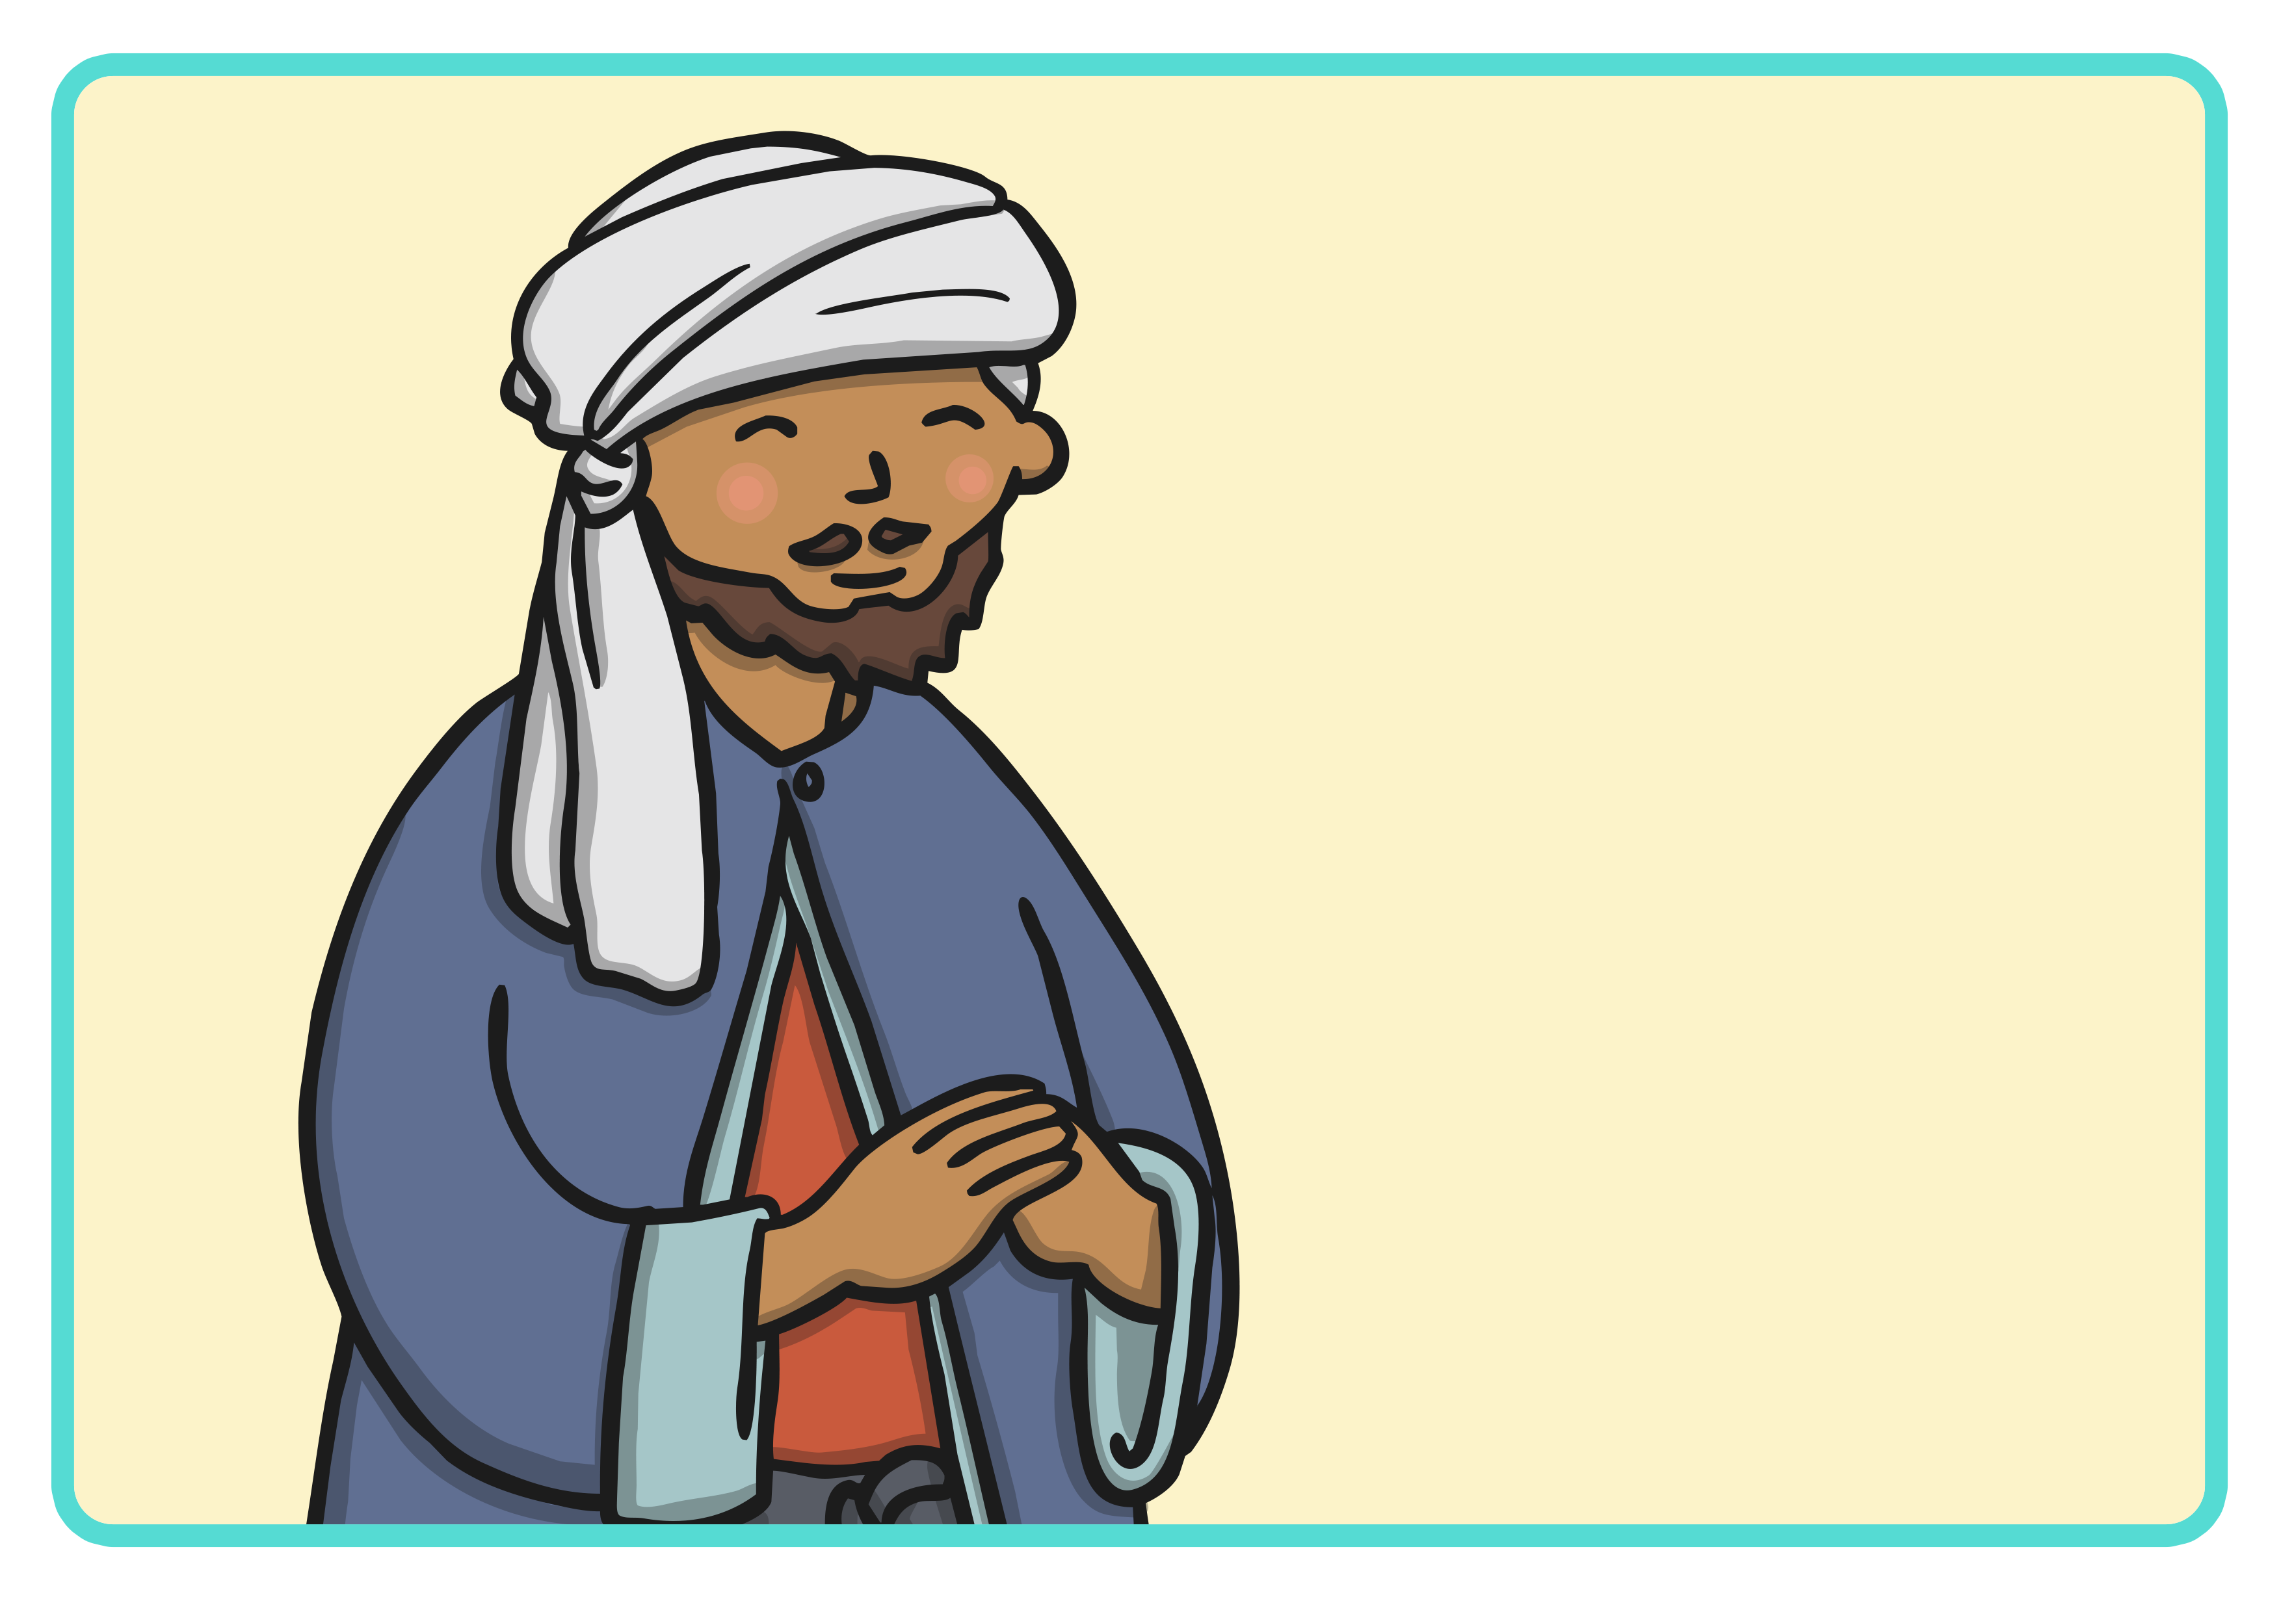
Be My Guest

Slide 6
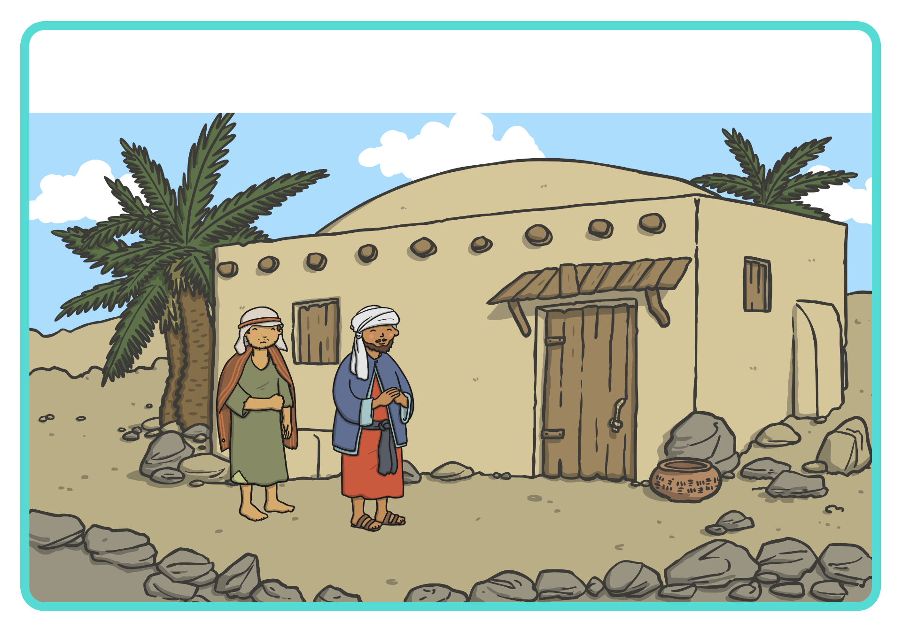
Prophet Muhammad (Peace Be Upon Him) asked Abu Talha to take a
poor and very hungry man home, to feed him and look after him.

Slide 7
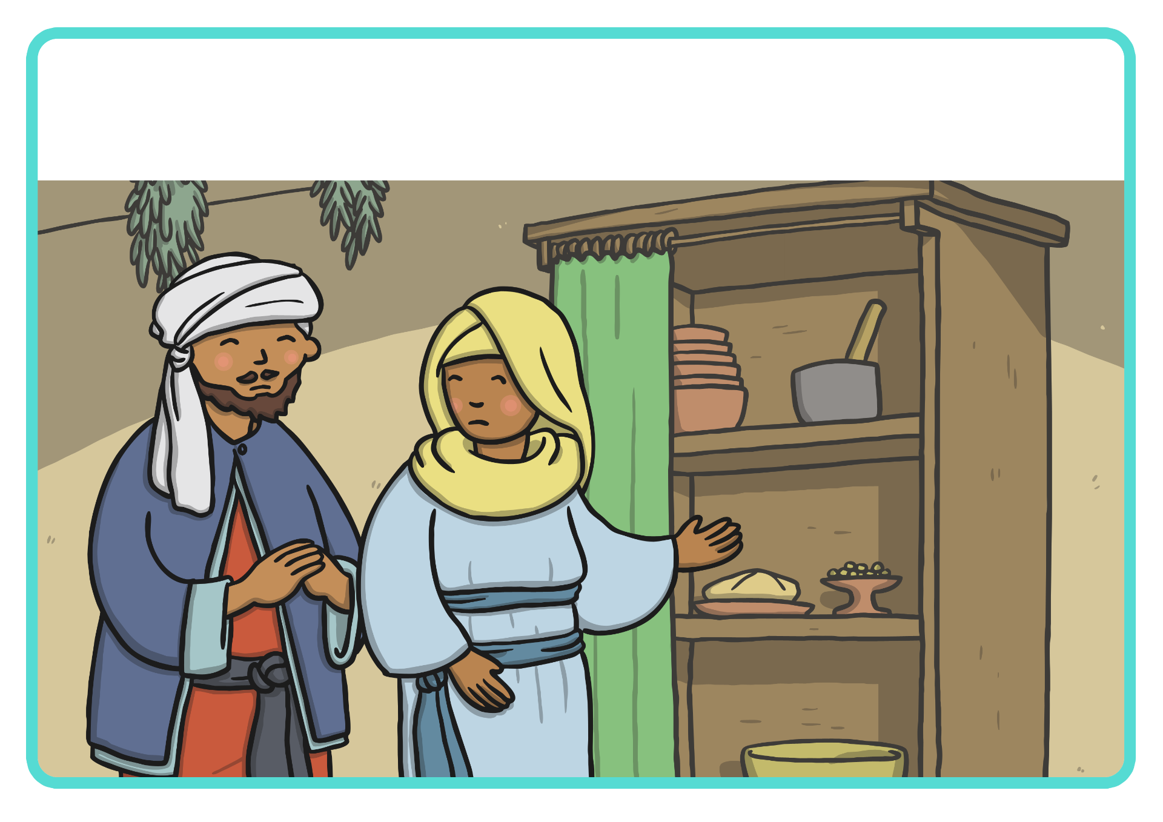
Abu Talha returned home and told his wife what Prophet Muhammad (Peace Be Upon Him) had asked him to do. His wife told Abu Talha that sadly, they only had enough food for their children that night.

Slide 8
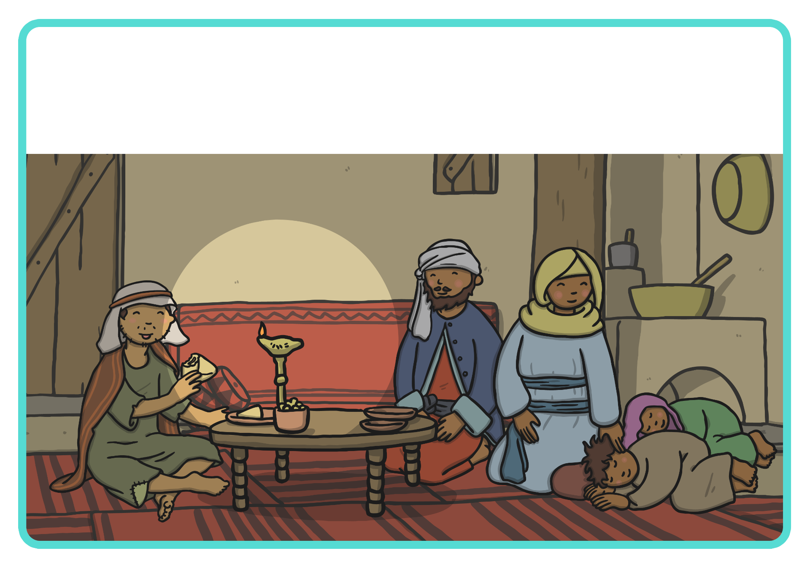
Abu Talha had to make a difficult decision and sent his children to
bed. A meal was prepared for their visitor using the food that they had.
To save the visitor from feeling sad, Abu Talha and his wife turned down the lamp so that he couldn’t see that they both had empty plates.

Slide 9
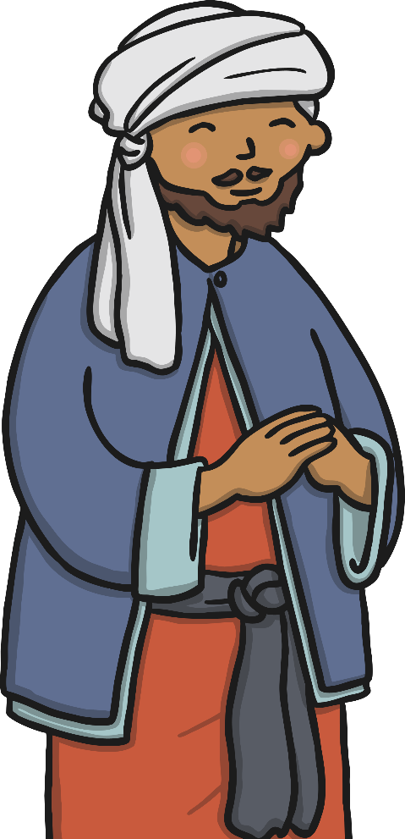
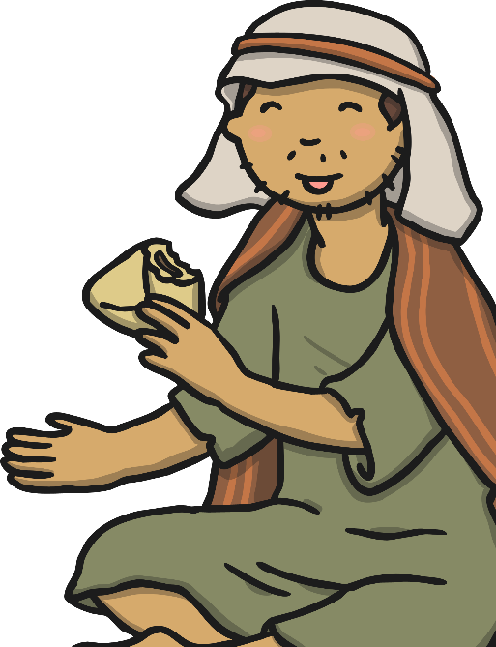
Putting Others Before Yourself
How did Abu Talha put the poor man’s needs before the needs of himself and his family?
What did Abu Talha sacrifice?
How do you think Abu Talha’s sacrifice made other people in the story feel?

Slide 10


Be My Guest Activity

Slide 11
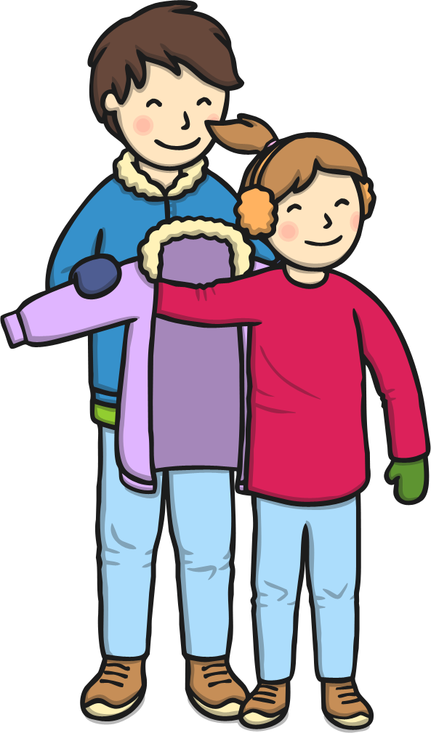
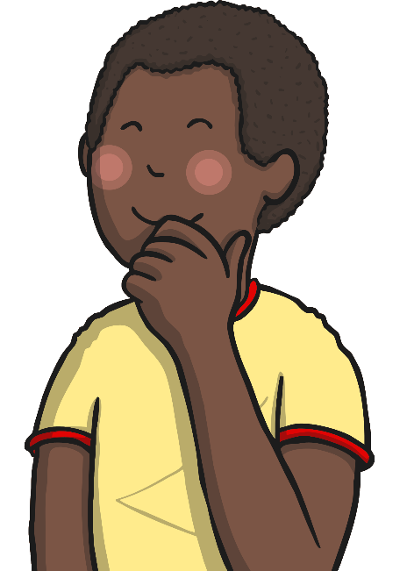
How Can The Story Help Us?
Think of a time when someone has put what you wanted before what they wanted.
What did they do and how did it make you feel?
What could you do to help other people?

Slide 12
Aim
I can explain the message in the story Be My Guest.
Success Criteria
I can tell you what making a sacrifice for someone means.
I can tell you why it’s important to think of others, before yourself.
I can say how the story can help me in my own life.

