Slide 1



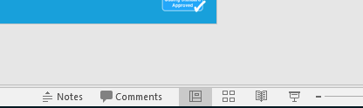


Guidance for Video/Audio in PowerPoints
1. Open the folder and copy all the files.
2. Paste the copied files into a new folder.
3. Open the PowerPoint file, enable editing and enter presentation mode (start the slide show). Go to slide 3 and the backing track will start automatically.
Please note the embedded audio may not be compatible with early versions of PowerPoint.
You may wish to delete this slide before beginning the presentation.

Slide 3


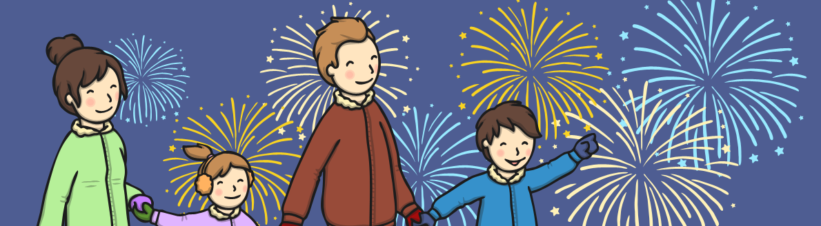
Let’s celebrate on Bonfire Night,
Bonfire Night, Bonfire Night,
Let’s celebrate on Bonfire Night,
It’s dark and chilly this evening.

Slide 4

The rockets go whoosh on Bonfire Night,
Bonfire Night, Bonfire Night,
(demonstrate bending down then shooting up!)
The rockets go whoosh on Bonfire Night,
It’s dark and chilly this evening!

Slide 5

The Catherine wheels spin on Bonfire Night,
Bonfire Night, Bonfire Night,
(demonstrate holding your hands to the side and slowly spinning!)
The Catherine wheels spin on Bonfire Night,
It’s dark and chilly this evening!

Slide 6
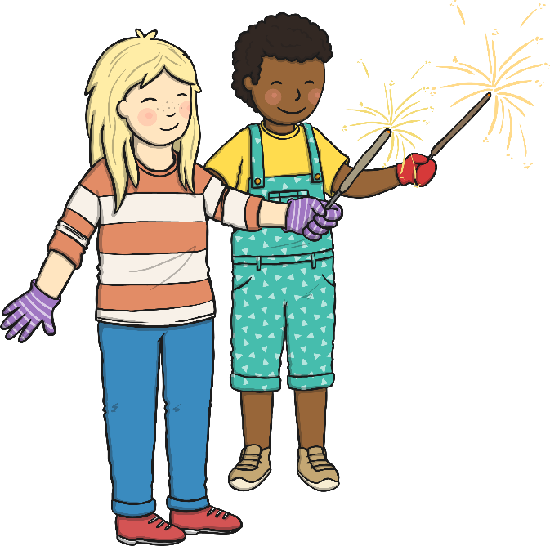
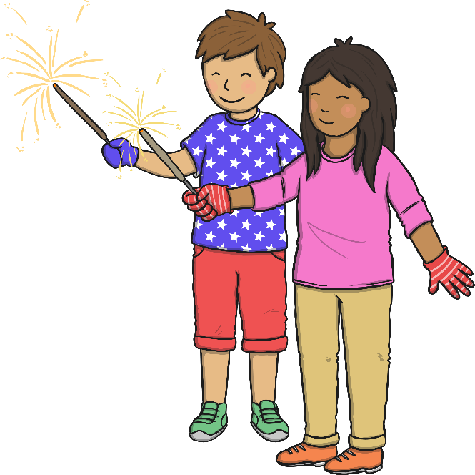
The sparklers crackle on Bonfire Night,
Bonfire Night, Bonfire Night,
(demonstrate opening and closing your hands or holding a sparkler)
The sparklers crackle on Bonfire Night,
It’s dark and chilly this evening!

Slide 7
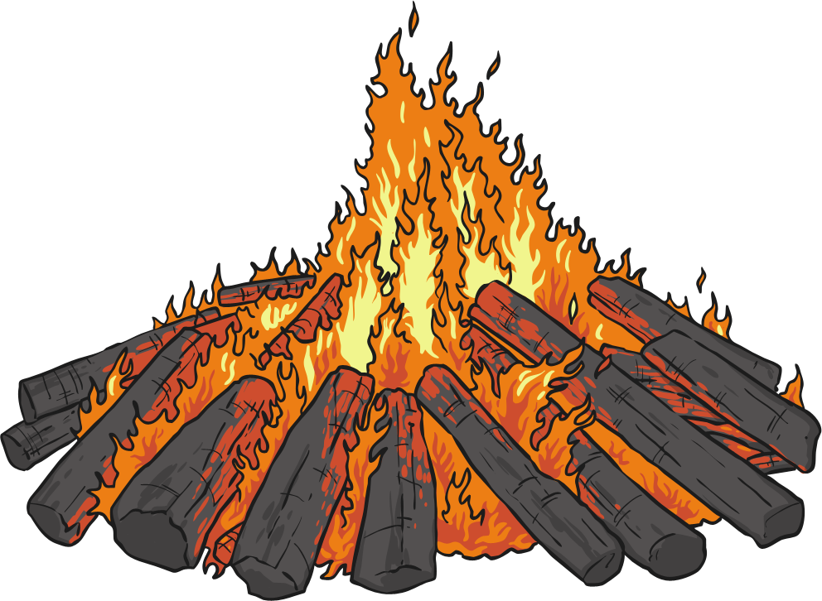
The bonfire glows on Bonfire Night,
Bonfire Night, Bonfire Night,
(demonstrate holding your hands like you’re warming them on a fire)
The bonfire glows on Bonfire Night,
It’s dark and chilly this evening!

Slide 8
Let’s celebrate on Bonfire Night,
Bonfire Night, Bonfire Night,
Let’s celebrate on Bonfire Night,
It’s dark and chilly this evening!

