Slide 1






Guidance for Video/Audio in PowerPoints
1. Open the folder and copy all the files.
2. Paste the copied files into a new folder.
3. Open the PowerPoint file, enable editing and enter presentation mode (start the slide show). Go to slide 3 and the backing track will start automatically.
Please note the embedded audio may not be compatible with early versions of PowerPoint.
You may wish to delete this slide before beginning the presentation.

Slide 3


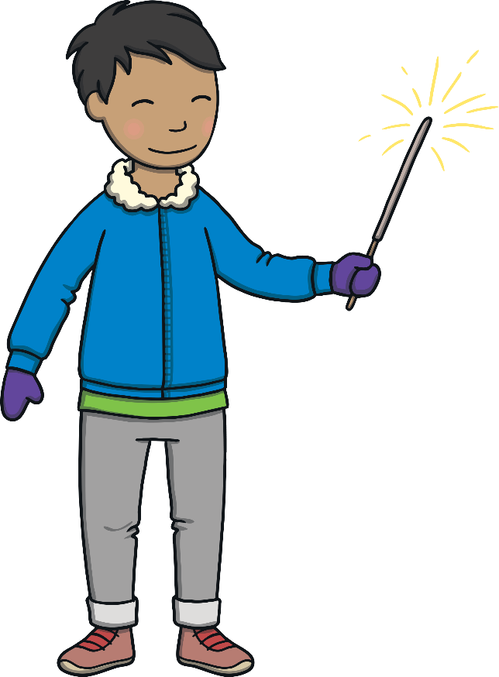
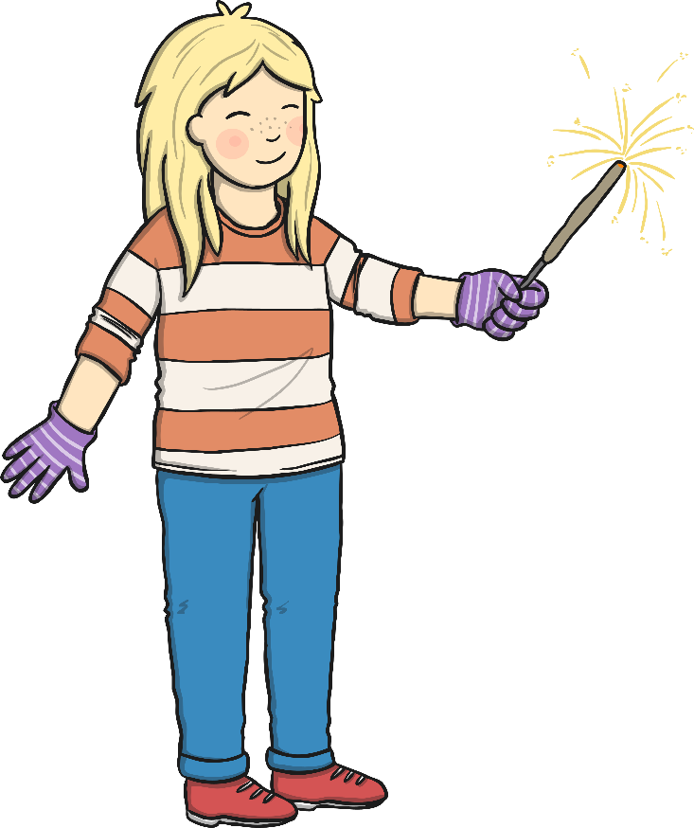
Bonfire night is here again,
Here again, here again.
Bonfire night is here again,
In November.

Slide 4

Build a bonfire with some wood,
With some wood, with some wood.
Build a bonfire with some wood,
In November.

Slide 5

Light the fire and watch the flames,
Watch the flames, watch the flames.
Light the fire and watch the flames,
In November.

Slide 6

Stand well back and don’t get hurt,
Don’t get hurt, don’t get hurt.
Stand well back and don’t get hurt,
In November.

Slide 7

Watch the rockets flying high,
Flying high, flying high.
Watch the rockets flying high,
In November.

Slide 8
Now the fire is dying down,
Dying down, dying down.
Now the fire is dying down,
In November.

Slide 9
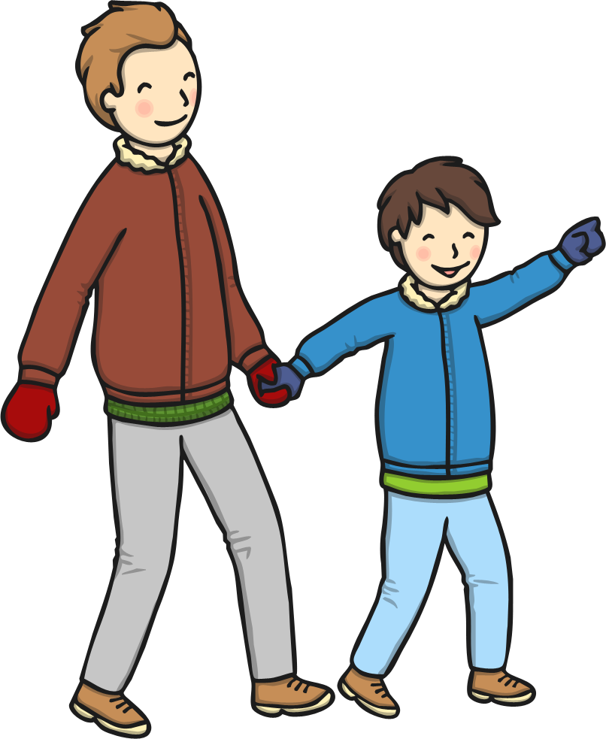
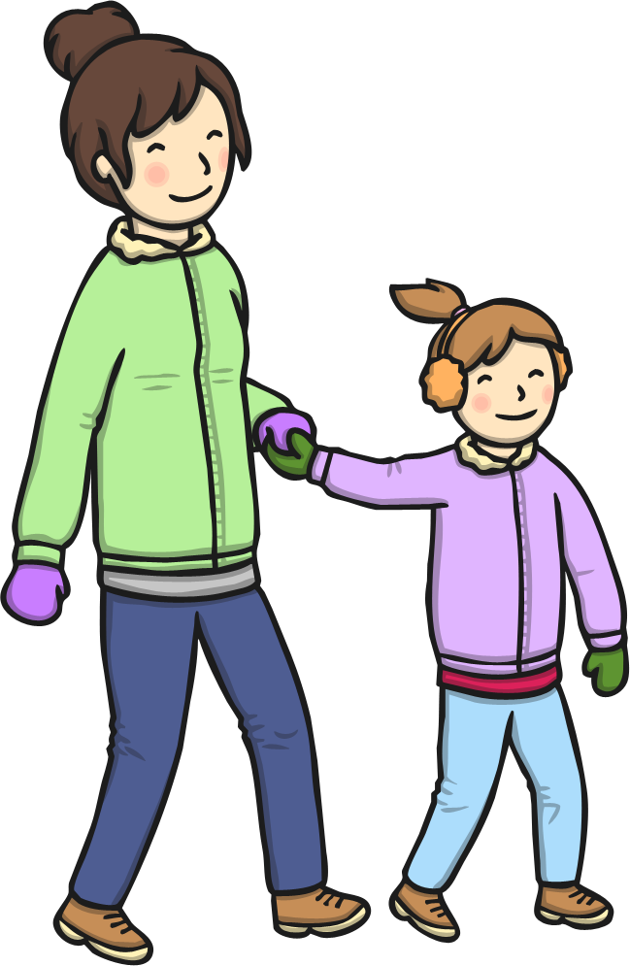
Let’s hold hands and all walk home,
All walk home, all walk home.
Let’s hold hands and all walk home,
In November.

Slide 10

Time for bed, so curl up small,
Curl up small, curl up small.
Time for bed, so curl up small,
In November.

