Slide 1






Guidance for Video/Audio in PowerPoints
1. Open the folder and copy all the files.
2. Paste the copied files into a new folder.
3. Open the PowerPoint file, enable editing and enter presentation mode (start the slide show). Go to slide 3 and the backing track will start automatically.
Please note the embedded audio may not be compatible with early versions of PowerPoint.
You may wish to delete this slide before beginning the presentation.

Slide 3


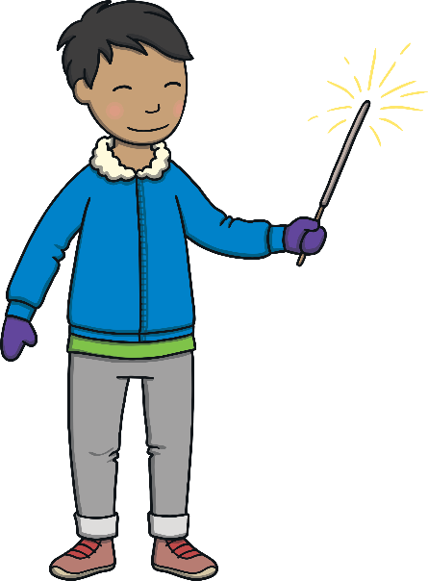
Won’t it be fun on Bonfire Night?
(hold hands in a circle)
Bonfire Night, Bonfire Night.
(Go around imaginary Bonfire)
Won’t it be fun on Bonfire Night?
On Bonfire Night in the garden.
(continue in a circle)

Slide 4

We’ll build a fire and it’ll burn bright,
On Bonfire Night, Bonfire Night.
(build an imaginary fire)
We’ll build a fire and it’ll burn bright,
On Bonfire Night in the garden.
(rub and warm hands)

Slide 5

But we must be careful and stand right back,
On Bonfire Night, Bonfire Night.
But we must be careful and stand right back,
Then we’ll be safe in the garden.
(wag finger in warning and step back)

Slide 6


The fireworks will whizz and bang!
On Bonfire Night, Bonfire Night.
The fireworks will whizz and bang!
On Bonfire Night in the garden.
(mime a rocket and clap hands)

