Slide 2



In a rocket, in a rocket,
Flying high, flying high.
Baby Bear is flying, Baby Bear is flying,
Through the sky, through the sky.

Slide 3

In a rocket, in a rocket,
Owl flew by, owl flew by.
Would you like to join me? Would you like to join me?
We’ll fly high, we’ll fly high.

Slide 4

In a rocket, in a rocket,
To the moon, to the moon.
Flying past a big plane, flying past a big plane,
Be there soon, be there soon!

Slide 5



In a rocket, in a rocket,
Owl and bear, owl and bear.
Having a moon picnic, having a moon picnic,
Whilst they’re there, whilst they’re there.

Slide 6

In a rocket, in a rocket,
Home time soon, home time soon.
Then it will be bath time, then it will be bath time,
Goodbye moon, goodbye moon.

Slide 7
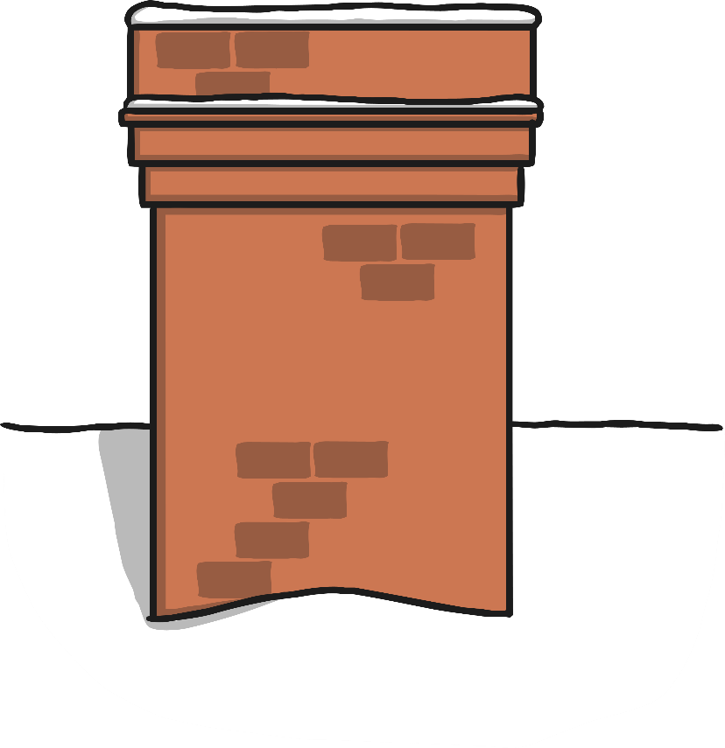
In a rocket, in a rocket,
Mum won’t guess, Mum won’t guess!
I flew down the chimney, I flew down the chimney,
What a mess, what a mess!

