Slide 2


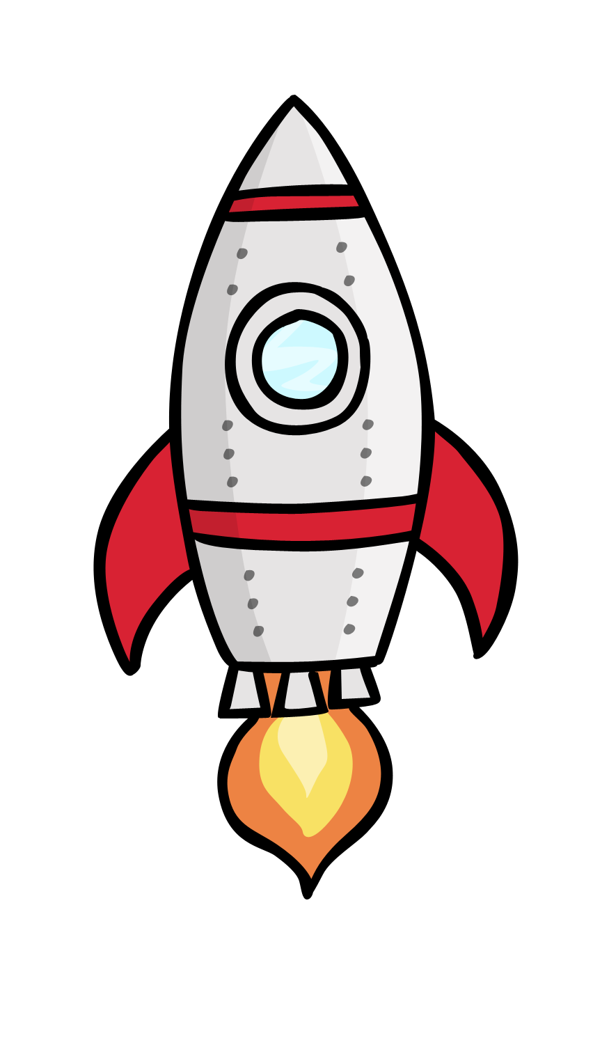
I want to fly up to the moon,
To the moon, to the moon.
I want to fly up to the moon,
So first I need a rocket!

Slide 3
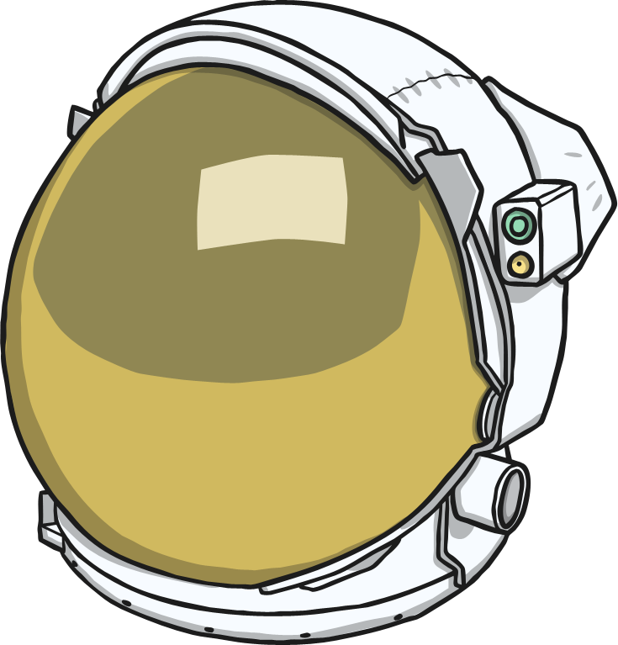
Then I put on my space helmet,
Space helmet, space helmet.
Then I put on my space helmet,
I’m nearly ready to fly now!

Slide 4
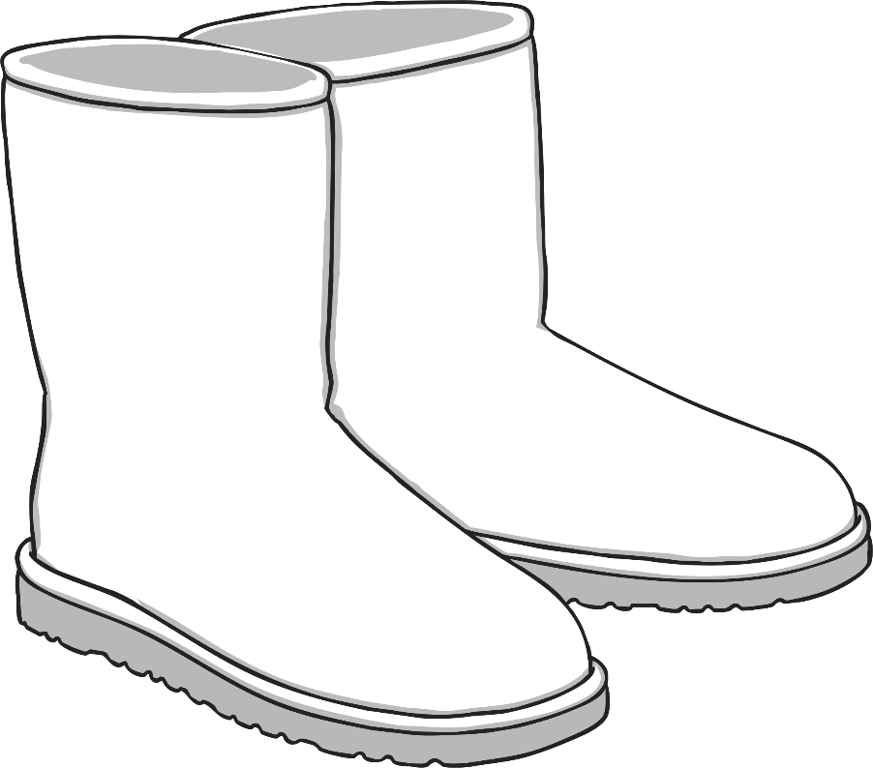
Then I can put my space boots on,
Space boots on, space boots on.
Then I can put my space boots on,
I’m nearly ready to fly now!

Slide 5
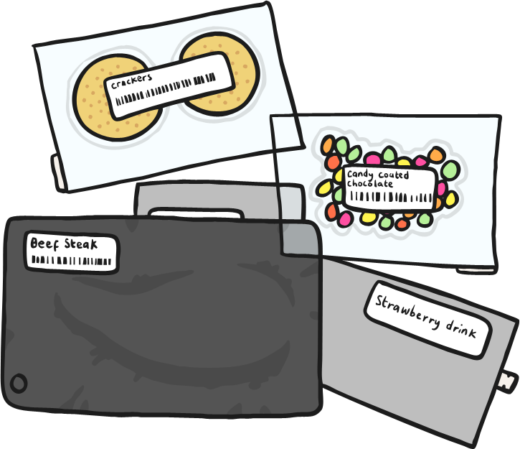
Then I can pack some food and drink,
Food and drink, food and drink.
Then I can pack some food and drink,
I must not for-get my teddy!

Slide 6
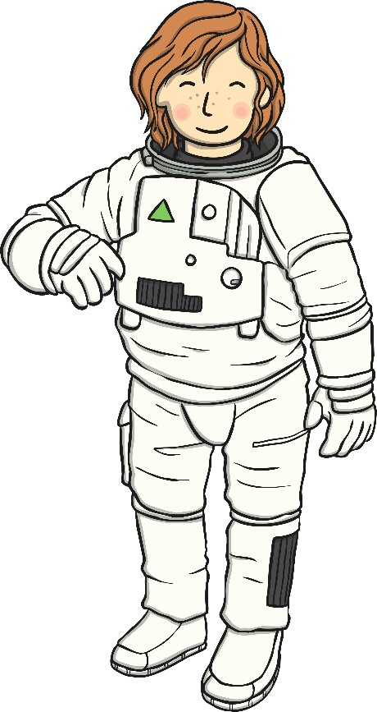
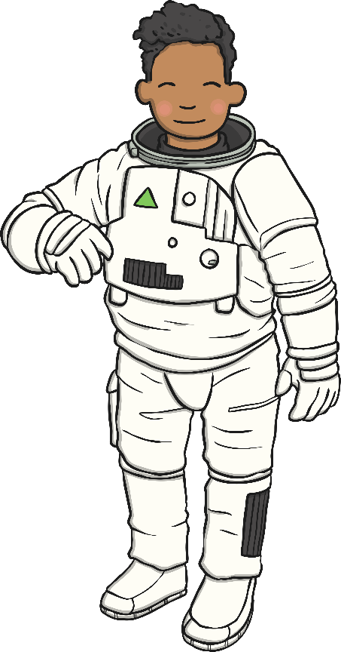
I want to fly up to the moon,
To the moon, to the moon.
I want to fly up to the moon,
I’m ready for my long journey!

