Slide 2
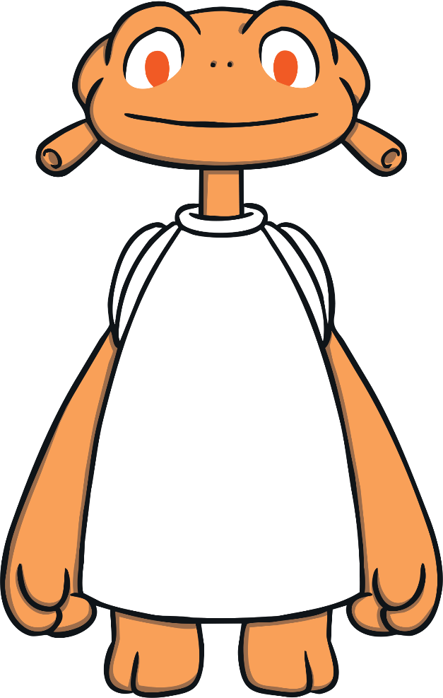
Instructions
I love living on planet Doop! There are so many things to see in space.
Can you help me count them?
Count the pictures and then click on the correct numeral.
Start

Slide 3
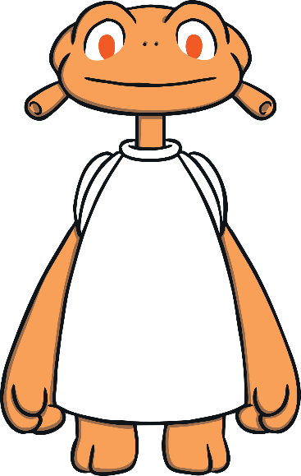

How many suns can you see?
Can you click on the matching number?
1
3
5

Slide 4
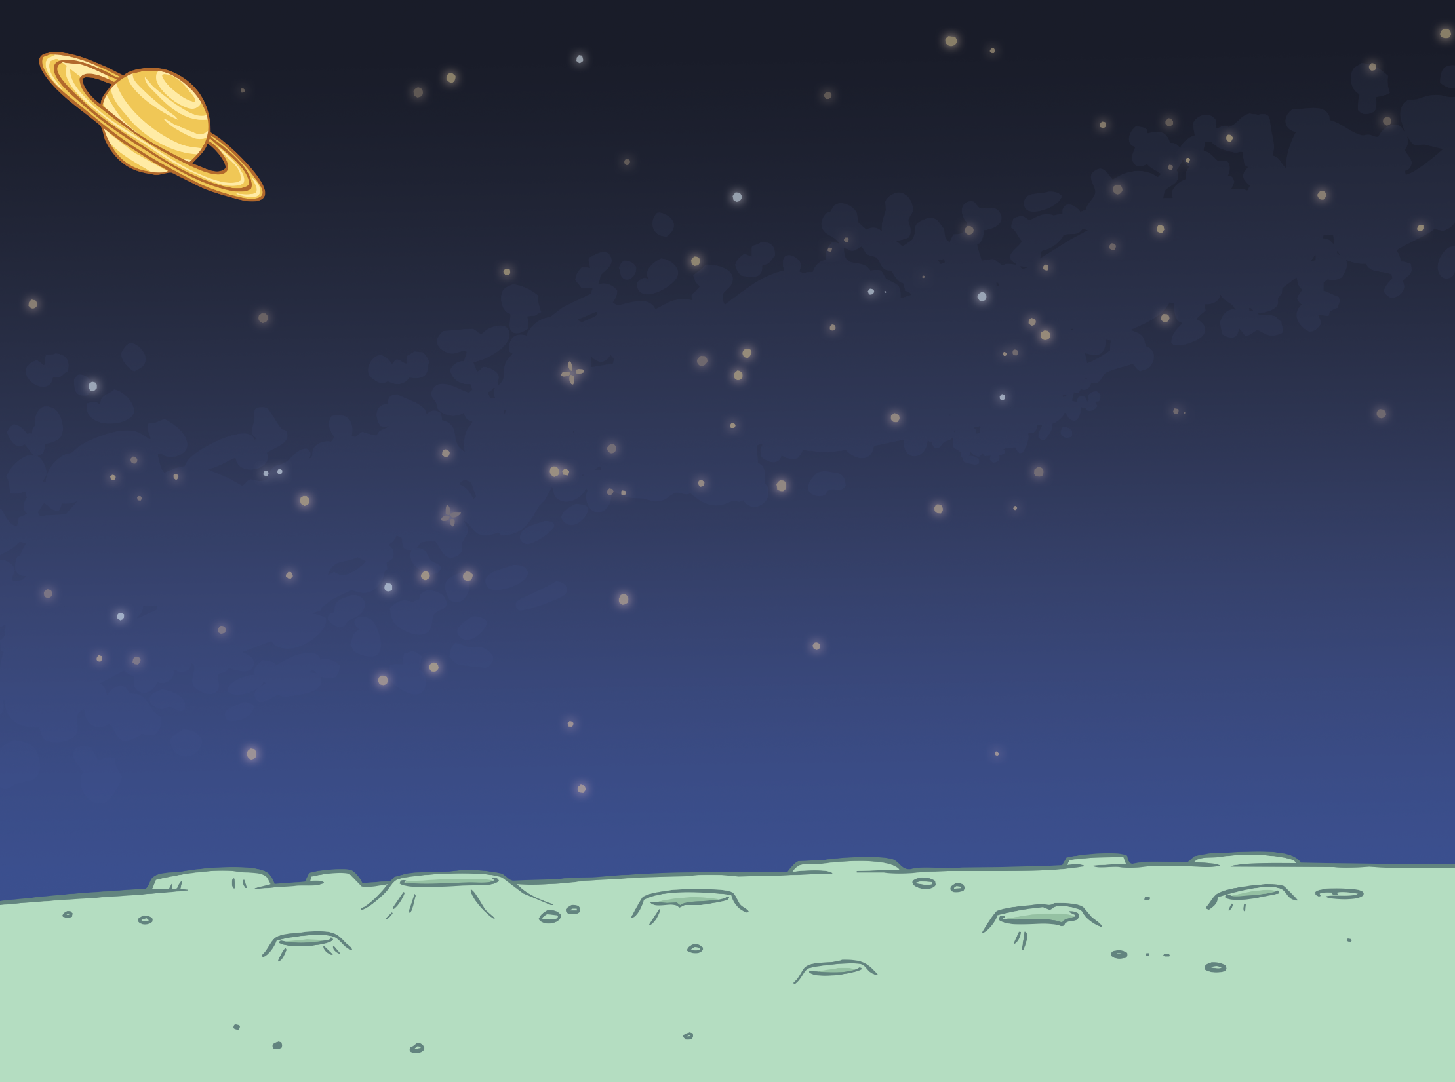
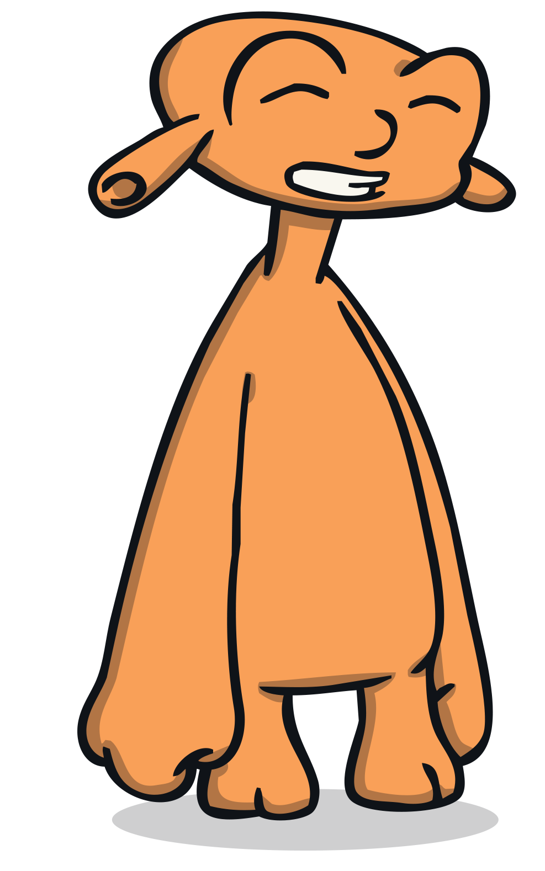

Correct!
1 sun
next

Slide 5
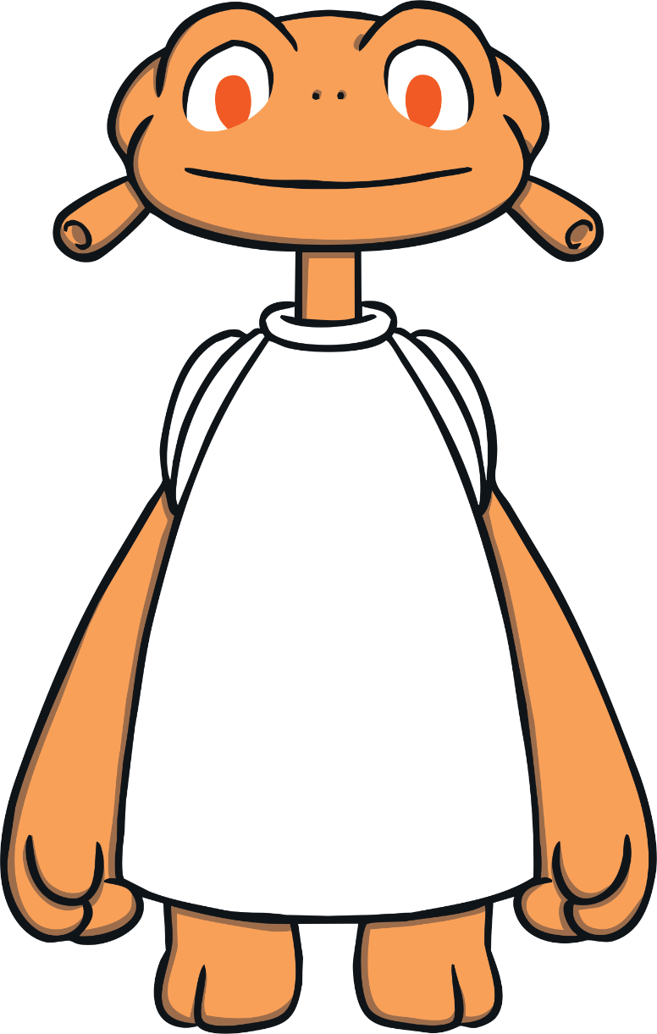
Try again!
back

Slide 6
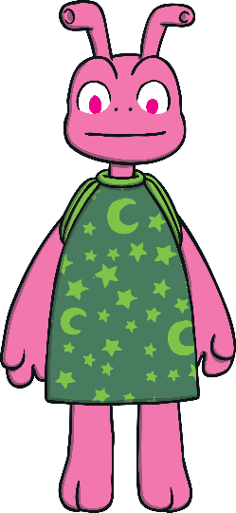
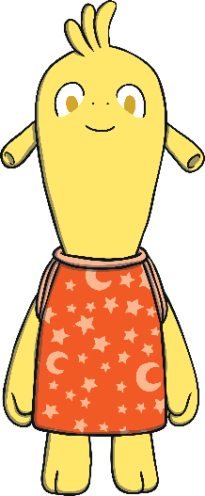
How many of my alien friends can you see? Can you click on the matching number?
3
2
1

Slide 7


Correct!
2 aliens
My friends, Yoff and Mab.
next

Slide 8
Try again!
back

Slide 9
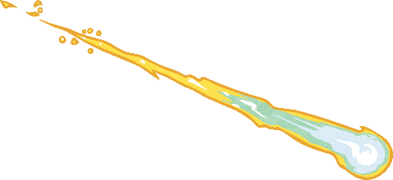
How many shooting stars can you see? Can you click on the matching number?
0
5
3

Slide 10

Correct!
5 shooting stars
next

Slide 11
Try again!
back

Slide 12

How many rockets can you see? Can you click on the matching number?
4
2
6

Slide 13
Correct!
4 rockets
next

Slide 14
Try again!
back

Slide 15
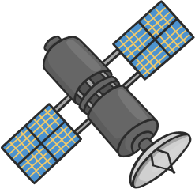
How many satellites can you see? Can you click on the matching number?
2
7
0

Slide 16
Correct!
7 satellites
next

Slide 17
Try again!
back

Slide 18
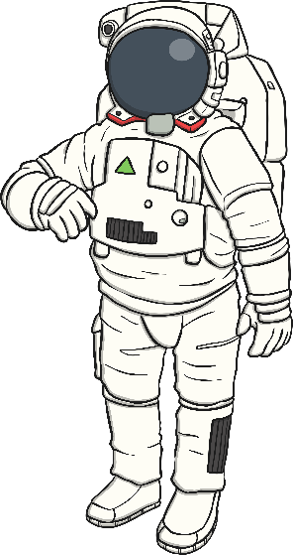
How many astronauts can you see? Can you click on the matching number?
5
8
3

Slide 19
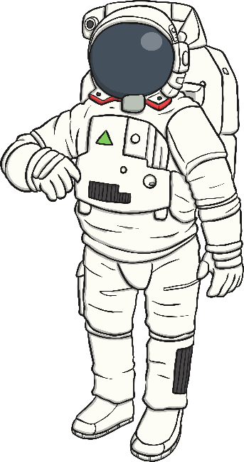
Correct!
3 astronauts
next

Slide 20
Try again!
back

Slide 21
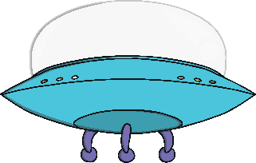
How many spaceships can you see? Can you click on the matching number?
9
4
7

Slide 22
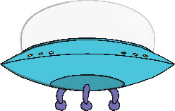
Correct!
9 spaceships
next

Slide 23
Try again!
back

Slide 24
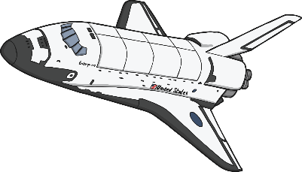
How many space shuttles can you see? Can you click on the matching number?
5
2
6

Slide 25
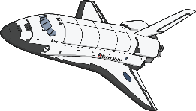
Correct!
6 space shuttles
next

Slide 26
Try again!
back

Slide 27
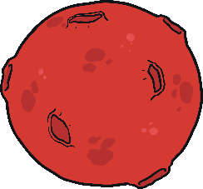
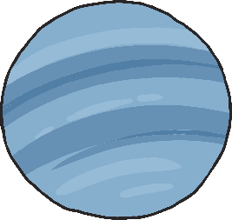
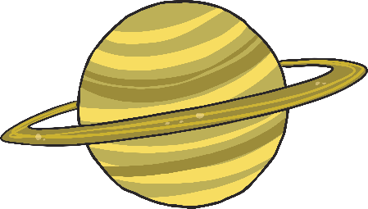
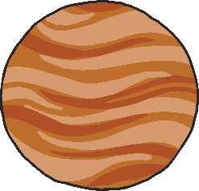
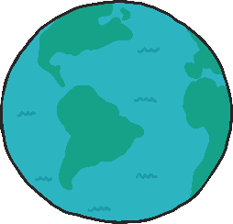
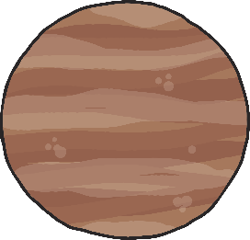
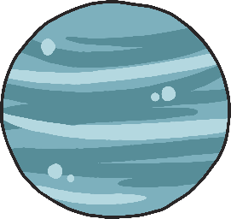

How many planets can you see? Can you click on the matching number?
5
8
3

Slide 28
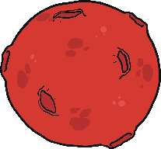
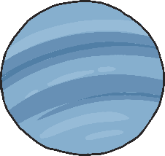
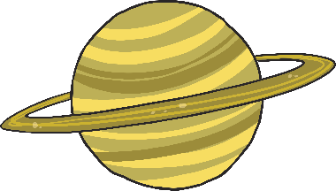



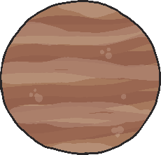
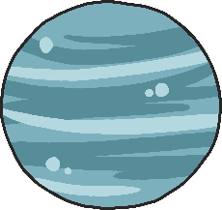
Correct!
8 planets
next

Slide 29
Try again!
back

Slide 30
How many stars can you see? Can you click on the matching number?
7
4
10

Slide 31
Correct!
10 stars
The End

Slide 32
Try again!
back

Slide 33
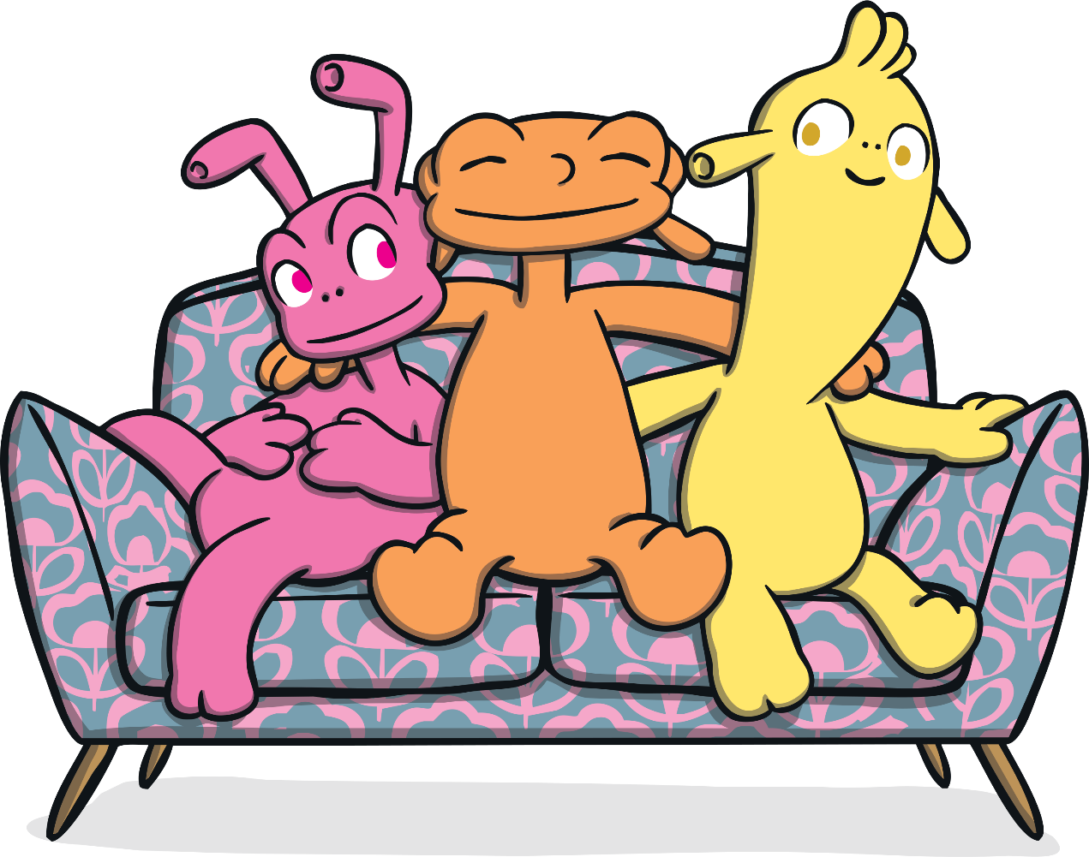
Well done!
You can meet Zid and other alien friends in this wonderful Twinkl Originals story, The Best Dress Ever.
Play again!

