Slide 1
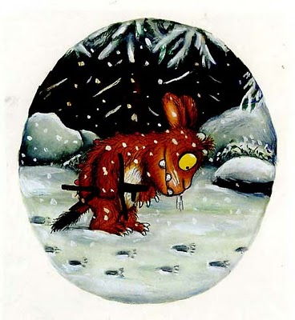
The Gruffalo’s Child
Maths
LO: I can recognise numerals 1-5
I can count accurately.

Slide 2
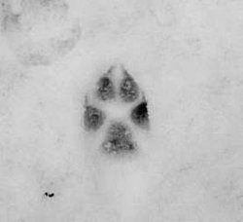
How many footprints can you see?
1

Slide 3
2
How many footprints can you see?

Slide 4
3
How many footprints
can you see?

Slide 5
4
How many footprints
can you see?

Slide 6
5
How many footprints
can you see?

