Slide 1
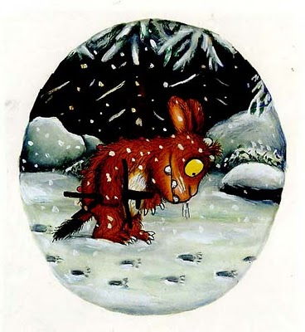
The Gruffalo’s Child
Maths Doubling Problems
LO: I can double numbers to 10.

Slide 2
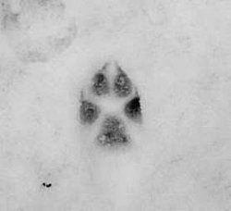
Remember doubling means we add
the same number to itself.
For example, double of 2 is 2 + 2 = 4

Slide 3

The Gruffalo’s child saw 1 footprint in the snow.
What is double 1?

Slide 4
The Gruffalo’s child saw 2 footprints in the snow.
What is double 2?

Slide 5
The Gruffalo’s child saw 3 footprints in the snow.
What is double 3?

Slide 6
The Gruffalo’s child saw 4 footprints in the snow.
What is double 4?

Slide 7
The Gruffalo’s child saw 5 footprints in the snow.
What is double 5?

