Slide 1

Holidays

Slide 2
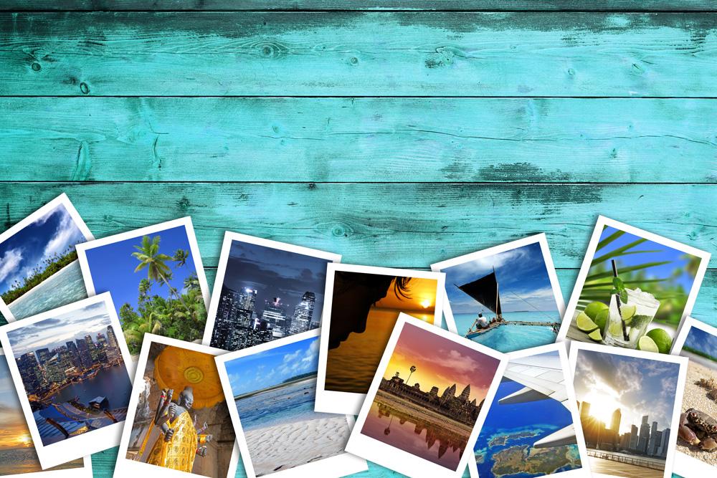
People like to go on different types of holiday.
Have you been on holiday? Where did you go?

Slide 3
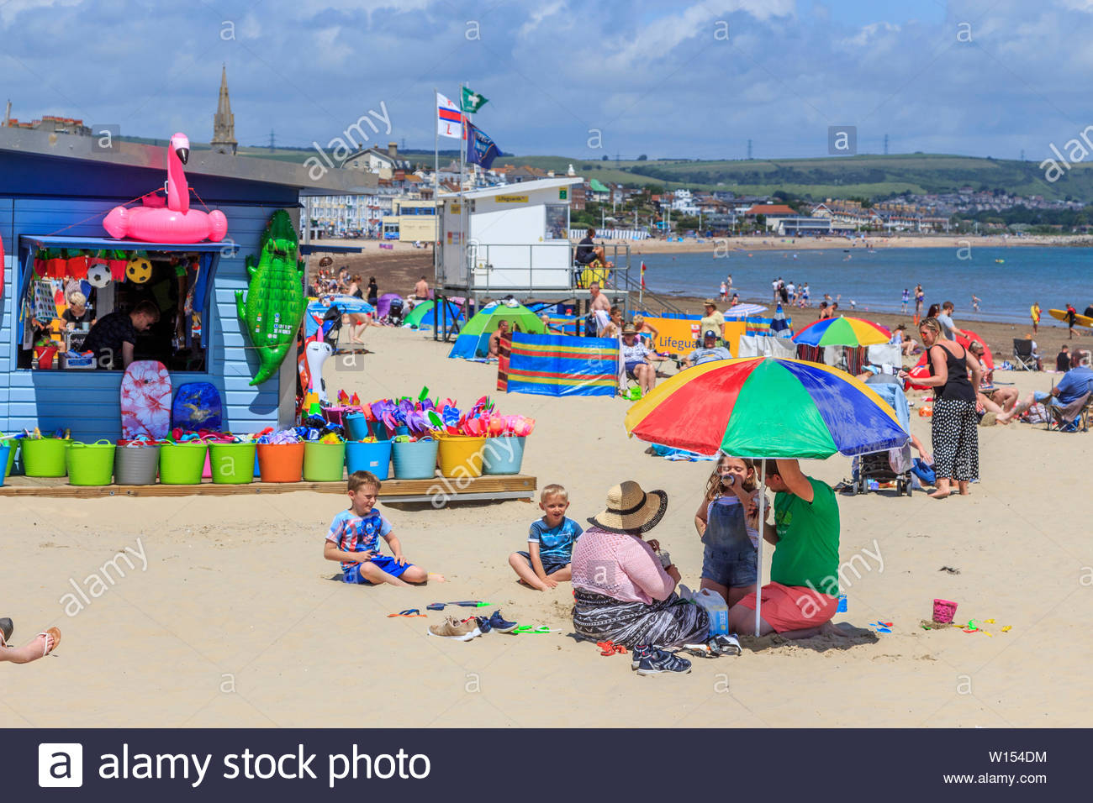
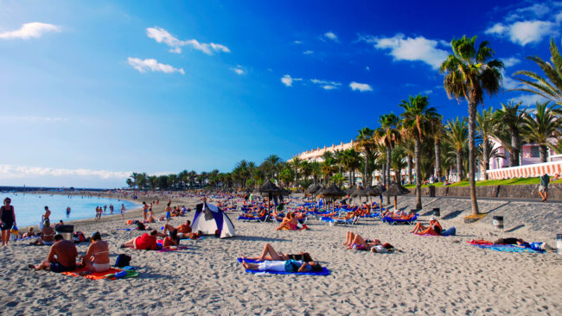
Some people like to go on holiday to the seaside. Sometimes they go to the seaside in the UK and sometimes they go on an aeroplane to places in Europe such as Spain, France, Greece, Turkey…

Slide 4
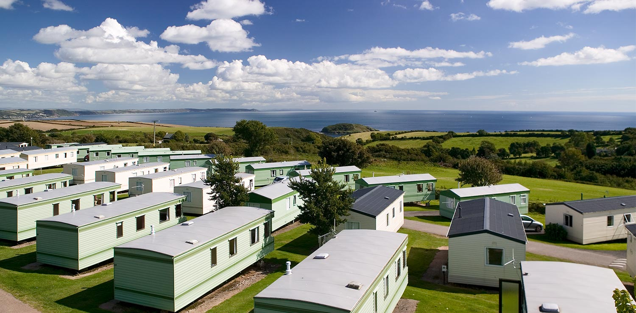
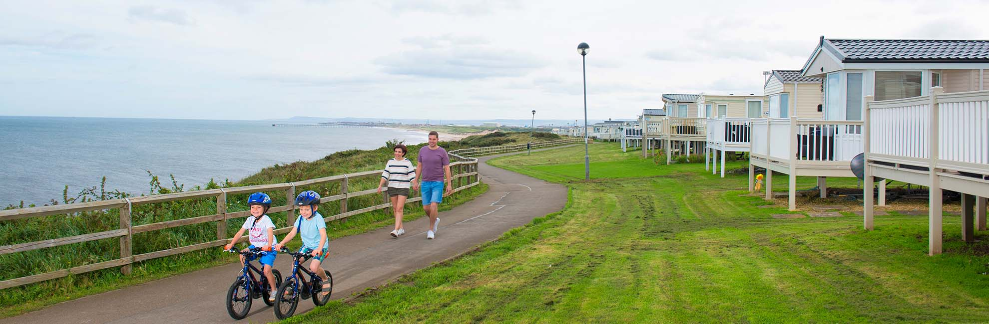
Some people like to go on holiday to a caravan park . At a caravan park there are lots of activities such as swimming and cycling…

Slide 5
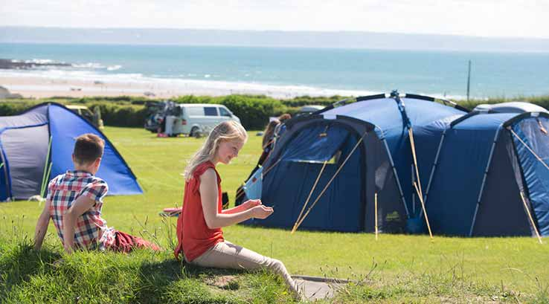
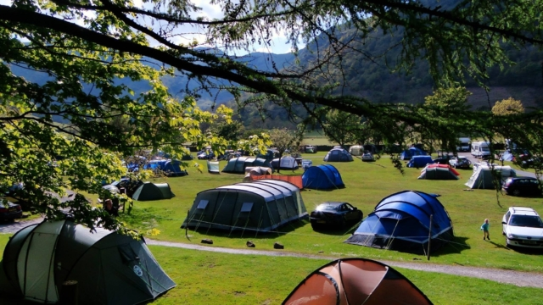
Some people like to go on holiday to a campsite. At a campsite people stay in tents. Campsites are usually in the countryside or on the coast.

Slide 6
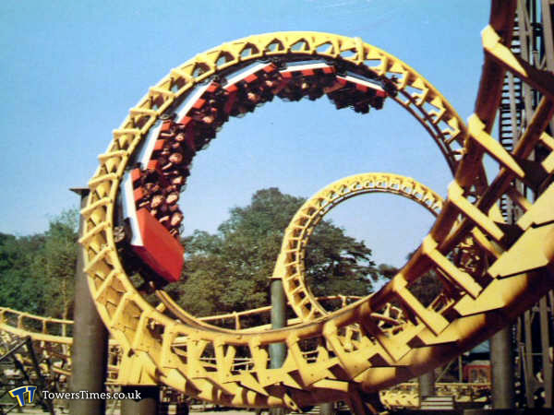
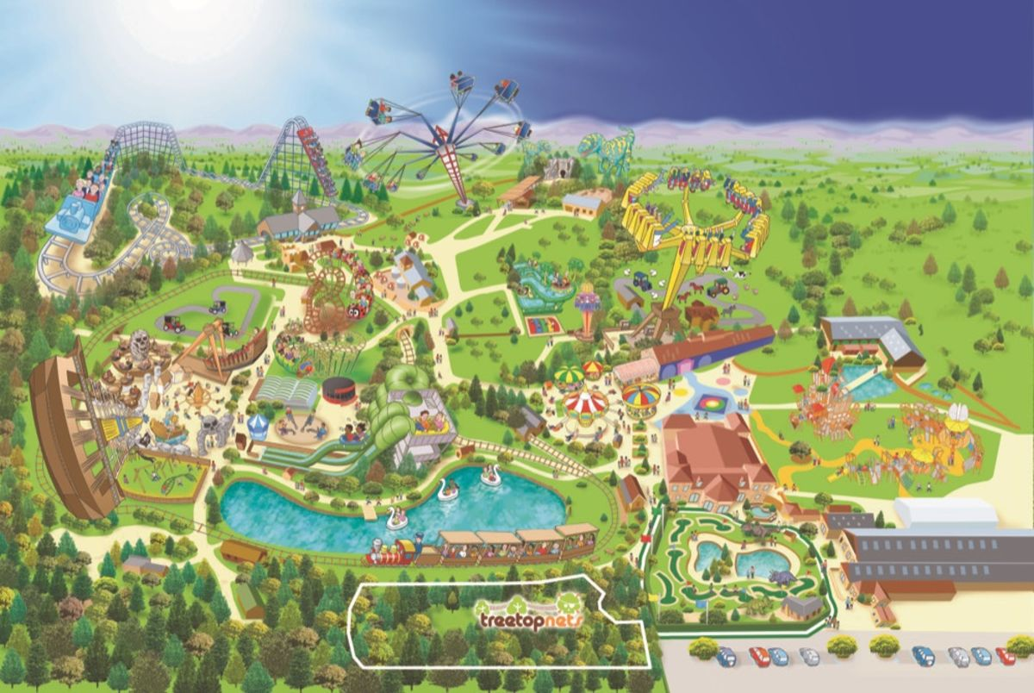
Some people like to go on holiday to a theme park . At a theme park there are lots of rollercoasters and activities. Some popular theme parks are Alton Towers, Flamingoland, Lightwater Valley.

Slide 7
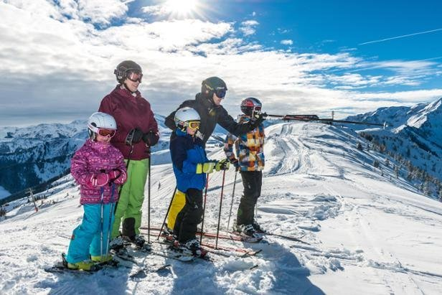
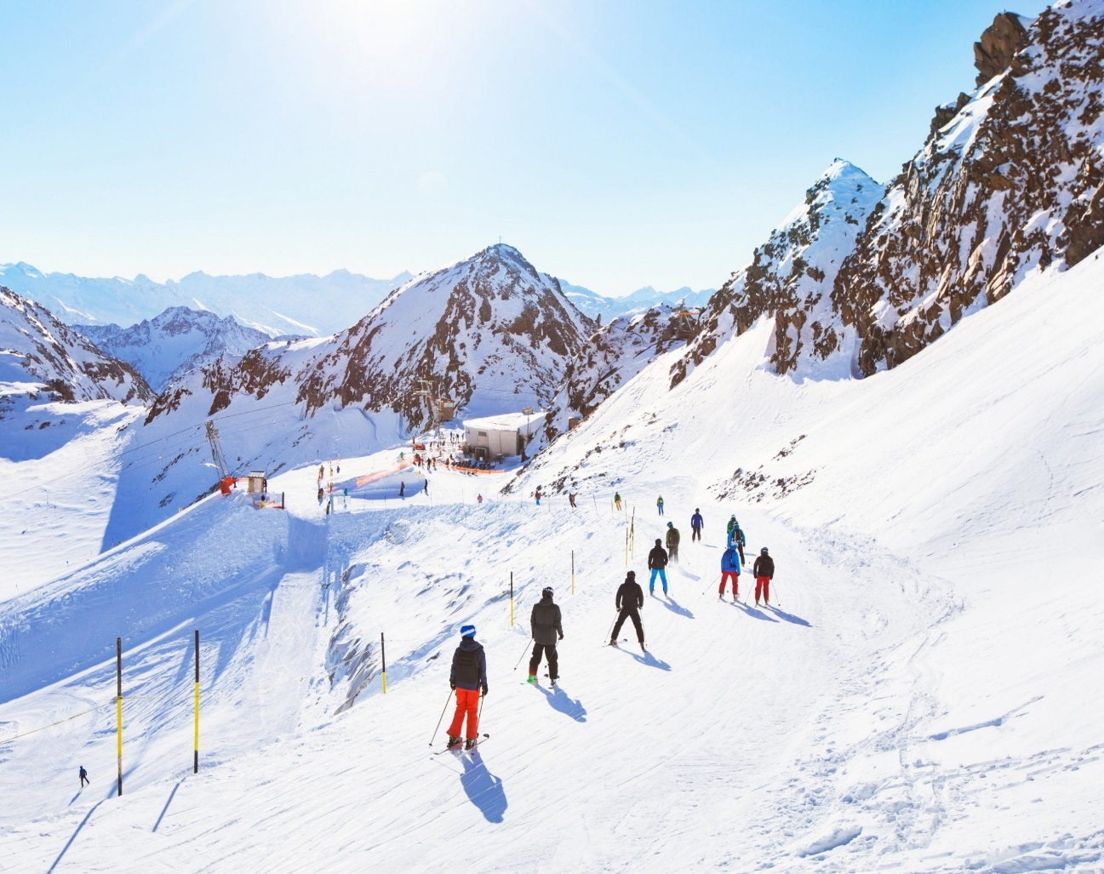
Some people like to go on a skiing holiday. People go on skiing holidays to places where it is very snowy and with lots of hills and mountains.

Slide 8
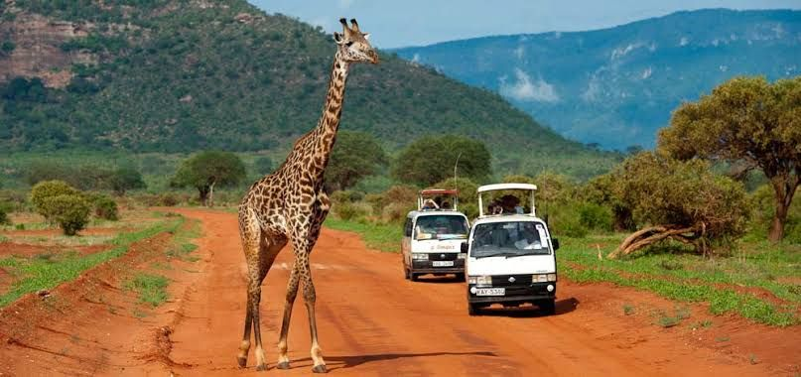
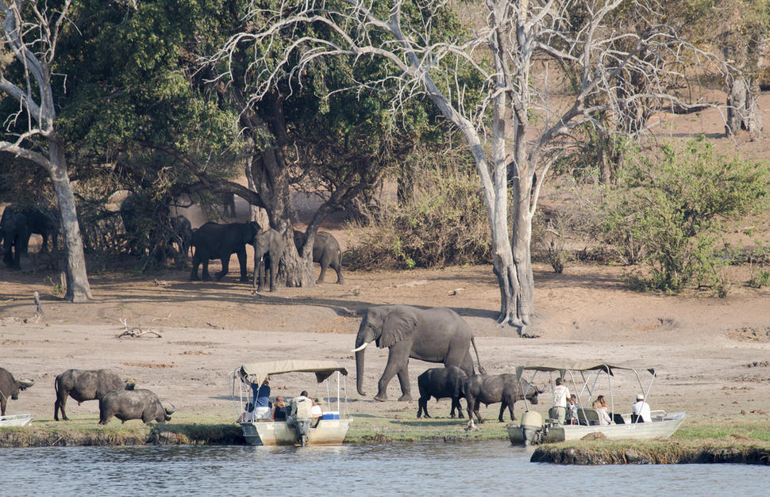
Some people like to go on holiday on Safari. Some people travel to countries such as South Africa, Kenya and Botswana. People travel on aeroplanes to go on safari.

Slide 9
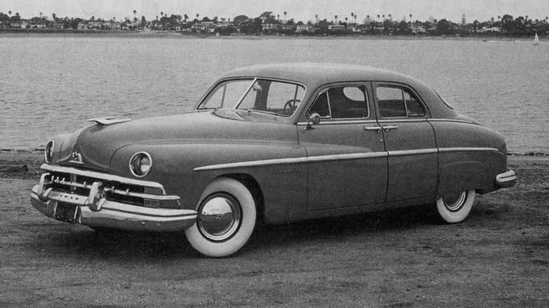
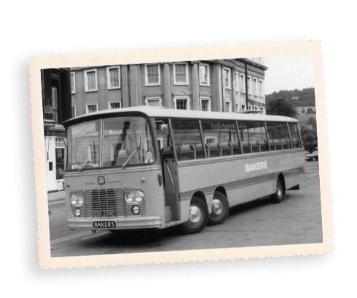
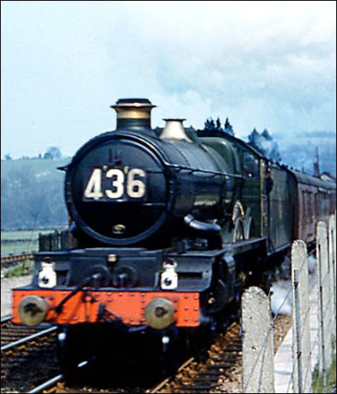
Then
A long time ago people mainly travelled by car, trains and buses to go on holiday.

Slide 10
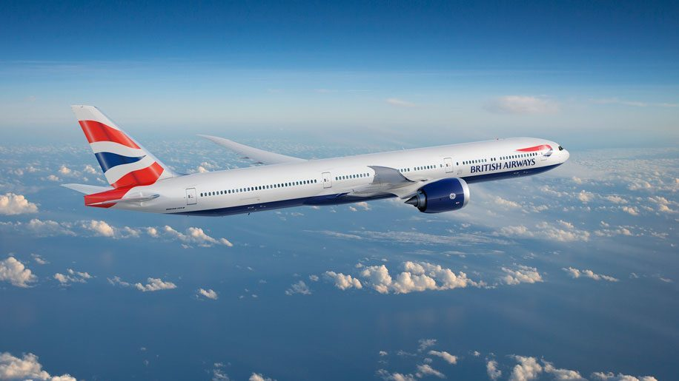
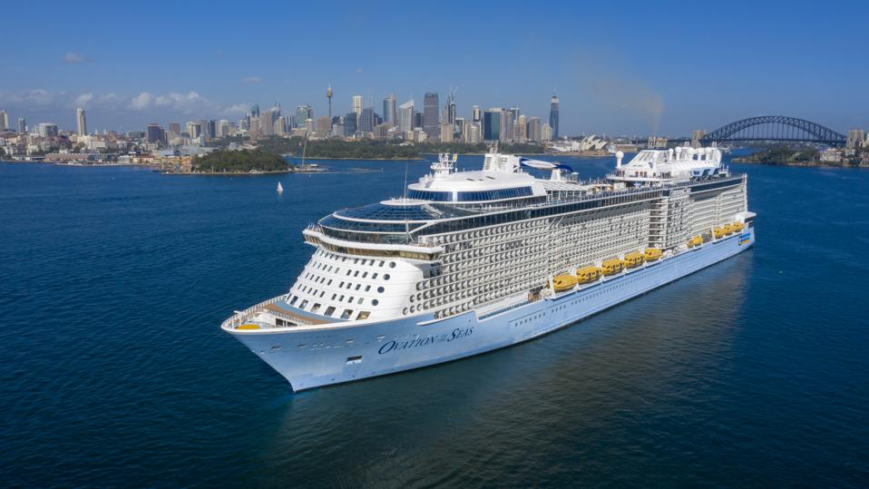
Now
A lot of people these days travel on holiday by aeroplane and boats.

