Slide 1
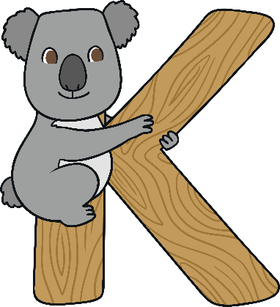
K

Slide 2

The Letter K Looks like This…
K
k
Can you draw it with your finger?

Slide 3
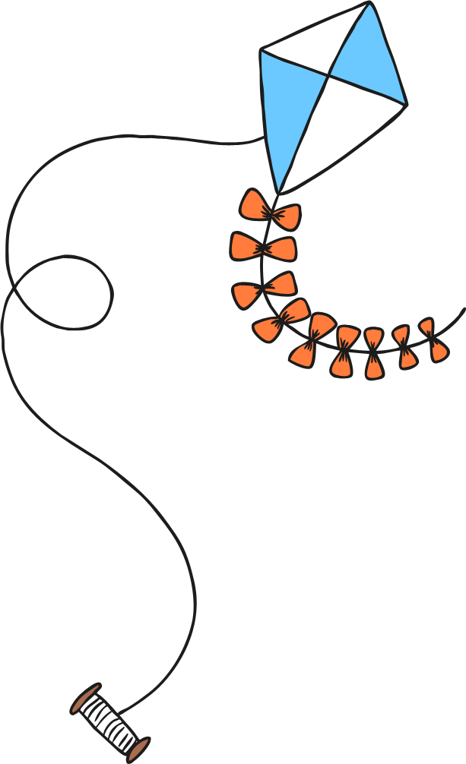
The Letter K Sounds like This…
K, K, K
Notes:
Say the sound /k/ and have children repeat it back multiple times.

Slide 4
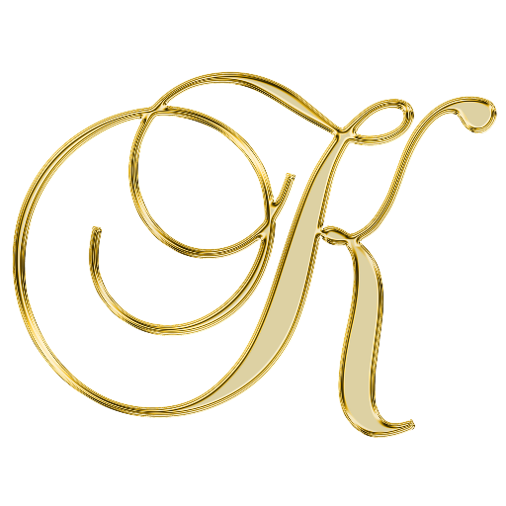




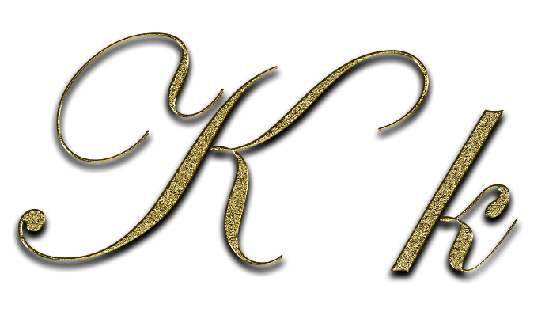
It Can Also Look like This…

Slide 5
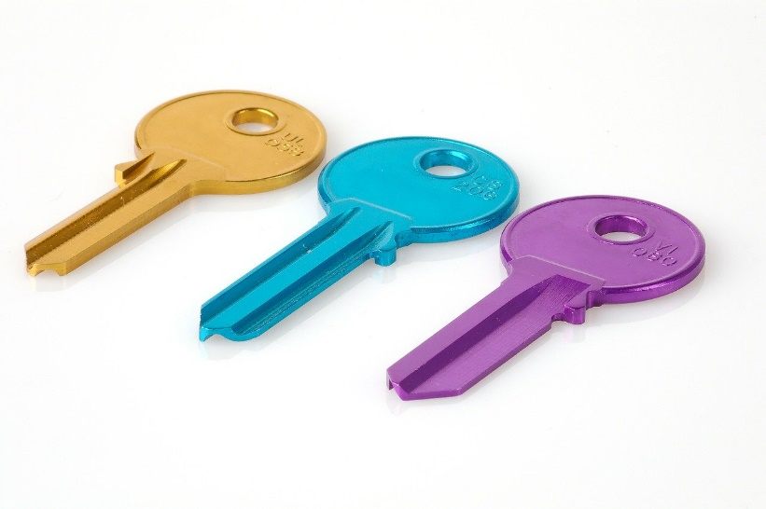
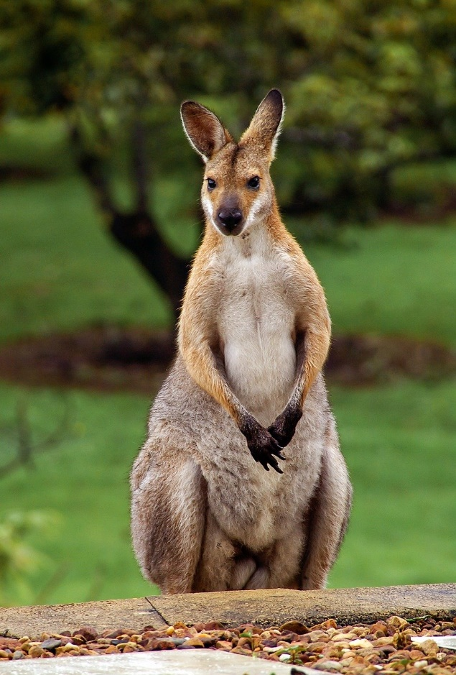
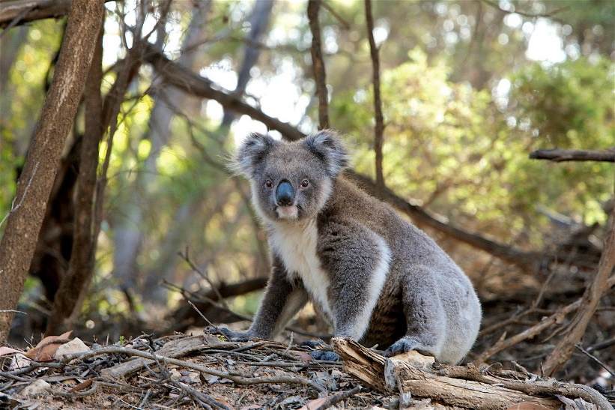
Some Things That Start with K Are…
Notes:
Kangaroo, koala, key

Slide 6
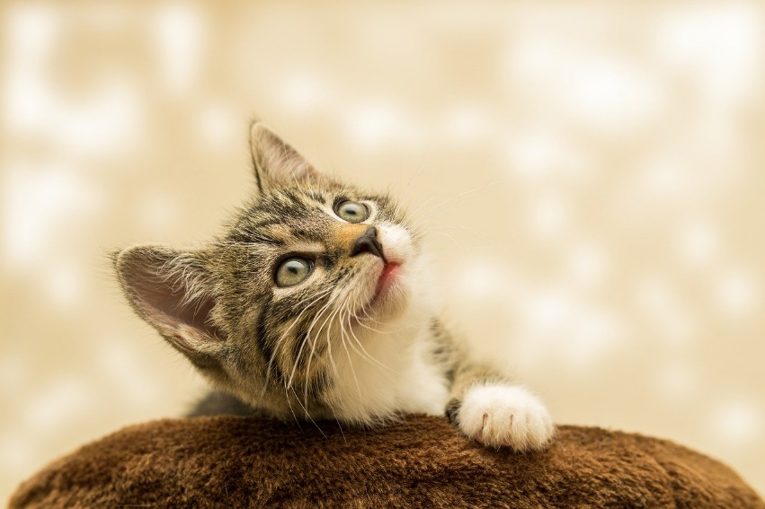
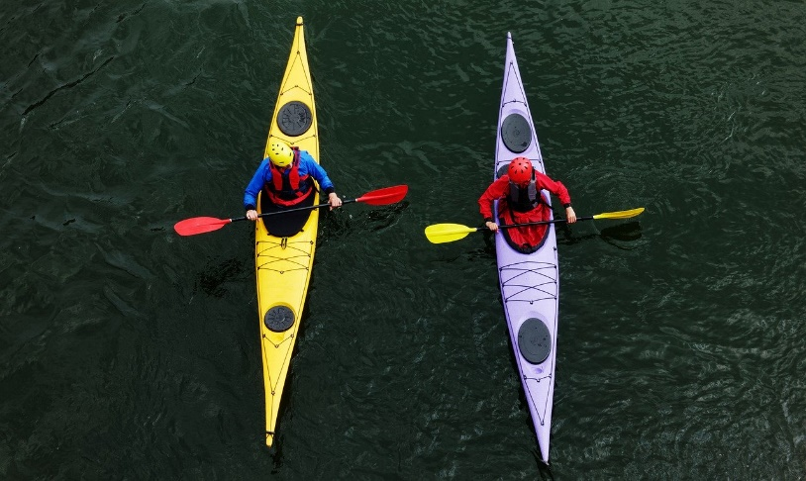
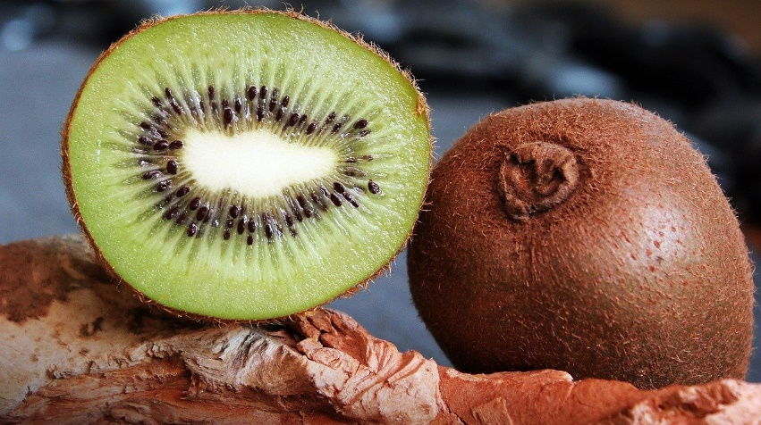
Some Things That Start with K Are…
Notes:
Kitten, kayak, kiwi

Slide 7

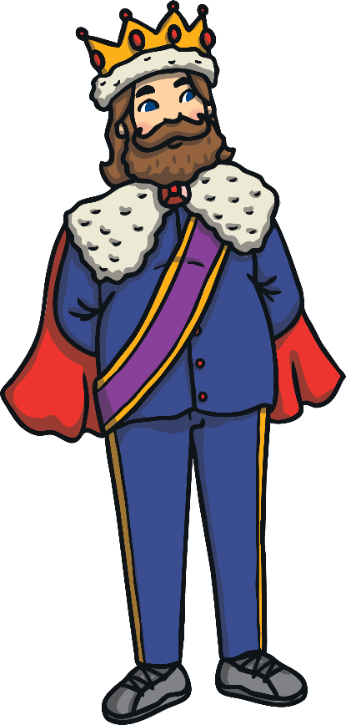
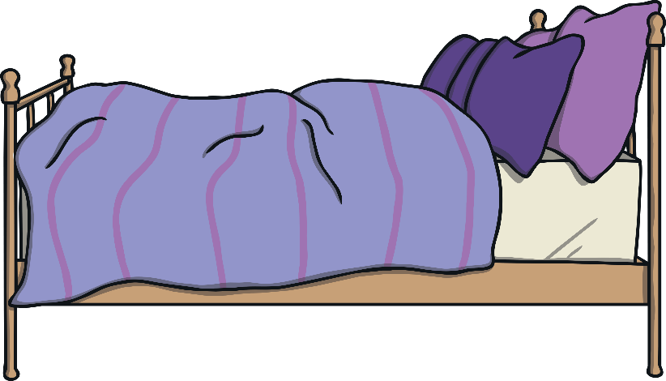
Which of These Start with K?
Try
Again!
Yes!
Notes:
Pause briefly after the initial sound of each word to assist students to identify the sounds
Bed, king

Slide 8
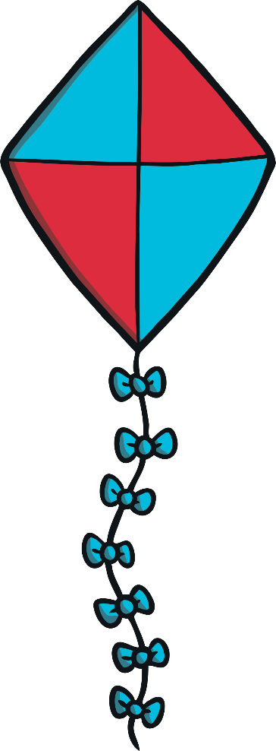

Which of These Start with K?
Try
Again!
Yes!
Notes:
Kite, scissors

Slide 9
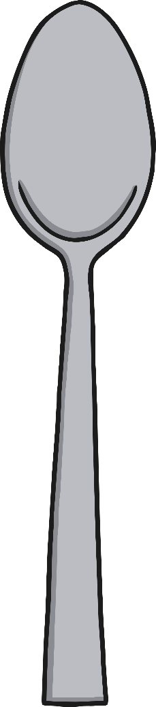
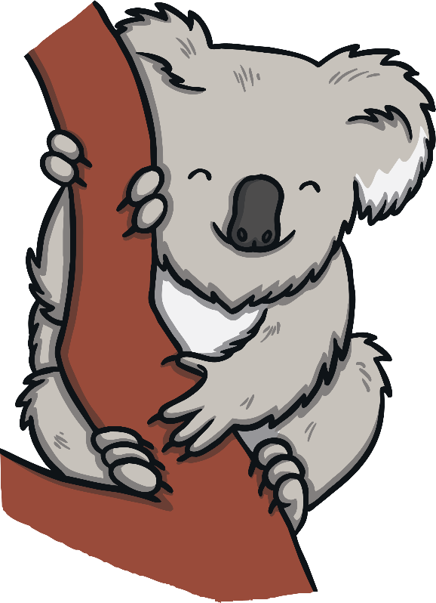
Which of These Start with K?
Try
Again!
Yes!
Notes:
Koala, spoon

Slide 10


Which of These Start with K?
Try
Again!
Yes!
Notes:
Kettle, moon

