Slide 2
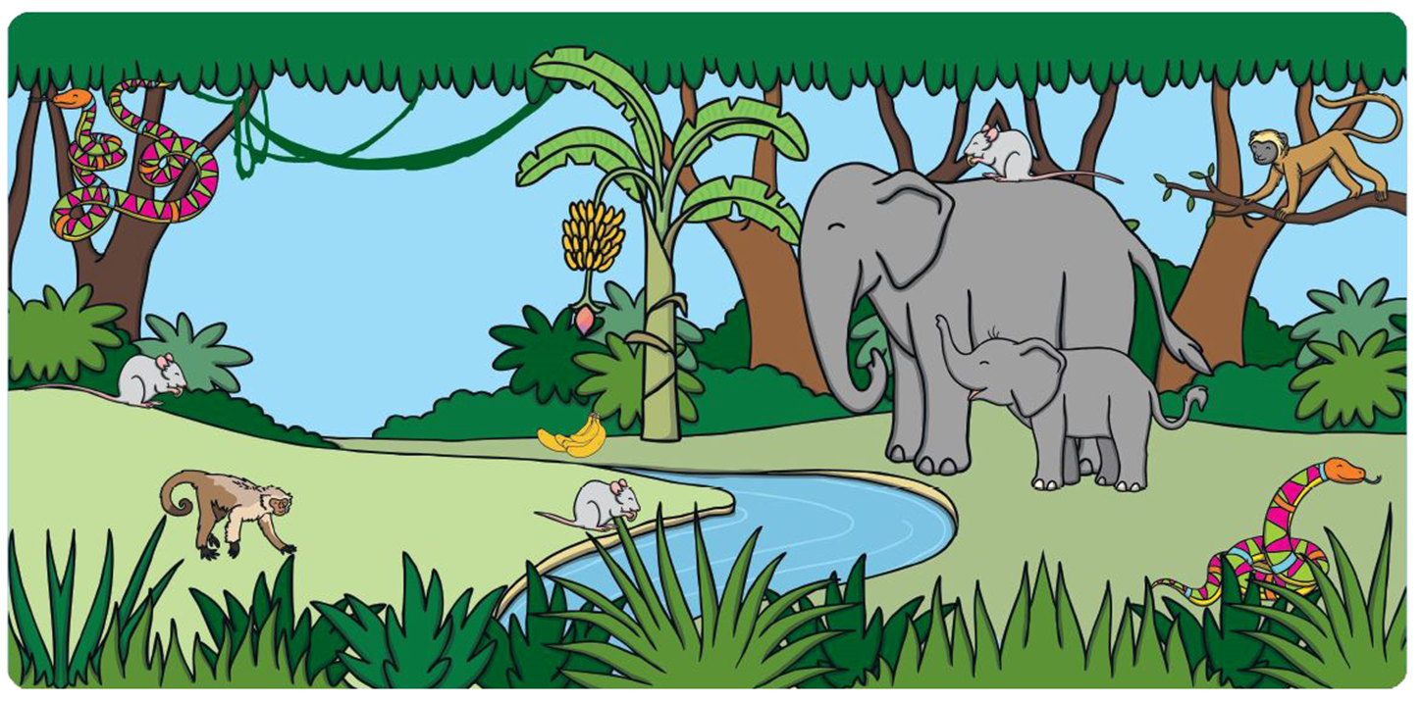
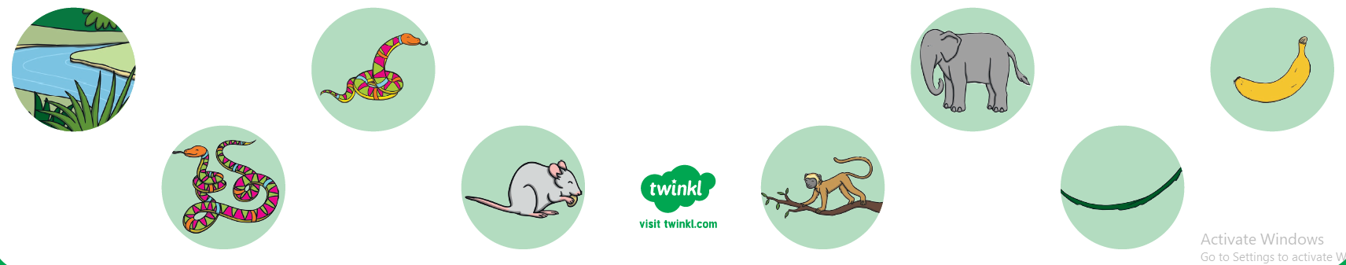
Can you find these things in the picture?
^{long river}
^{long snake}
^{mouse with the shortest tail}
^{shortest banana}
^{longest vine}
^{elephant with a long trunk}
^{monkey with the longest tail}

Slide 3
Maths: Length
‘Can You Find...?’ Instructions
Questions
Can you pretend to be an elephant with a long trunk?
What do elephants use their long trunks for?
Can you pretend to be a monkey with a long tail?
Why do you think monkeys need long tails?
Can you think of anything that is really long?
Can you think of anything that is really short?

