Slide 1
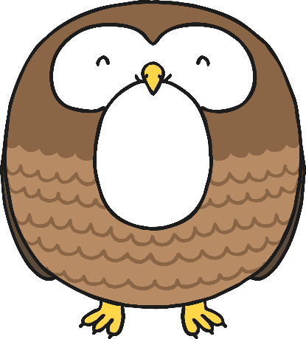
O

Slide 2

The Letter O Looks like This…
O
o
Can you draw it with your finger?

Slide 3
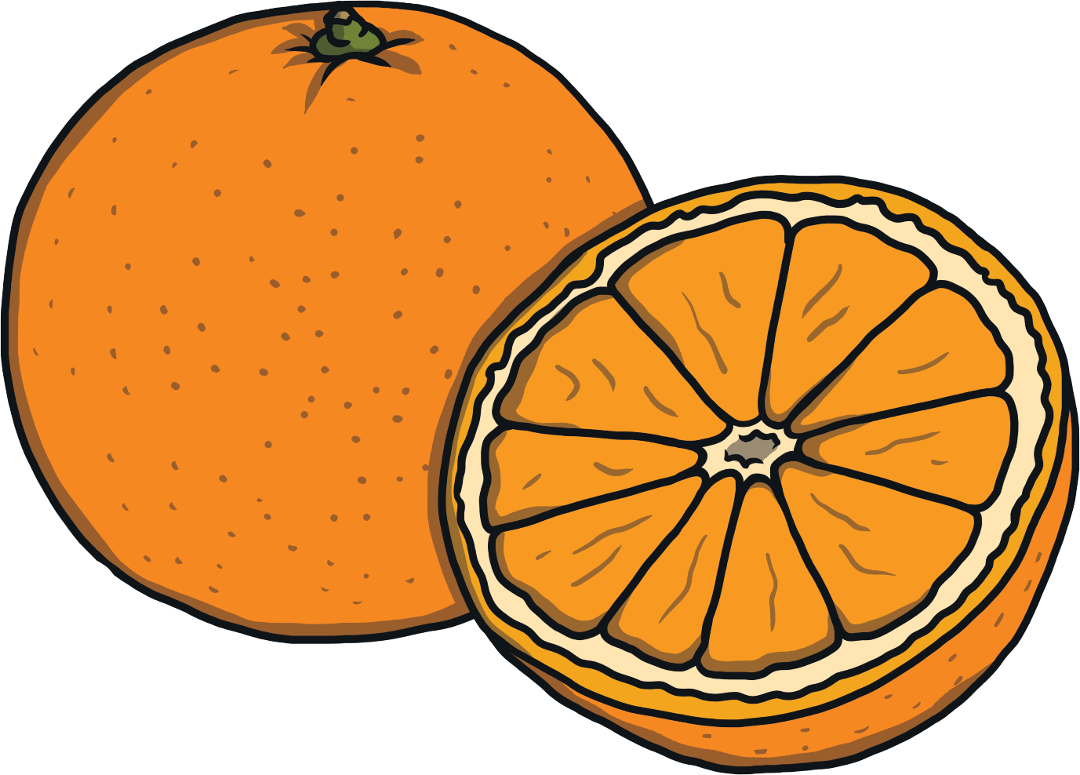
The Letter O Sounds like This…
O, O, O
Notes:
Say the sound /o/ and have children repeat it back multiple times.

Slide 4
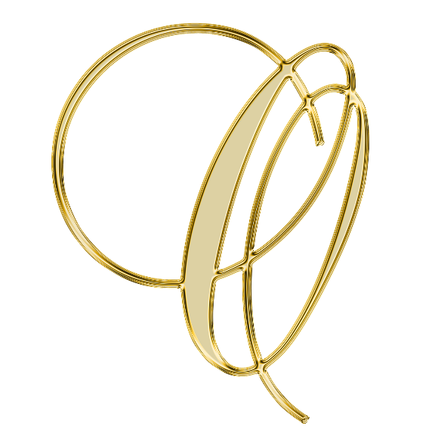




It Can Also Look like This…

Slide 5
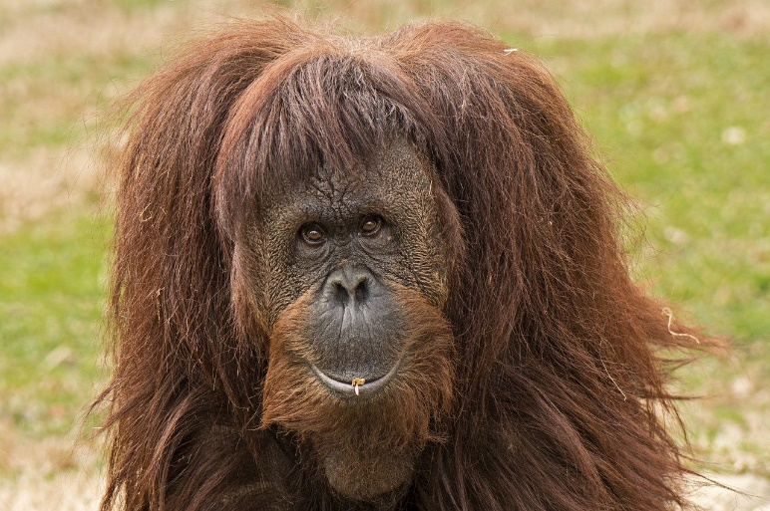
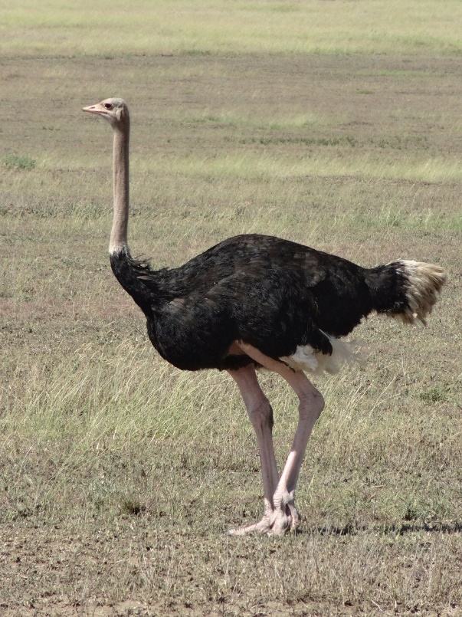
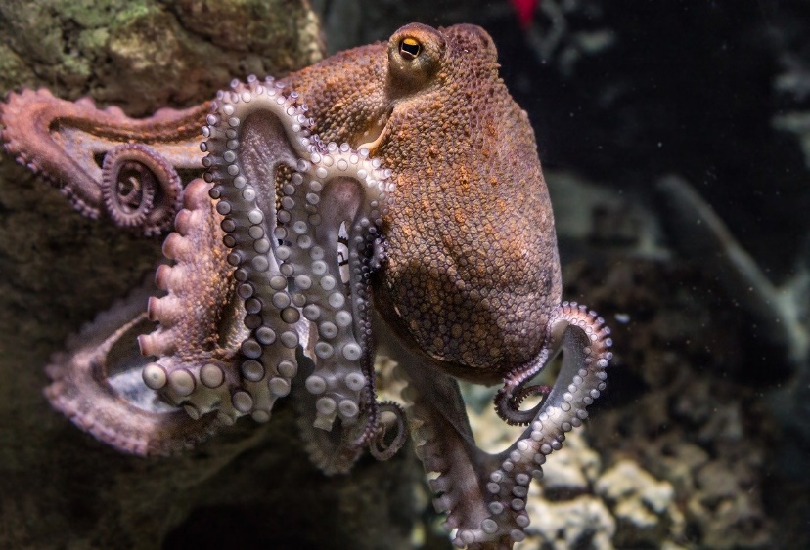
Some Things That Start with O Are…
Notes:
Orangutan, octopus, ostrich

Slide 6
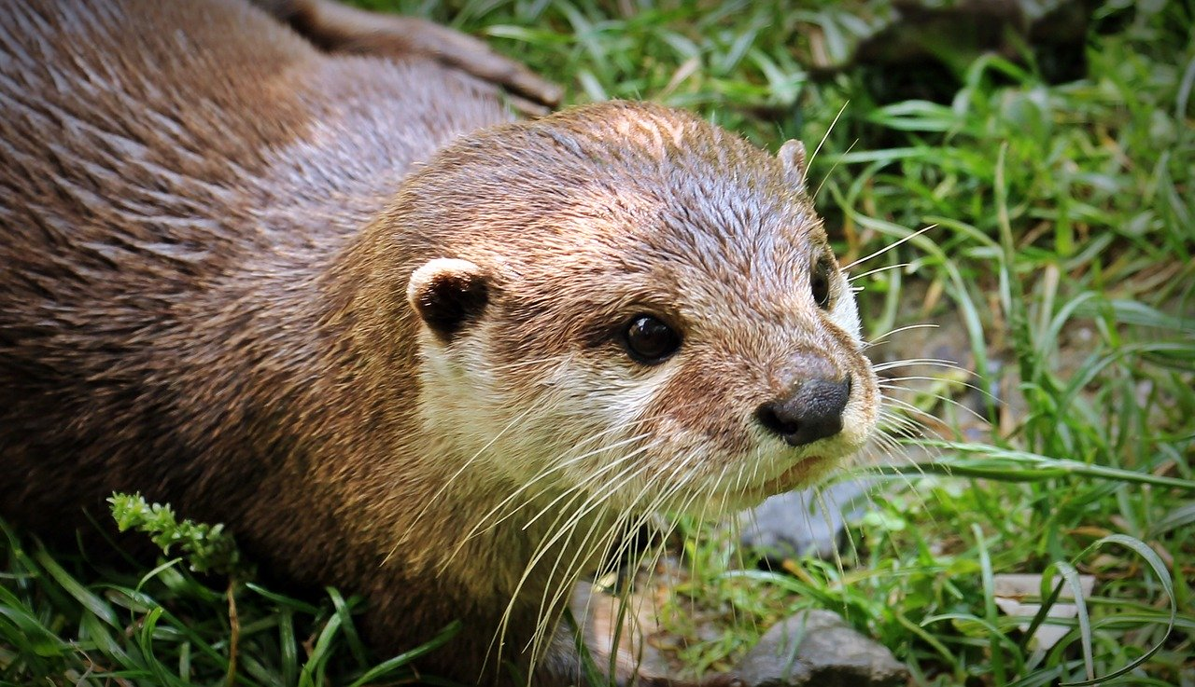
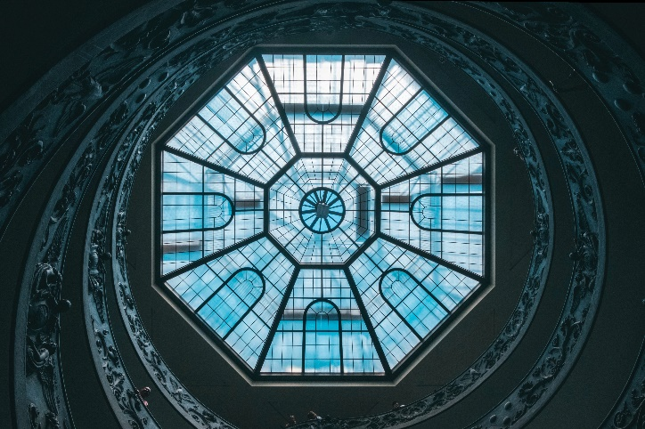
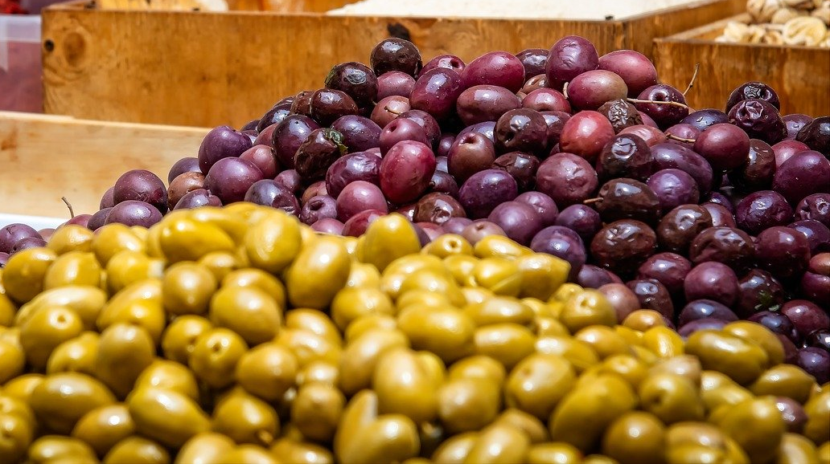
Some Things That Start with O Are…
Notes:
Otter, olive, octagon

Slide 7

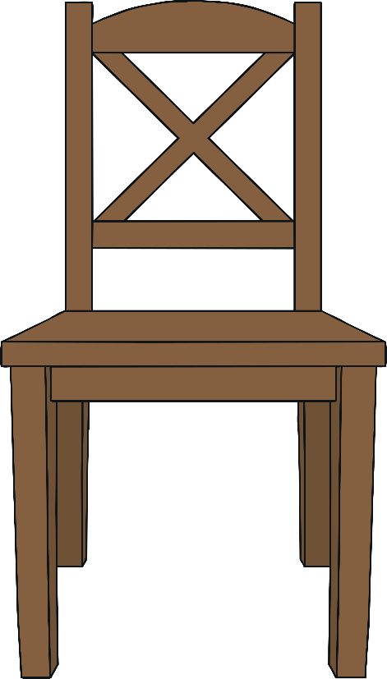
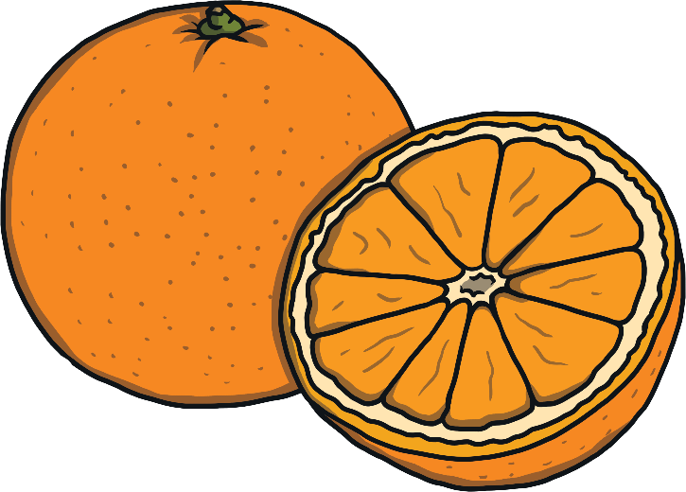
Which of These Start with O?
Try
Again!
Yes!
Notes:
Pause briefly after the initial sound of each word to assist students to identify the sounds
Chair, orange

Slide 8
Which of These Start with O?
Try
Again!
Yes!
Notes:
Octagon, triangle

Slide 9
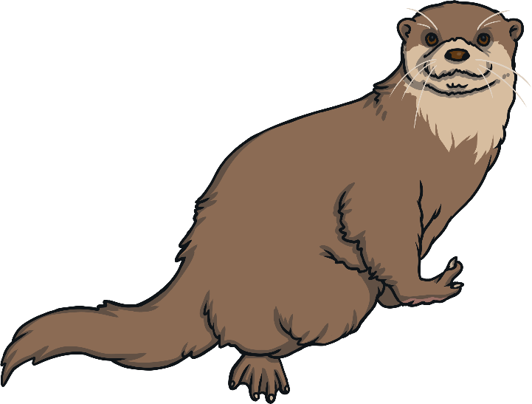
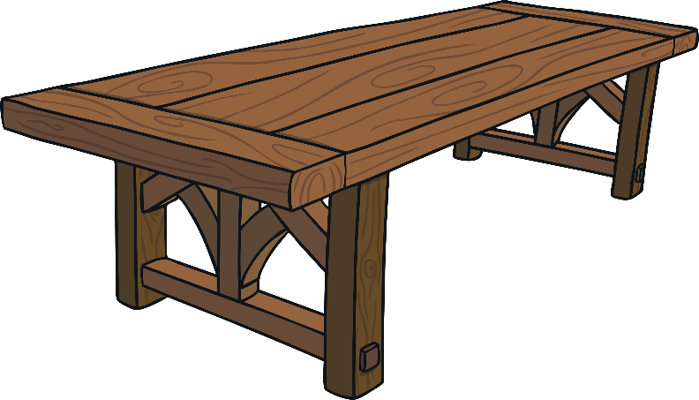
Which of These Start with O?
Try
Again!
Yes!
Notes:
Otter, table

Slide 10

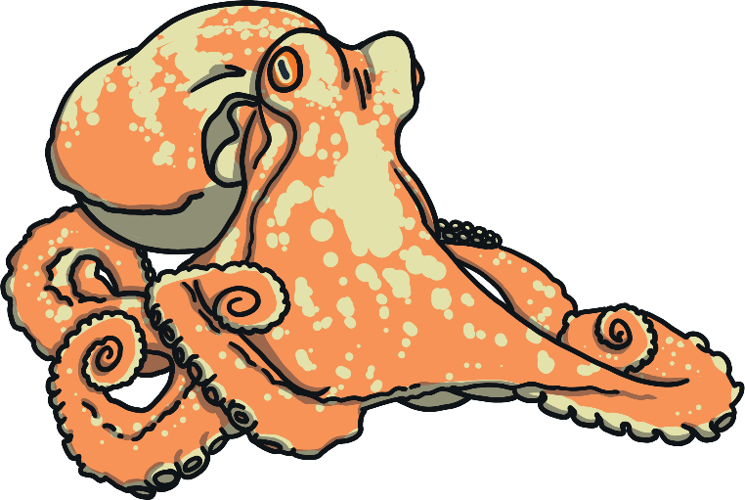
Which of These Start with O?
Try
Again!
Yes!
Notes:
Octopus, shell

