Slide 1

Holidays

Slide 2
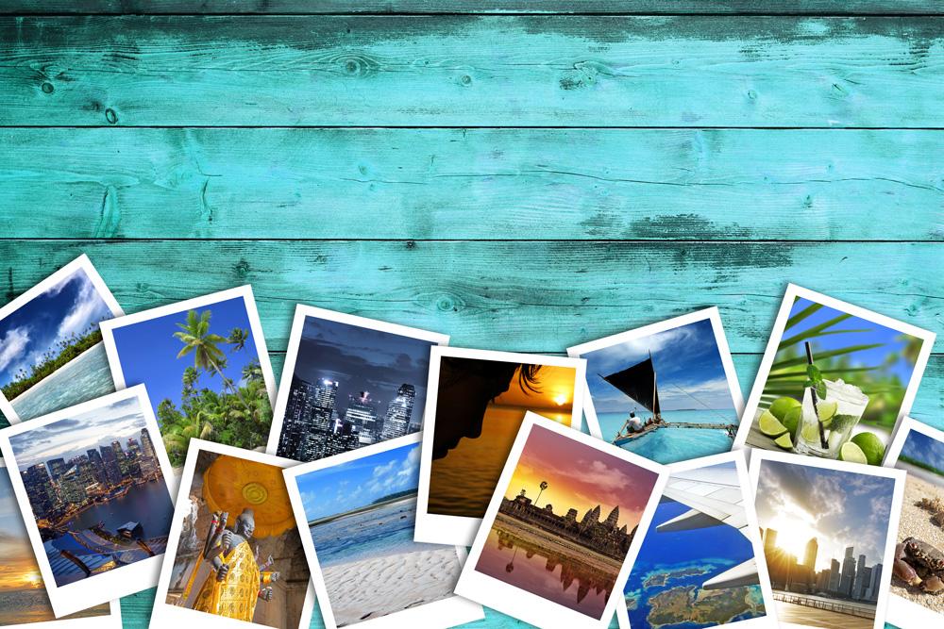
People like to go on different types of holiday.
Have you been on holiday? Where did you go?

