Slide 2
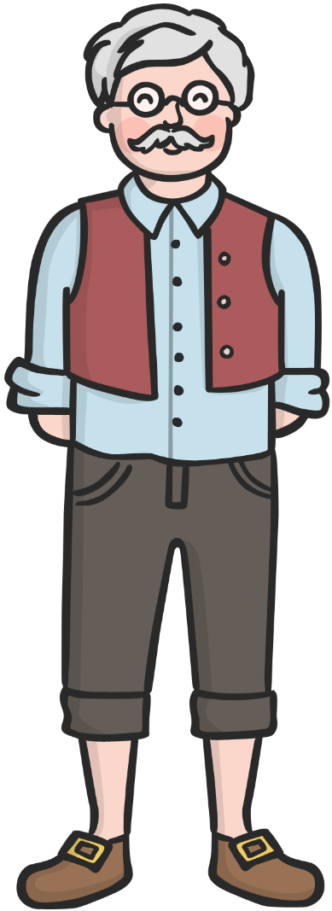
Once upon a time, there was an old man named Geppetto. He lived alone and longed for a child.

Slide 3
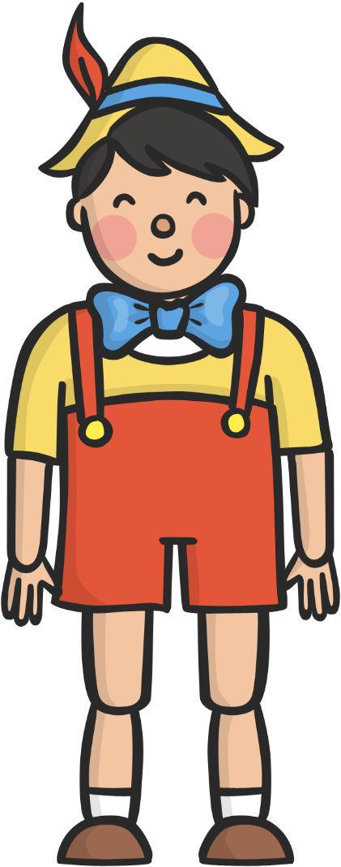
Geppetto made a puppet. He called it Pinocchio.

Slide 4

When Geppetto was sleeping the Blue Fairy appeared and cast a spell on the puppet.

Slide 5
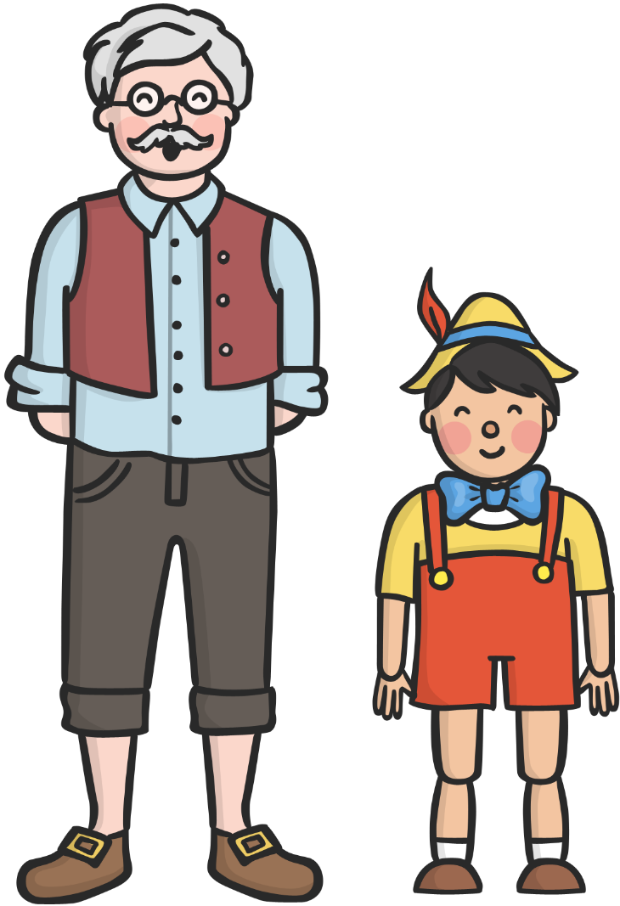
When Geppetto awoke he found that Pinocchio could speak and move!
Hello father!

Slide 6
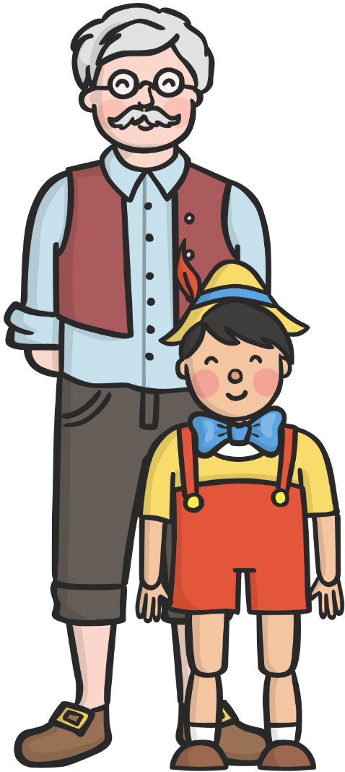
Geppetto loved and cared for Pinocchio like a son.

Slide 7
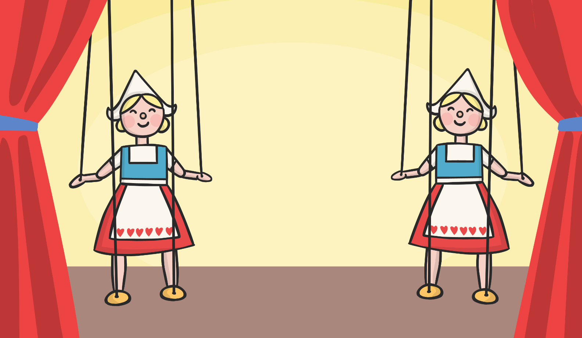

Pinocchio saw a puppet show and decided to join in.

Slide 8

He did so well he was paid five bronze coins!

Slide 9
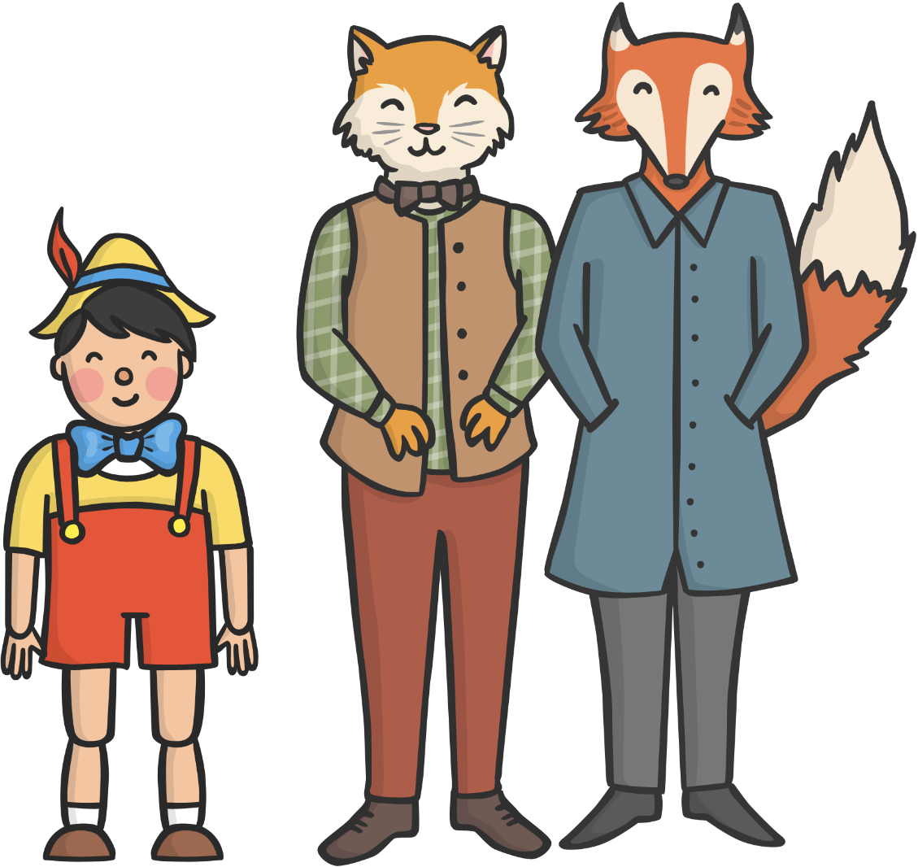
Pinocchio met a fox and a cat.

Slide 10

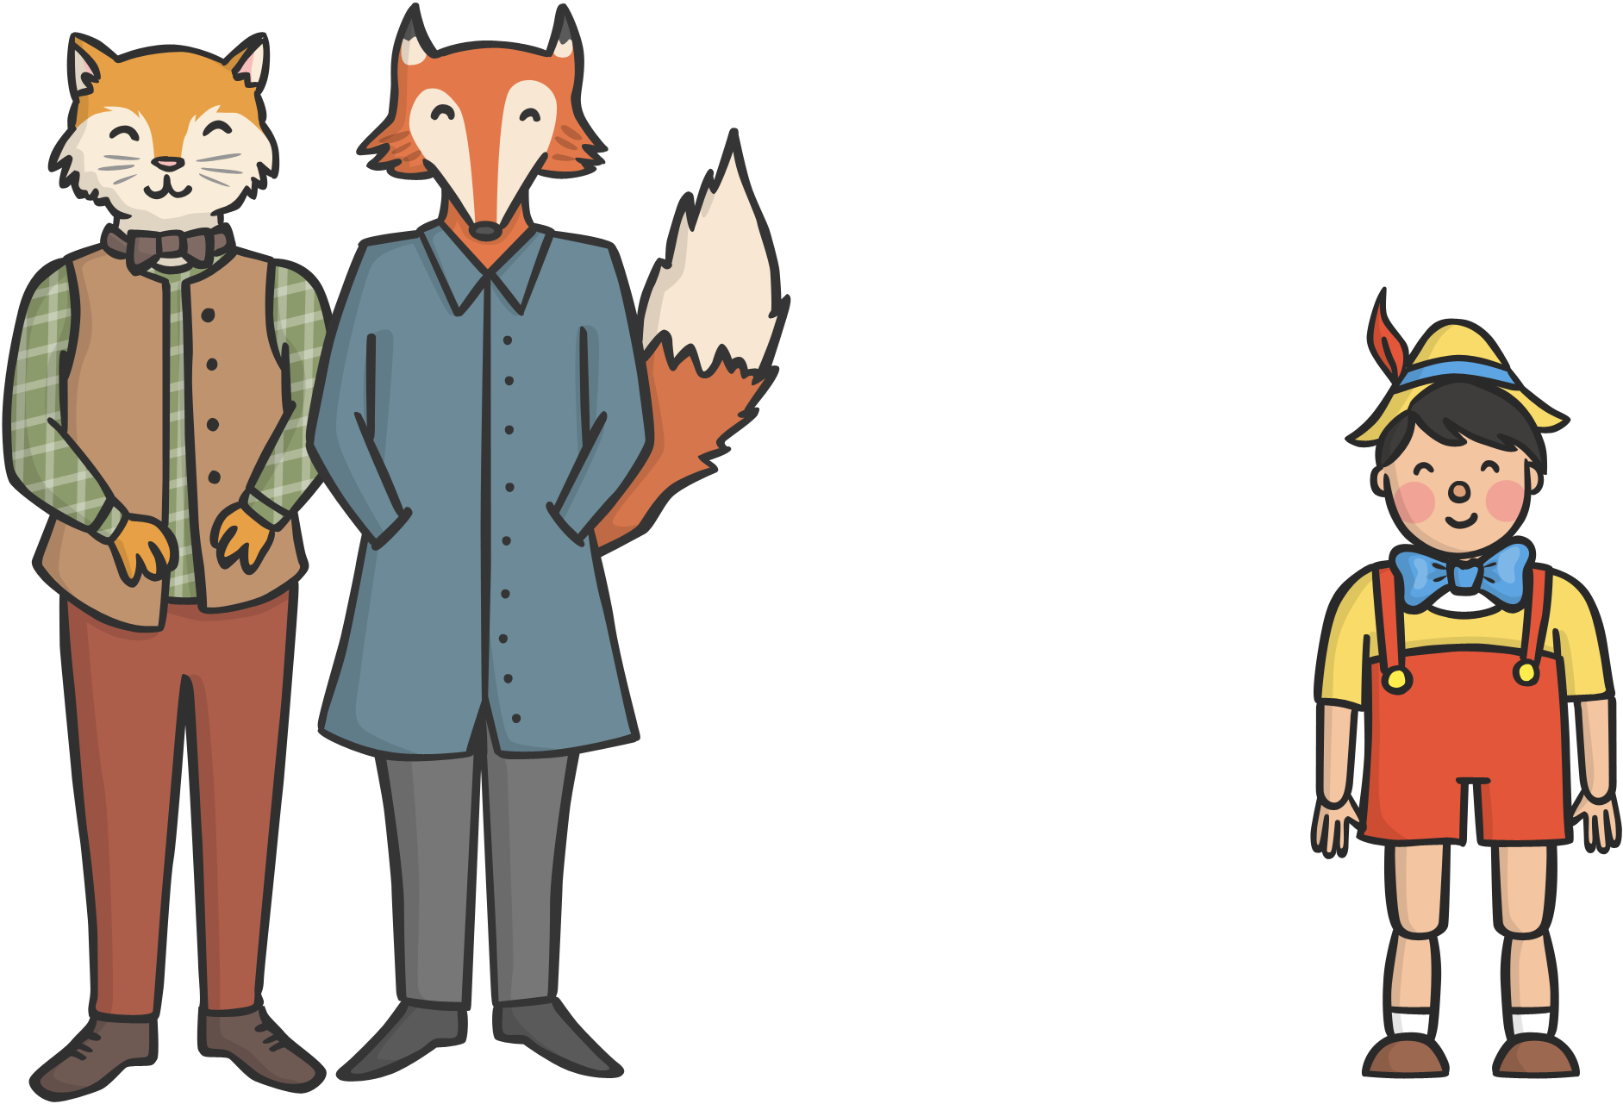
They told him if he planted his coins under a magic tree, he would become rich!

Slide 11
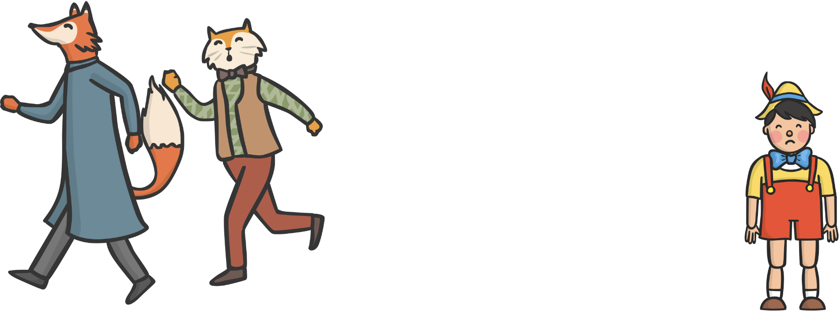

But they were trying to trick Pinocchio so they could take his money. The Blue Fairy sent a dog to scare them off.

Slide 12
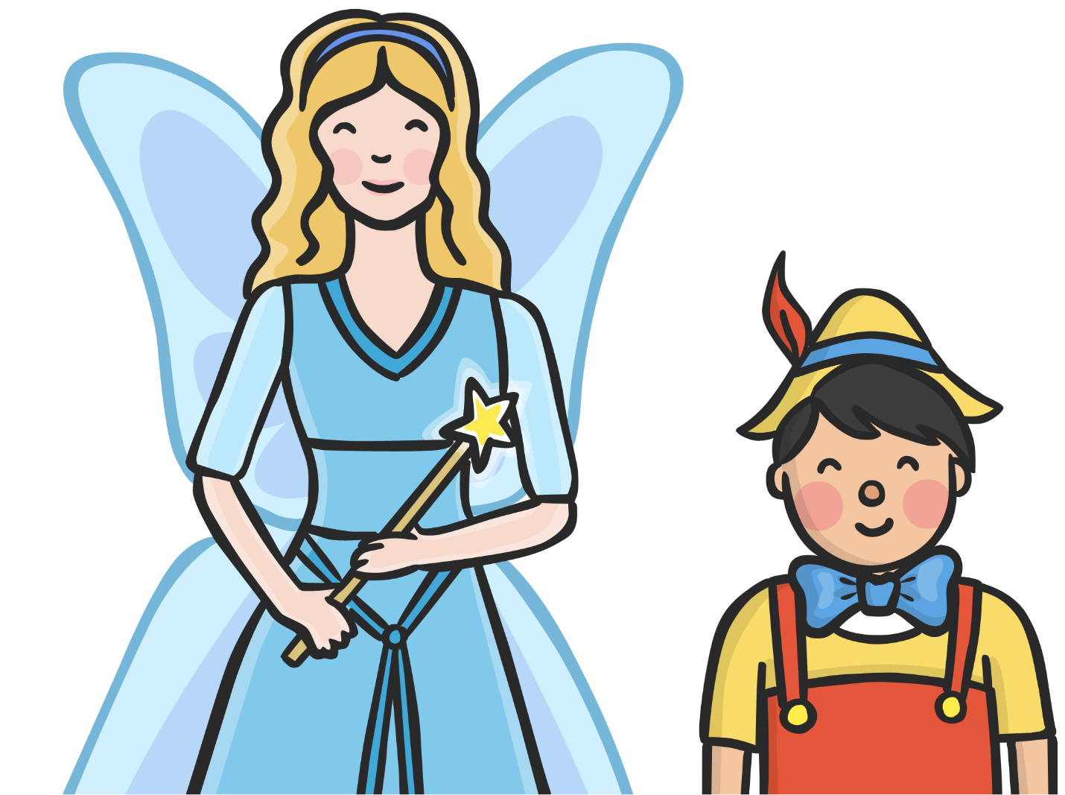
The Blue Fairy asked Pinocchio why he had not been to school that day.
I have been to school!

Slide 13
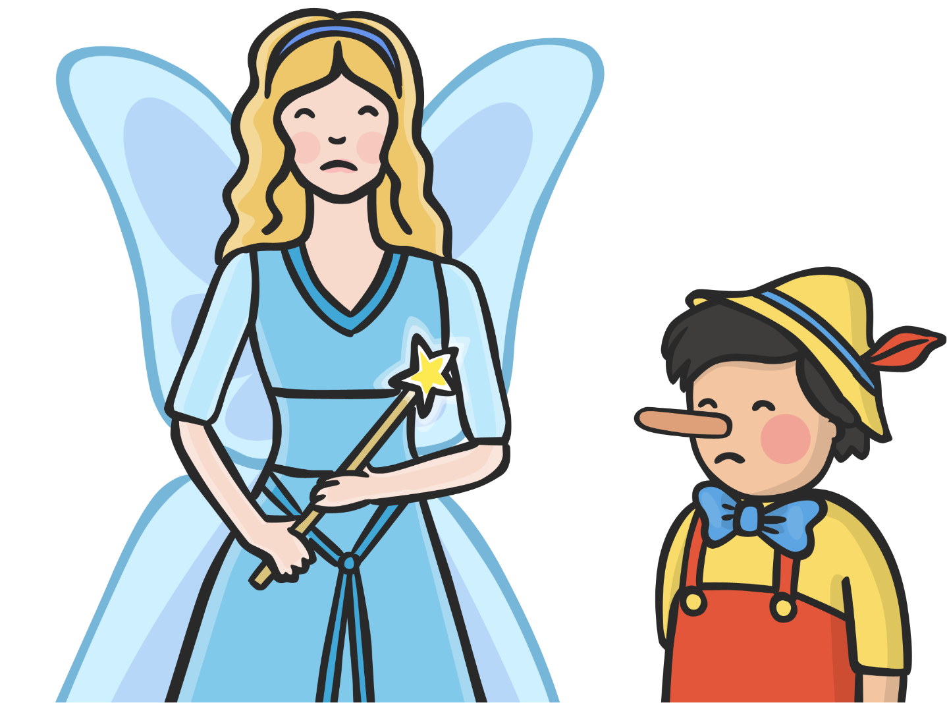
Pinocchio lied and his nose grew!

Slide 14
The Blue Fairy asked Pinocchio where he had put the bronze coins.

Slide 15
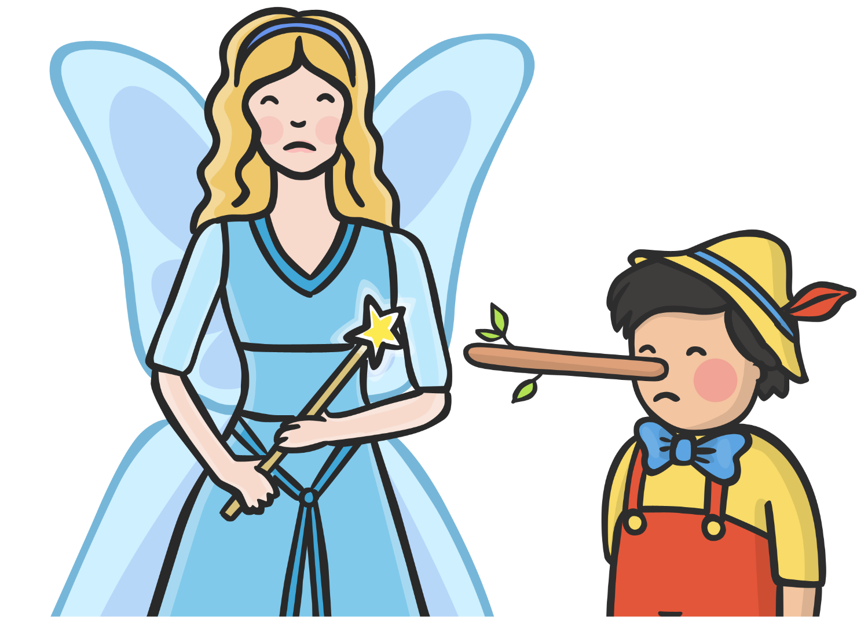
Pinocchio lied a second time and his nose grew even bigger!

Slide 16
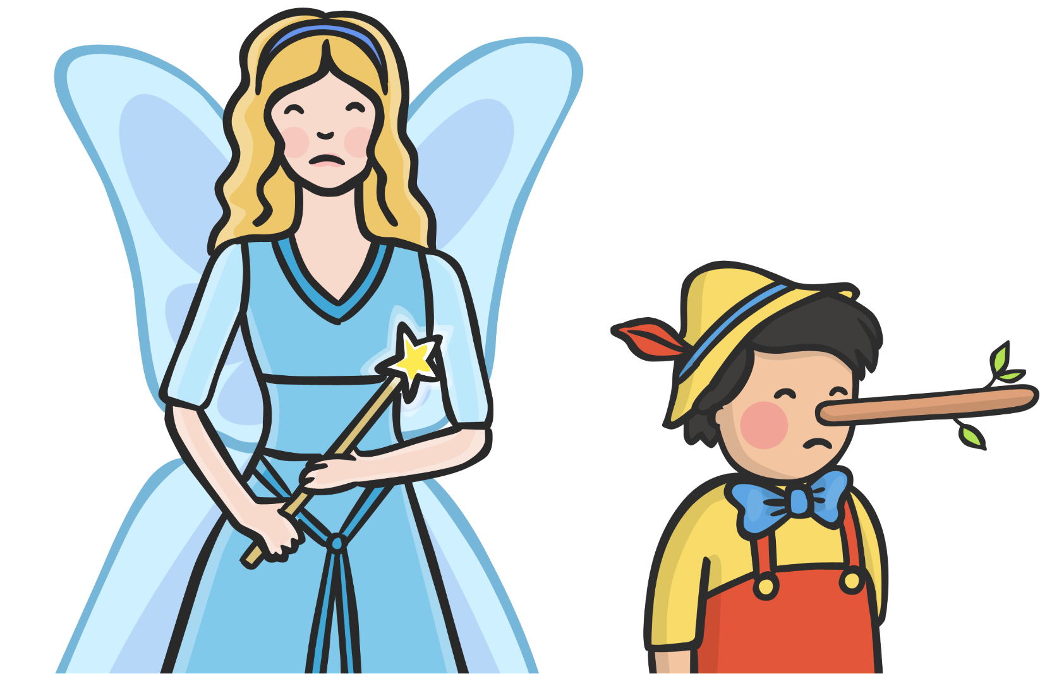
The Blue Fairy told Pinocchio his nose would only shrink when he told the truth.

Slide 17

Pinocchio went to the circus with some boys. They ate lots of sweets.

Slide 18
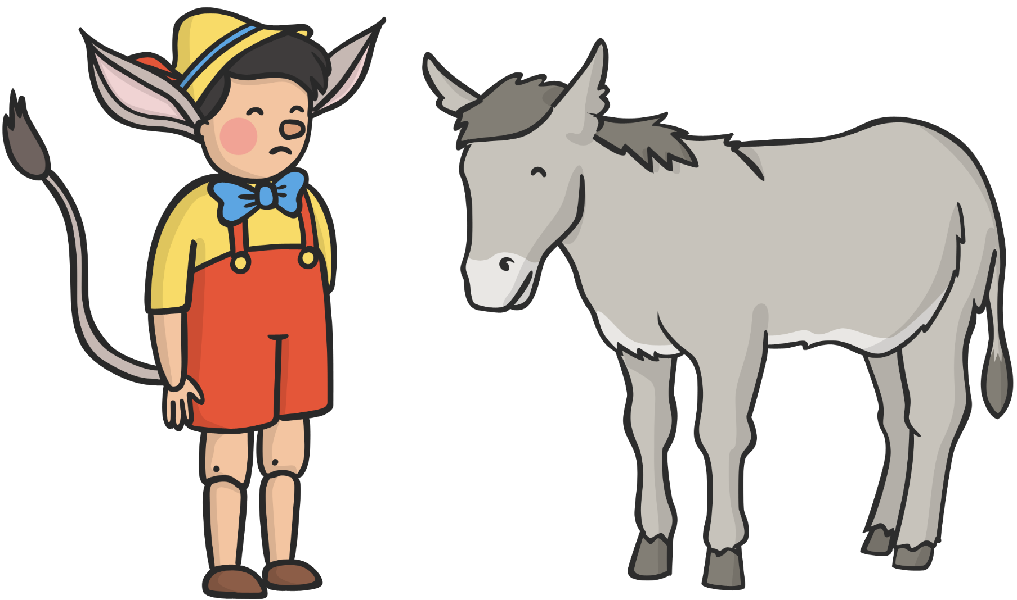
The boys began to turn into donkeys!

Slide 19
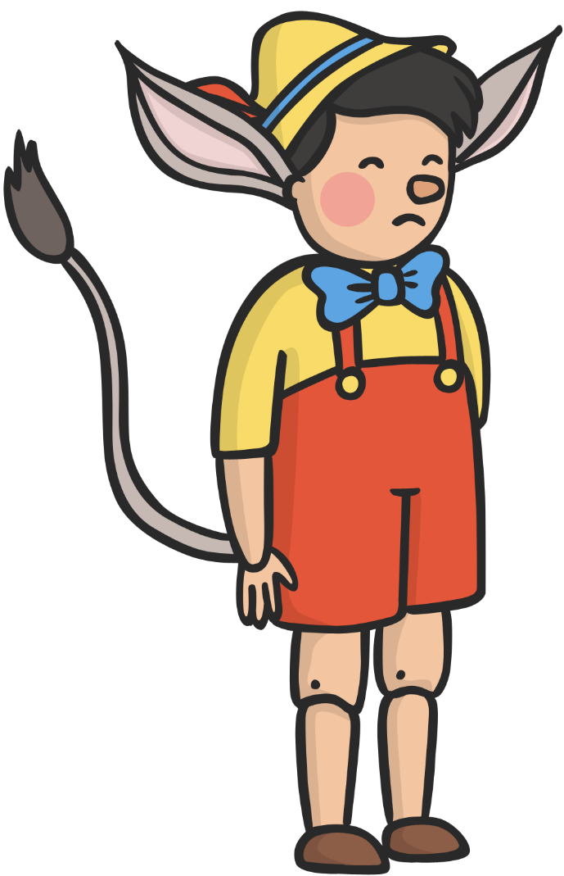
Pinocchio only grew ears and a tail because he was made of wood.

Slide 20

He was thrown into the sea and his ears and tail fell off.

Slide 21
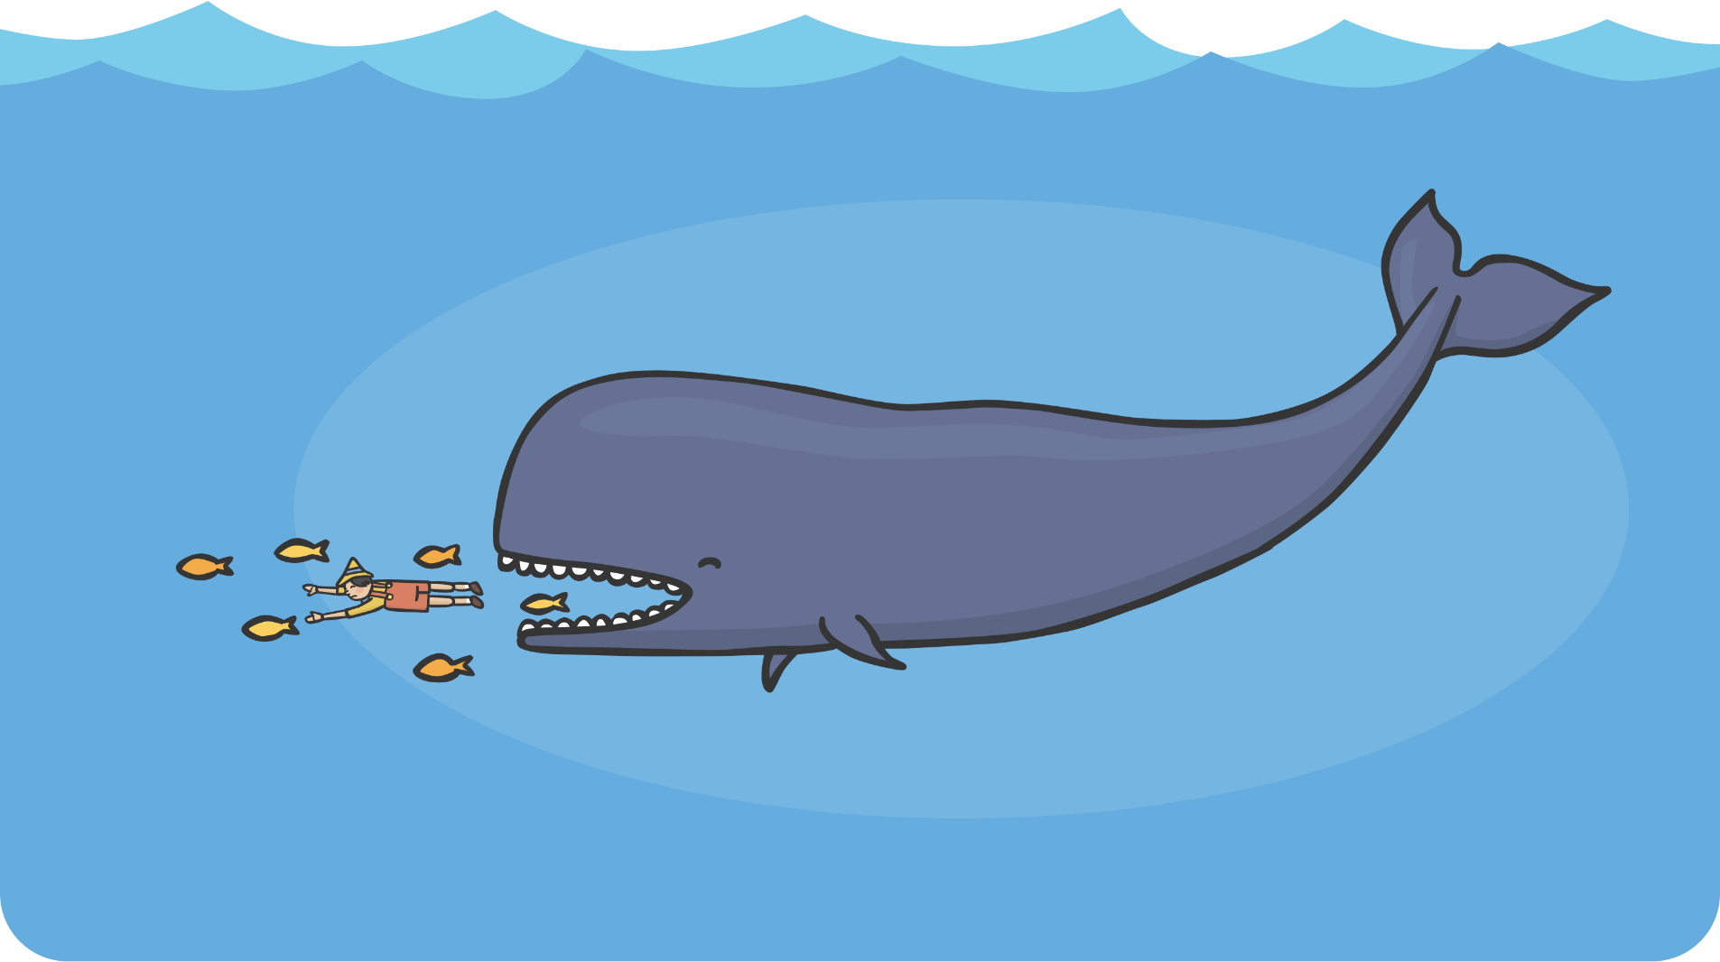
Pinocchio was swallowed by a huge whale!

Slide 22
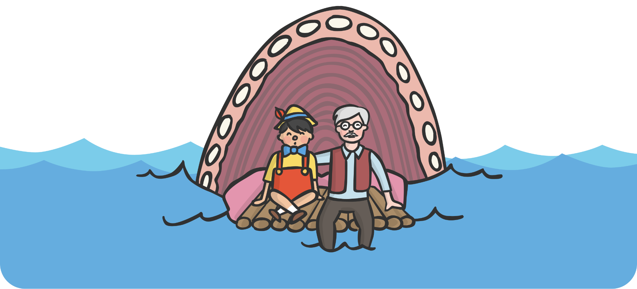
His father was inside the whale too! They built a raft and escaped.

Slide 23
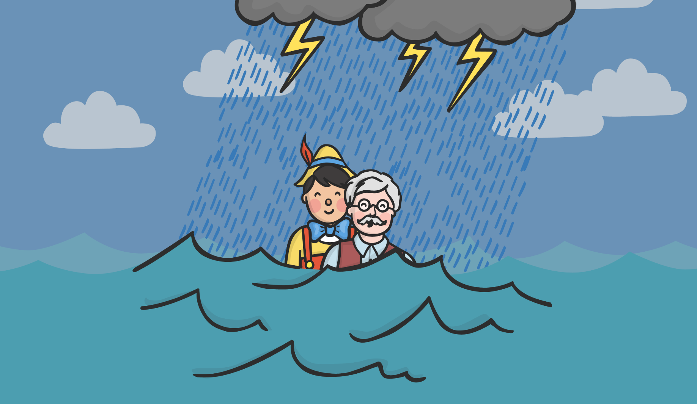
Pinocchio saved his father from a big storm.

Slide 24
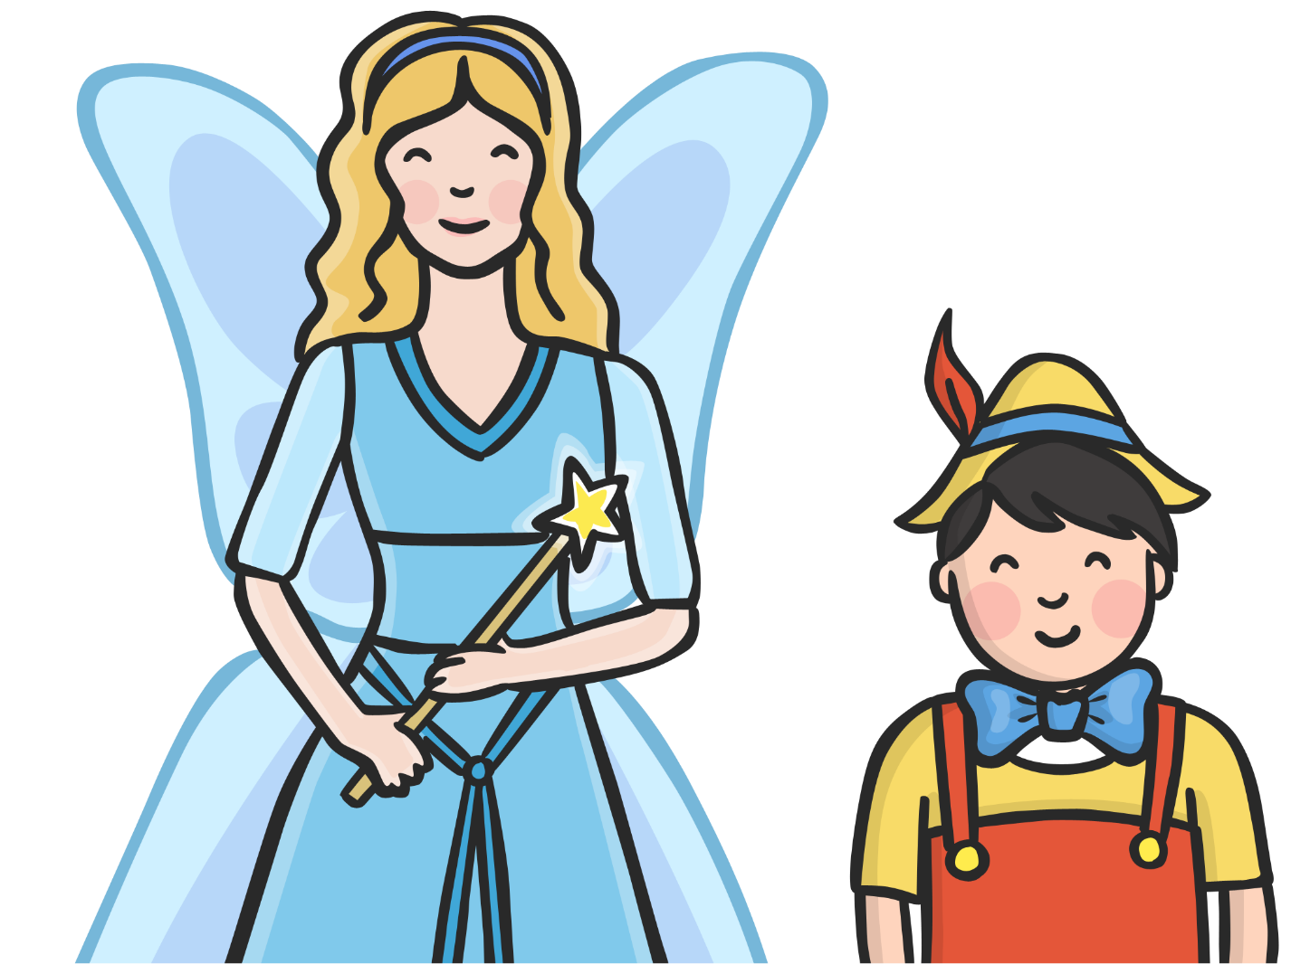
When they arrived home the Blue Fairy waved her wand and turned Pinocchio into a real boy.

Slide 25
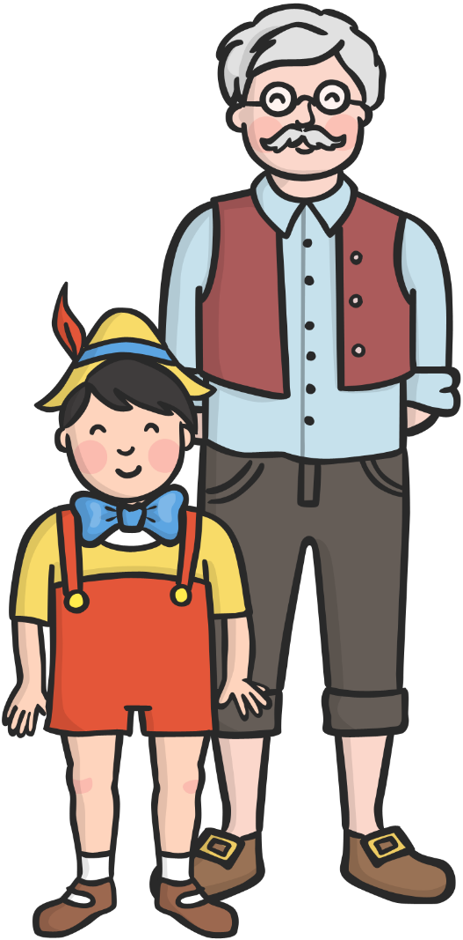
Pinocchio and Geppetto lived happily ever after.

