Slide 1
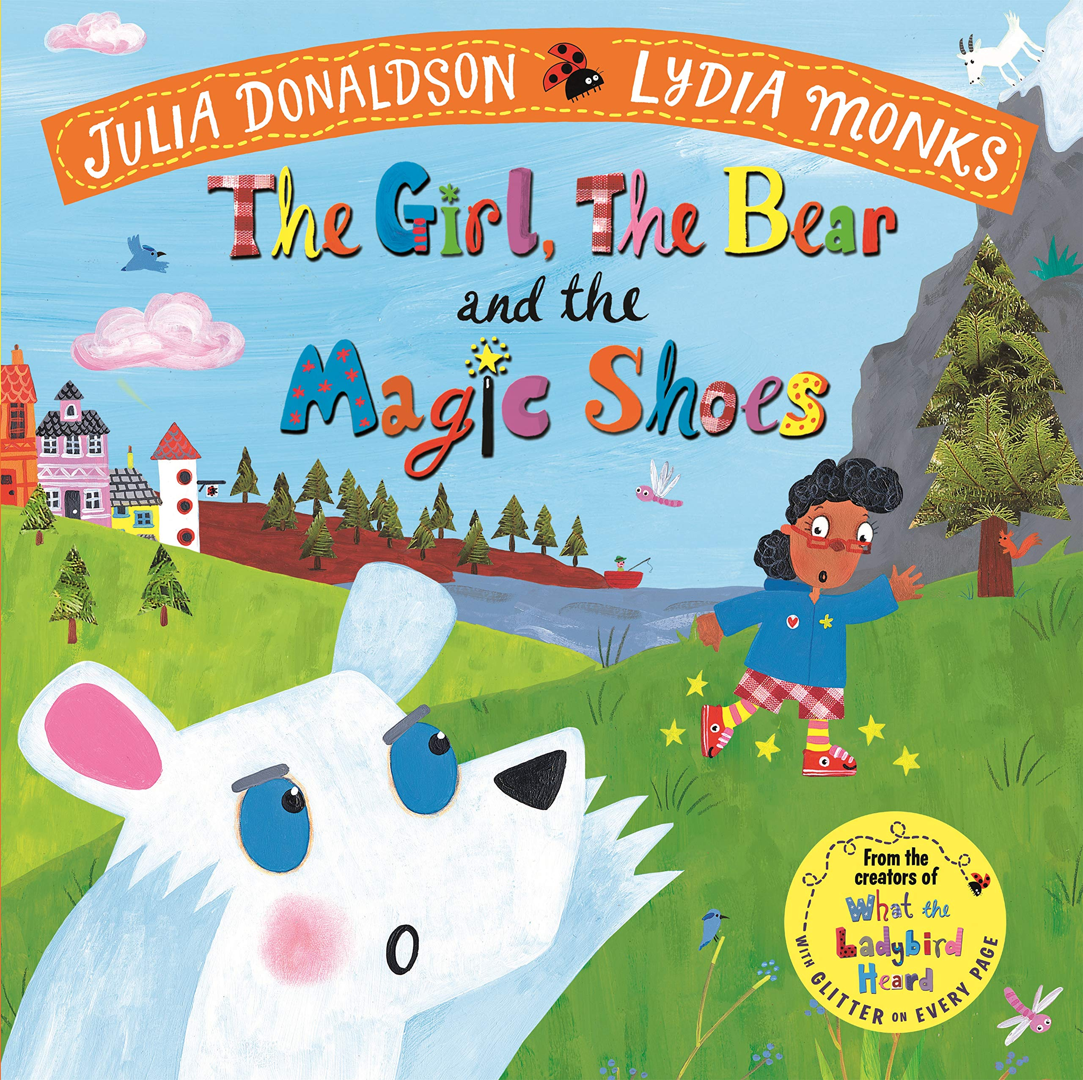

Slide 2
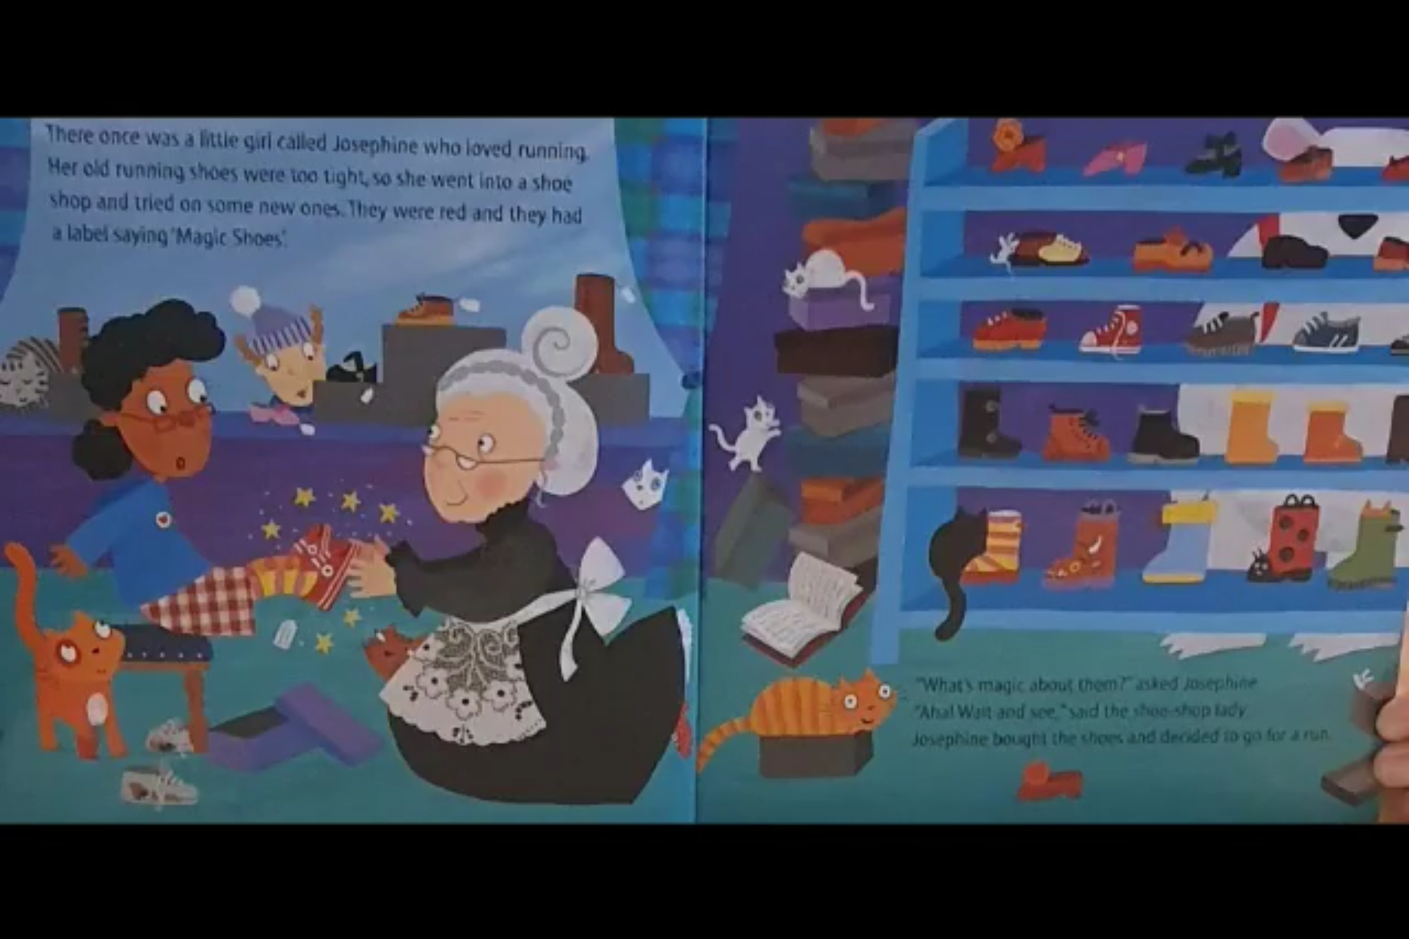
There once was a little girl called Josephine who loved running
Her old running shoes were too tight, so she went into a shoe
shop and tried on some new ones. They were red and they had
a label saying ‘Magic Shoes’.
“What’s magic about them?” asked Josephine.
“Aha! Wait and see”, said the shoe shop lady.
Josephine bought the shoes and decided to go for a run.

Slide 3
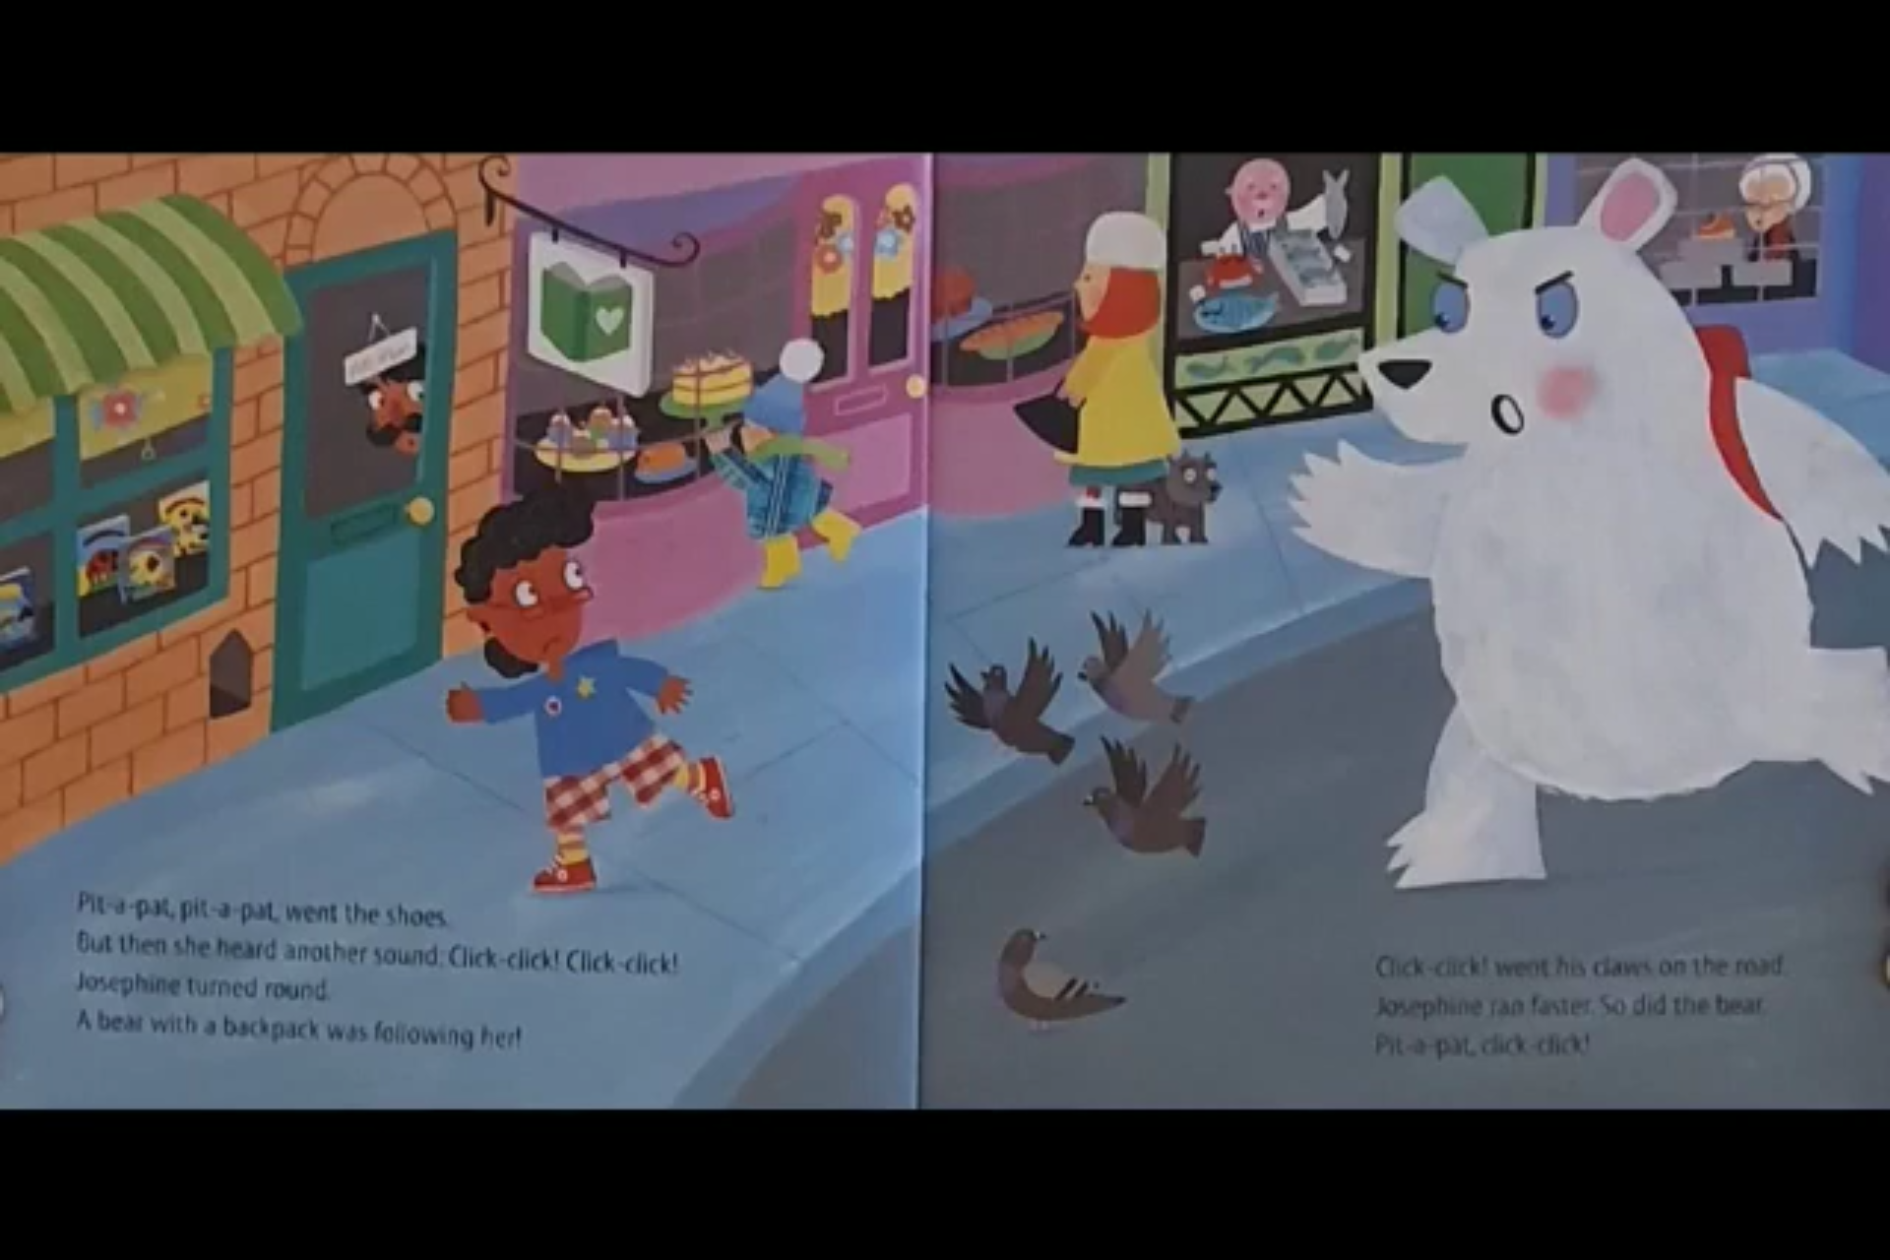
Pit-a-pat, pit-a-pat went the shoes.
But then she heard another sound, Click-click, click-click!
Josephine turned around
A bear with a backpack was following her!
Click-click went his claws on the road
Josephine ran faster, So did the bear.
Pit-a-pat, click-click!

Slide 4
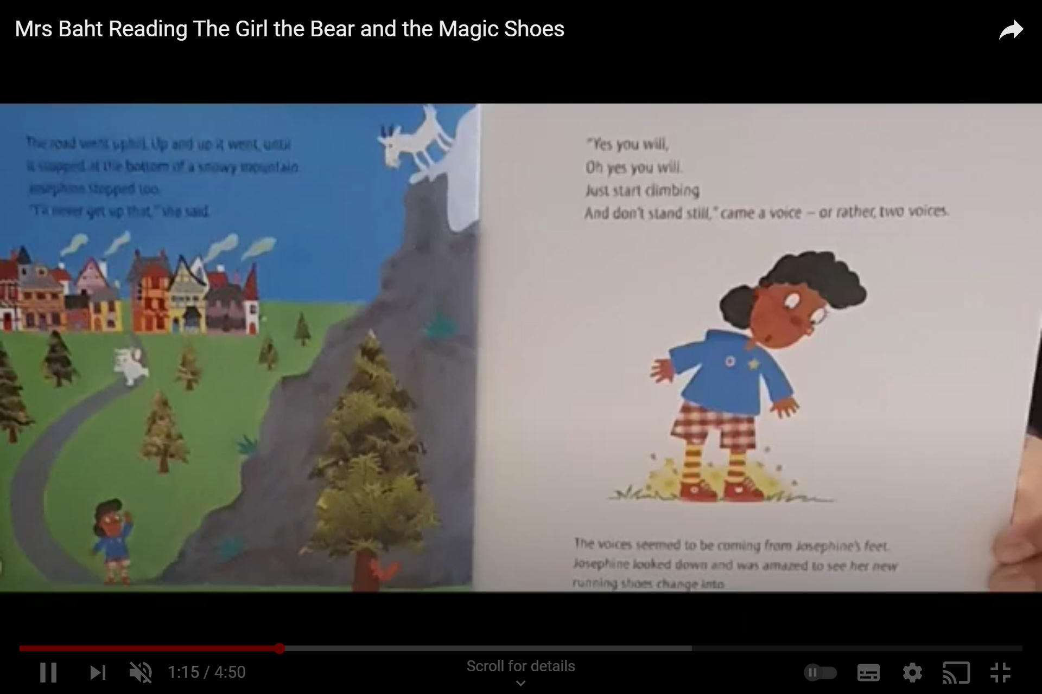
The road went uphill, up and up it went until
It stopped at the bottom of a snowy mountain
Josephine stopped too
“I’ll never get up that” she said.
“Yes you will,
Oh yes you will
And start climbing
And don’t stand still” came a voice - or rather two voices.
The voices seemed to be coming from Josephine’s feet.
Josephine looked down and was amazed to see her new
Running shoes changing into…

Slide 5
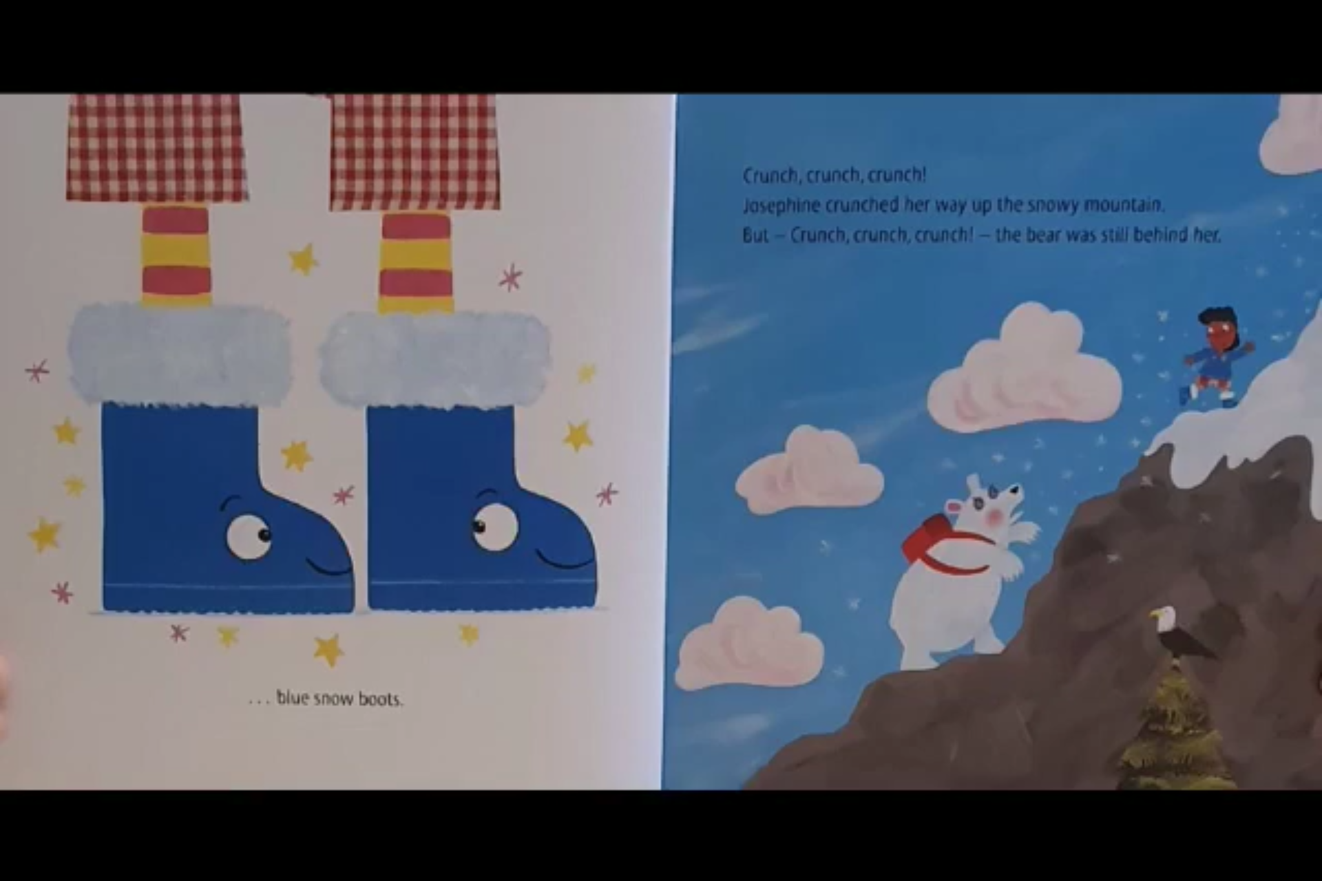
Crunch, crunch, crunch!
Josephine crunched her way up the snowy mountain
But – Crunch, crunch, crunch! – the bear was still behind her.
… blue snow boots.

Slide 6
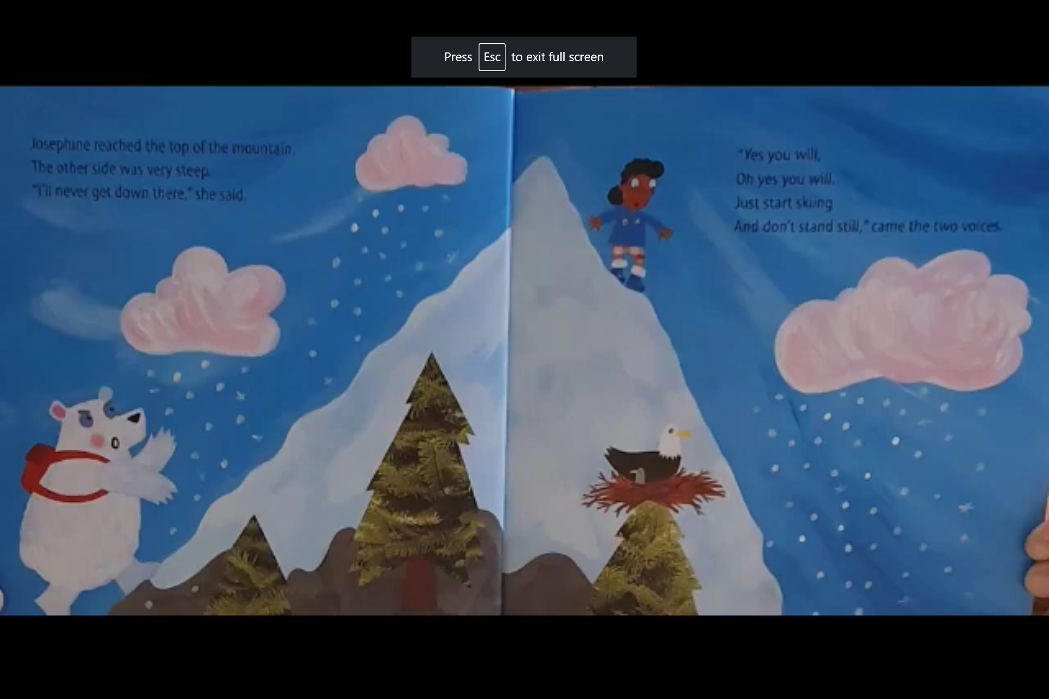
Josephine reached the top of the mountain
The other side was very steep.
“I’ll never get down there” she said.
“Yes you will,
Oh yes you ill
Just start skiing
And don’t stand still” came the two voices.

Slide 7
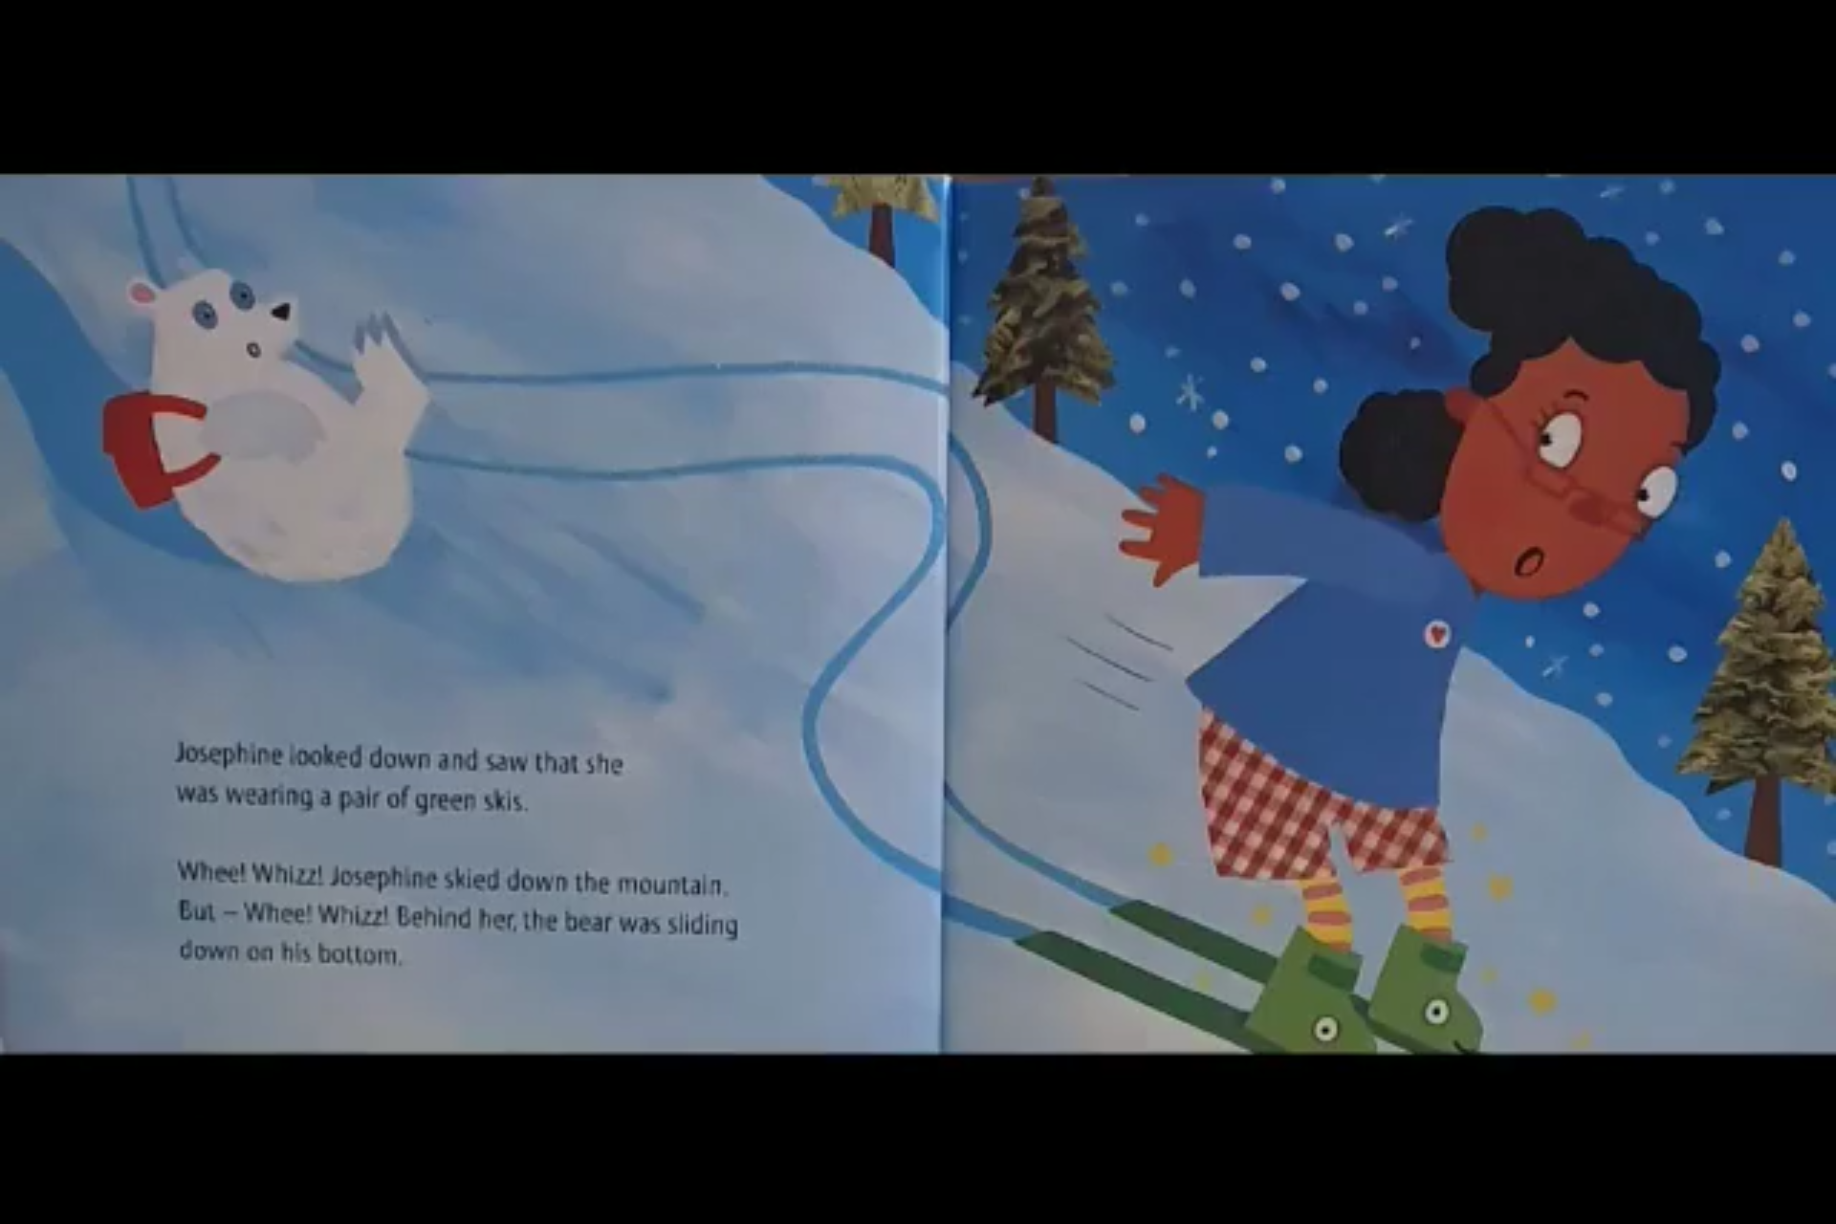
Josephine looked down and saw that she
was wearing a pair of green skis.
Whee! Whizz! Josephine skied down the mountain,
But – Whee! Whizz! Behind her the bear was sliding
down on his bottom.

Slide 8
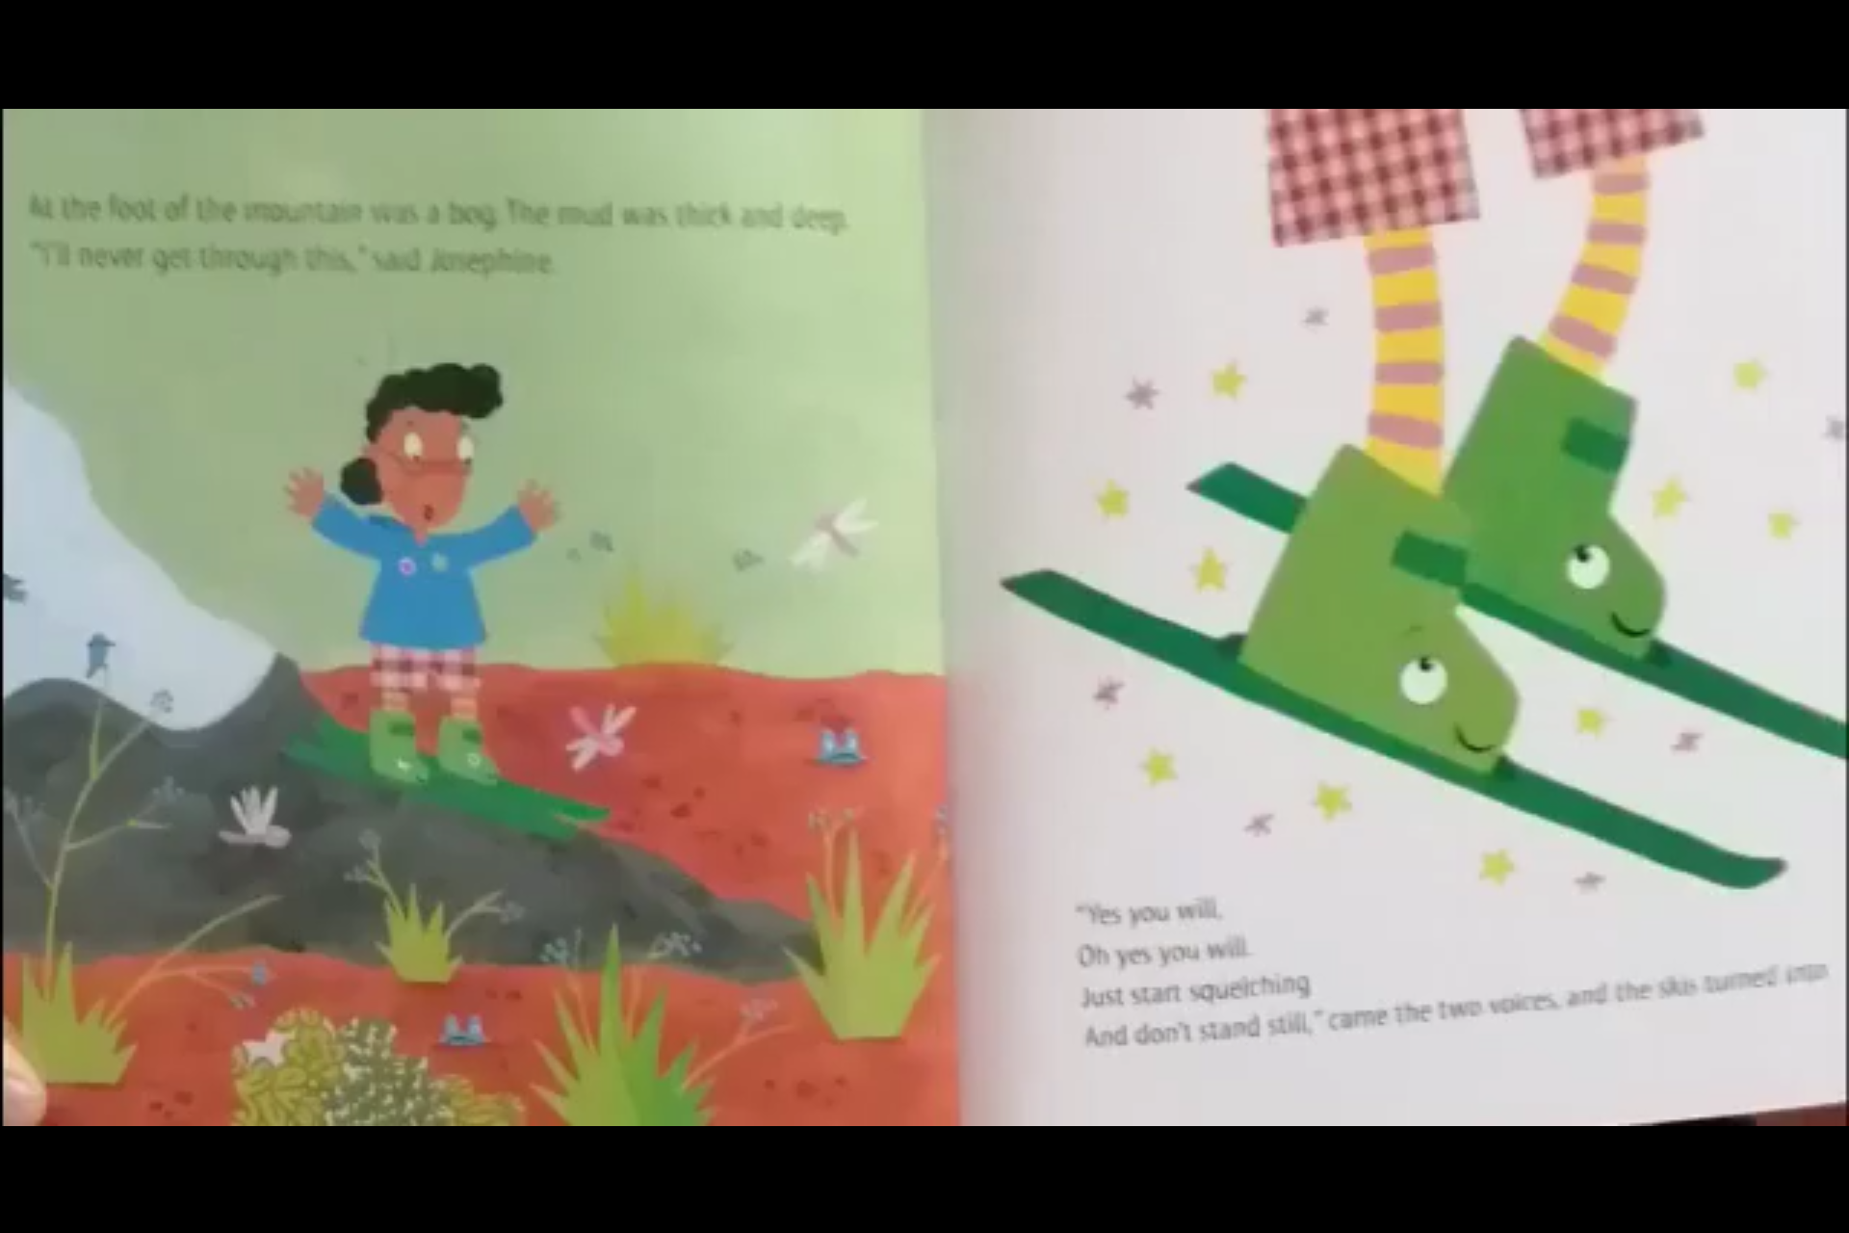
At the foot of the mountain was a bog. The mud was thick and deep.
“I’ll never get through this” said Josephine.
“Yes you will,
Oh yes you ill
Just start skiing
And don’t stand still” came the two voices.
And the skis turned into…

Slide 9
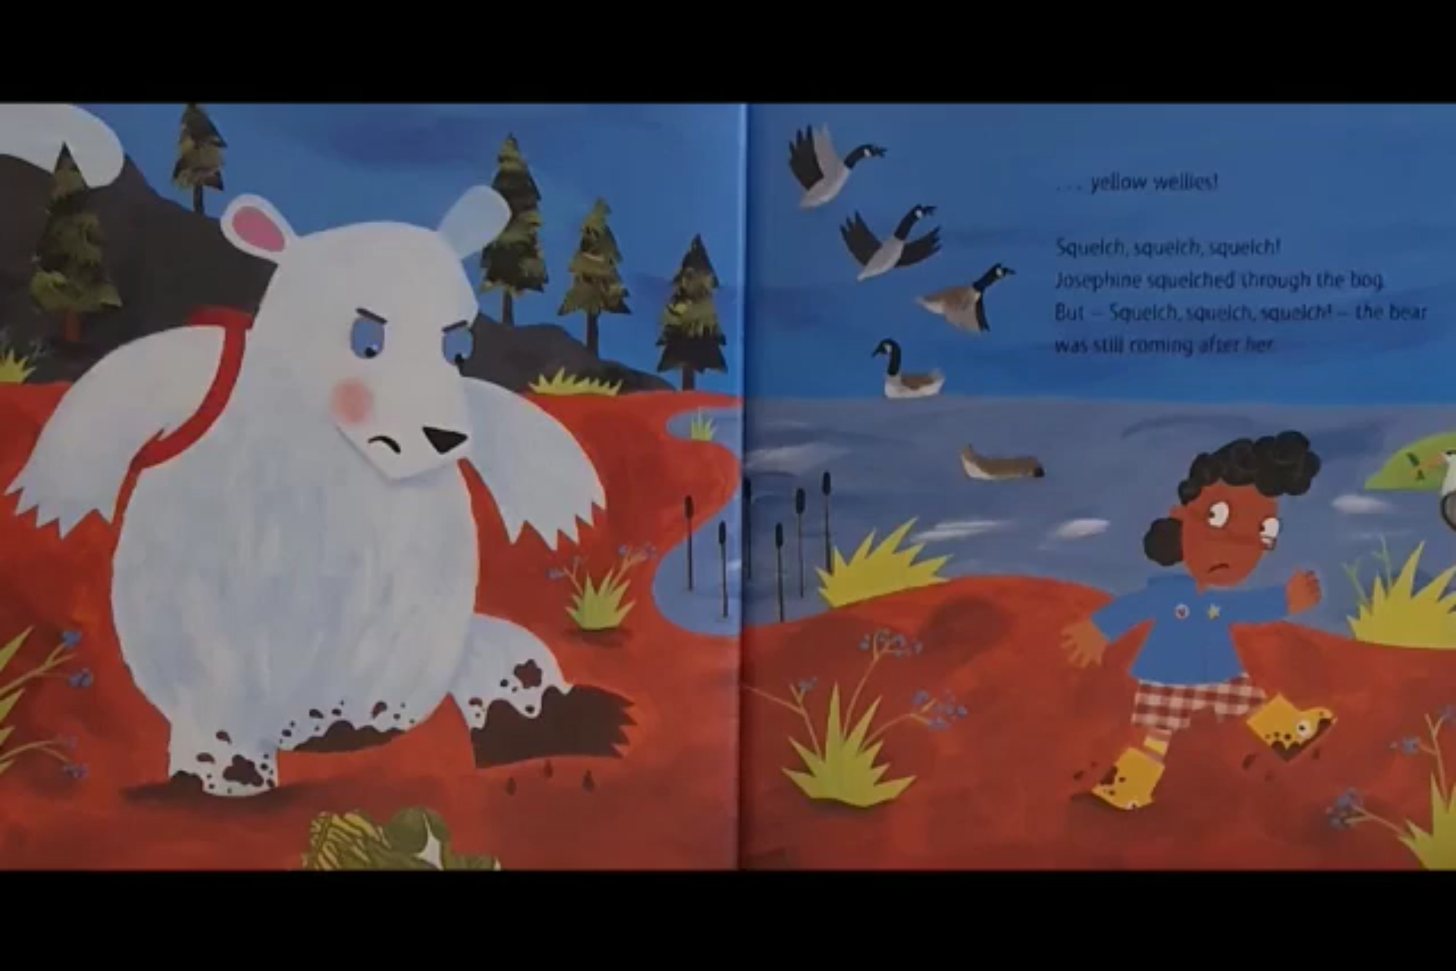
… Yellow wellies!
Squelch, squelch, squelch!
Josephine squelched through the bog
But – Squelch, squelch, squelch! – the bear
was still running after her.

Slide 10
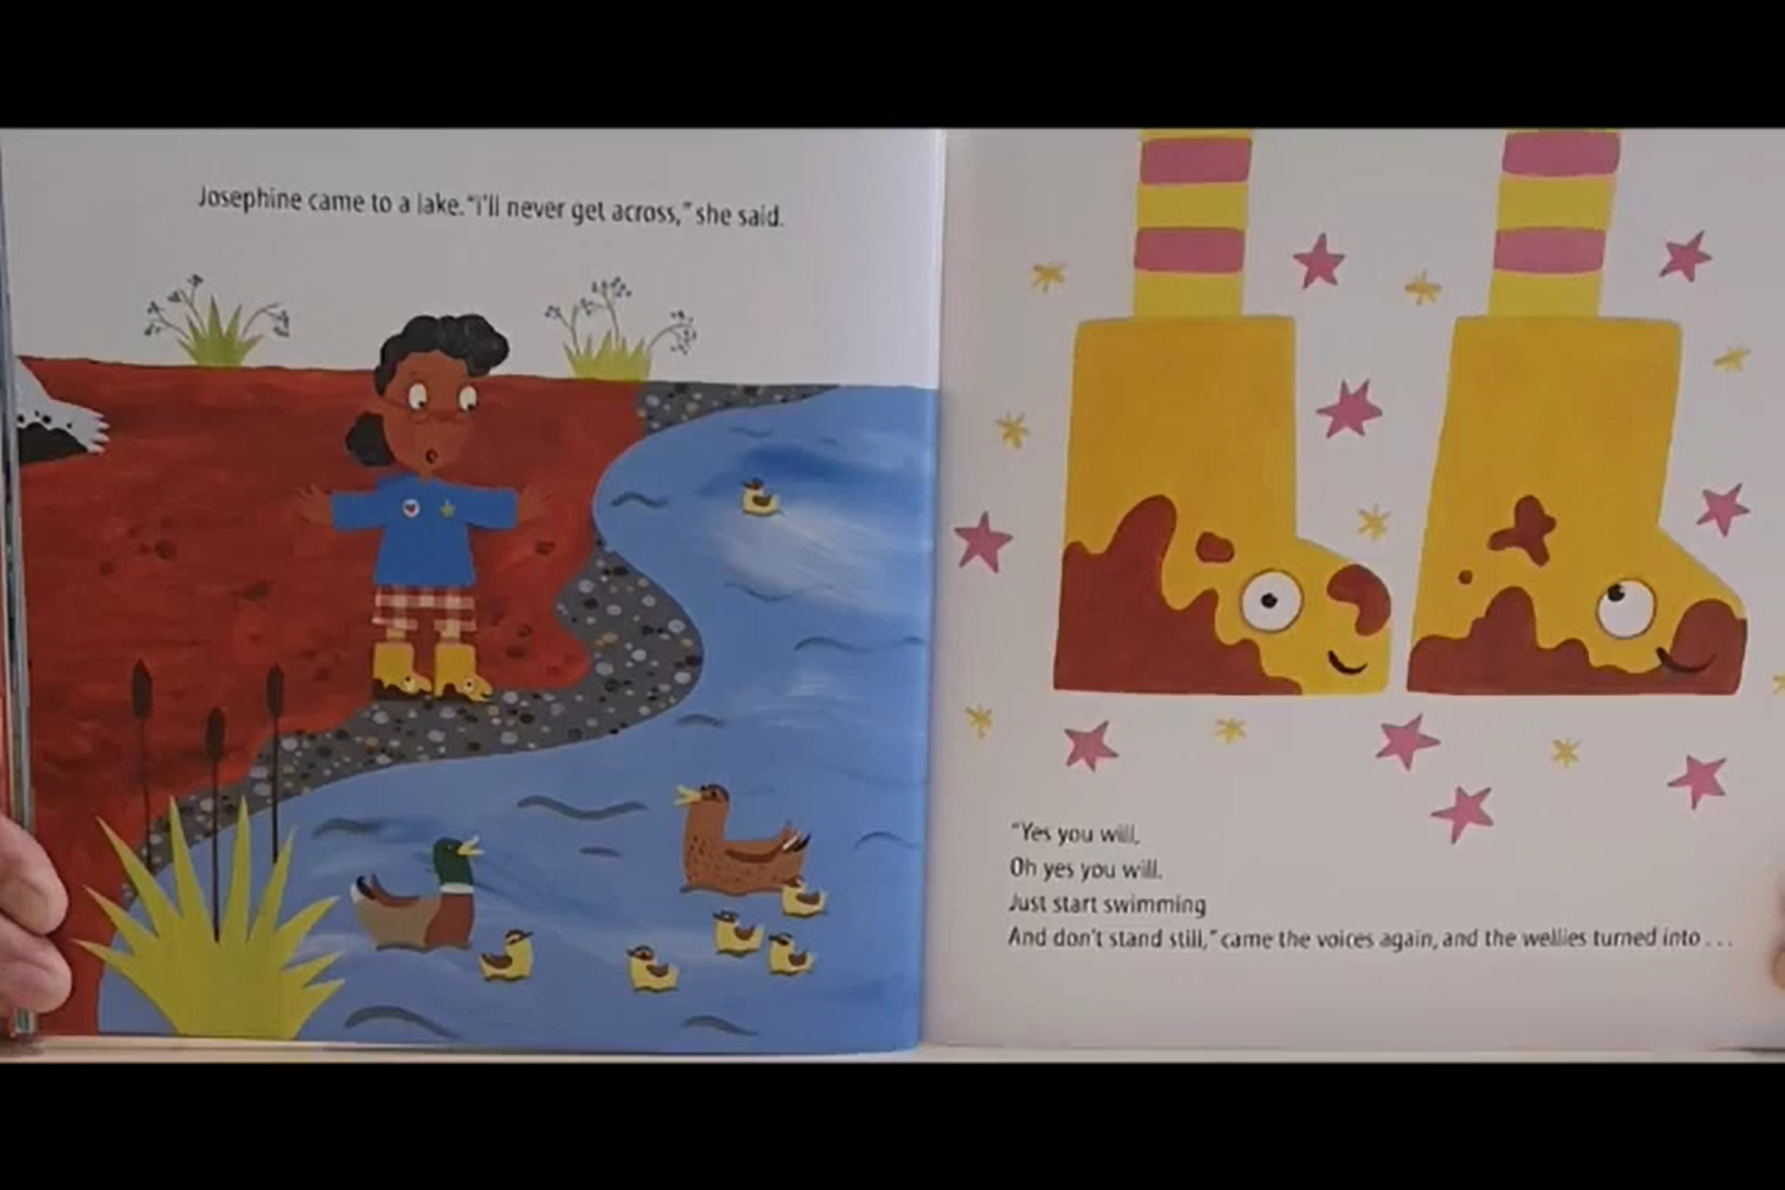
Josephine came to a lake, “I’ll never get across” she said.
“Yes you will,
Oh yes you ill
Just start skiing
And don’t stand still” came the two voices, and the wellies turned into…

Slide 11
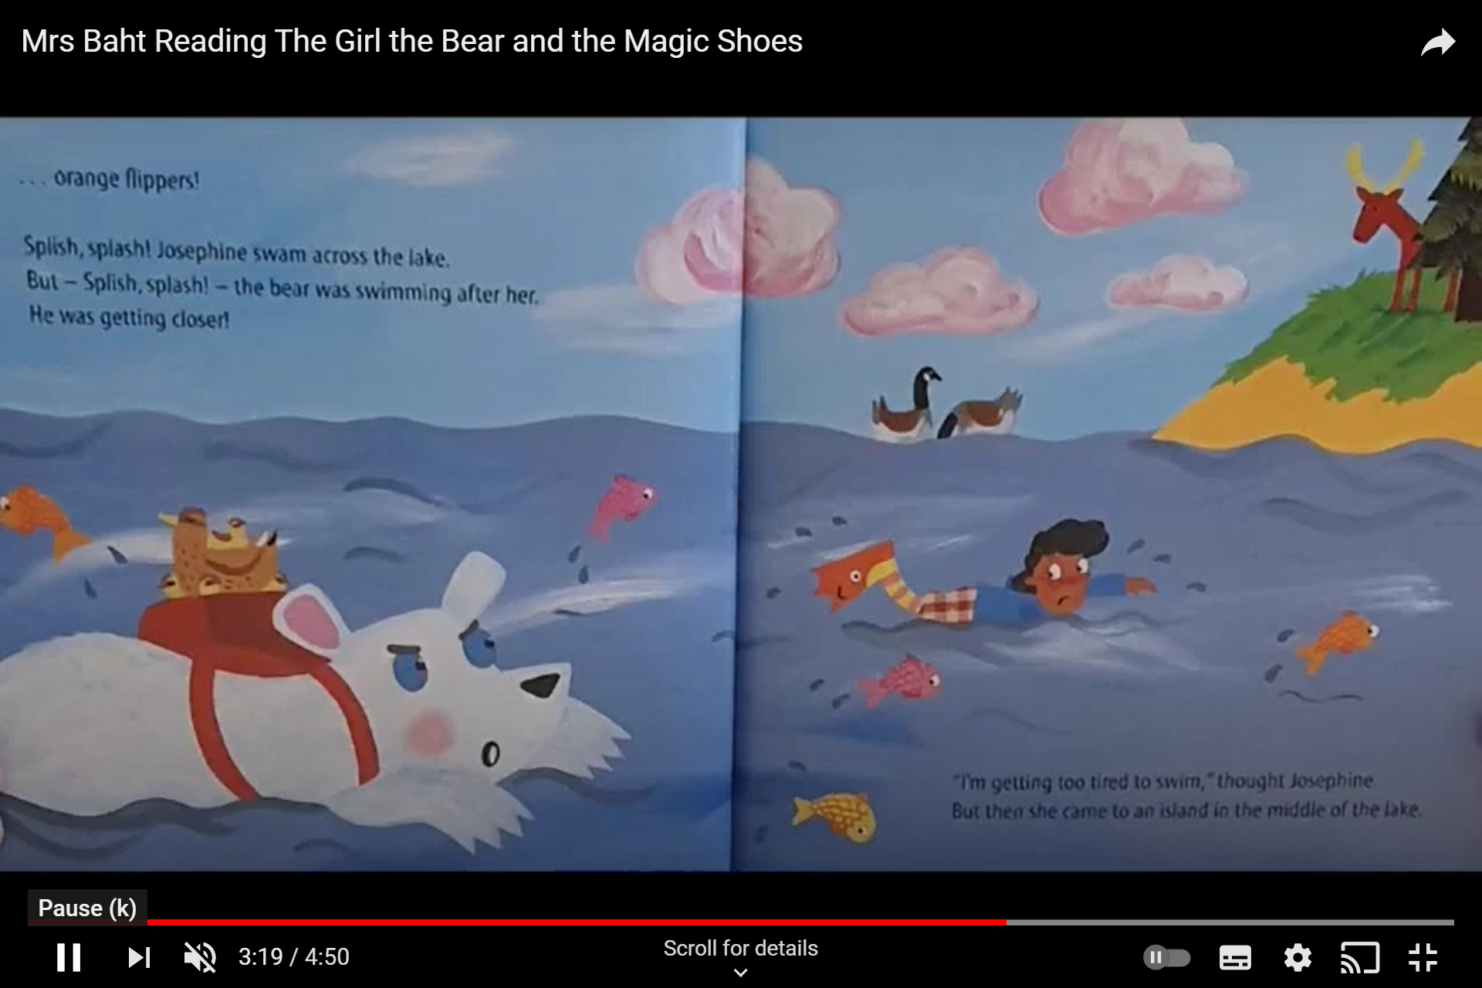
… orange flippers!
Splish, splash! Josephine swam across the lake.
But – Splish, splash! – the bear was swimming after her.
He was getting closer!
“I’m getting too tired to swim” thought Josephine
But then she came to an island in the middle of the lake.

Slide 12
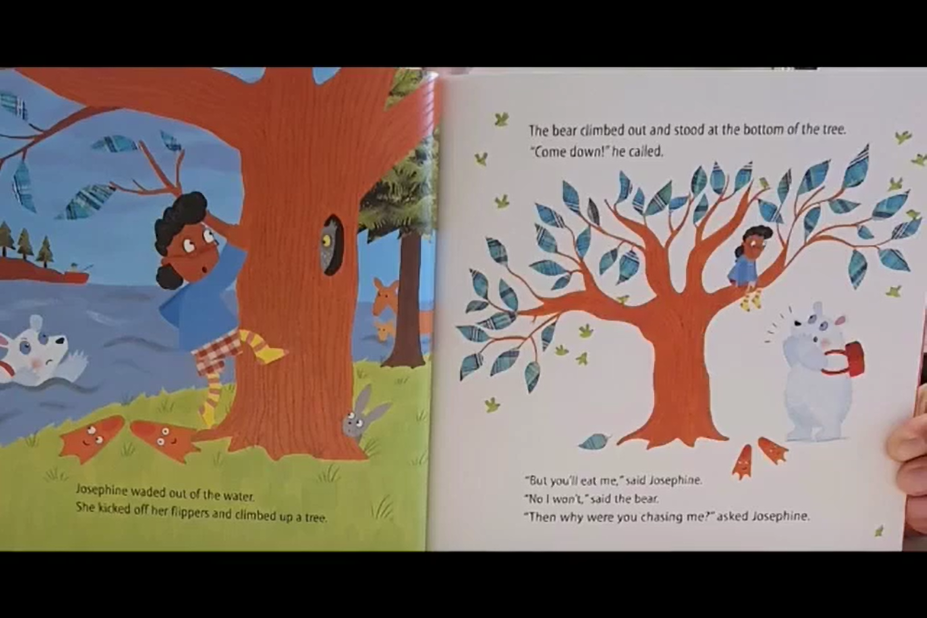
The bear climbed out and stood at the bottom of the tree.
“Come down!” he called.
Josephine waded out of the water
She kicked off her flippers and climbed up a tree
“But you’ll eat me” said Josephine.
“No I won’t” said the bear.
“Then why were you chasing me?” asked Josephine.

Slide 13
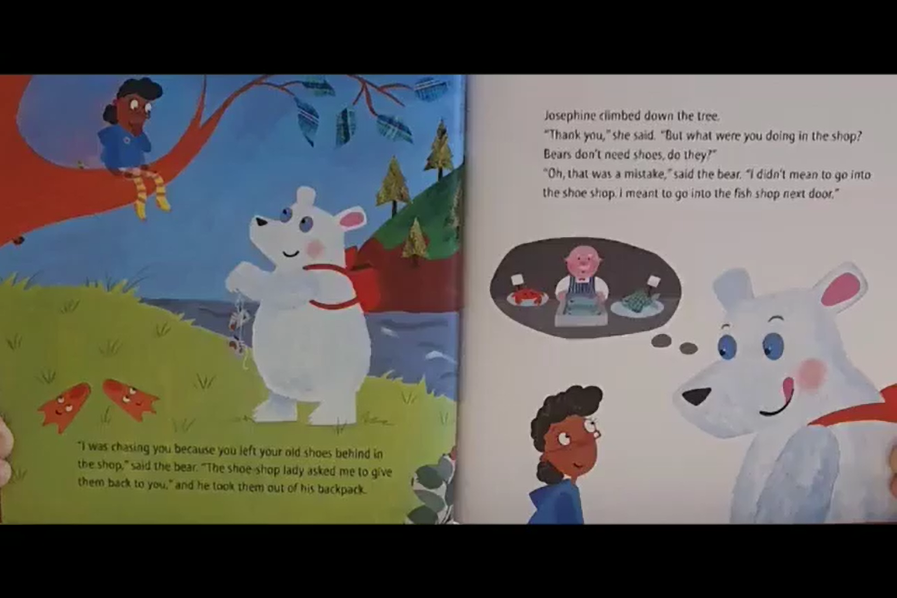
Josephine climbed down the tree.
“Thank you” she said, “But what were you doing in the shop?
Bears don’t need shoes, do they?”
“Oh, that was a mistake” said the bear, “I didn’t mean to go into
the shoe shop I meant to go into the fish shop next door”
“I was chasing you because you left your old shoes behind in
the shop” said the bear. “The shoe shop lady asked me to give
them back to you” and he took them out of his backpack.

Slide 14
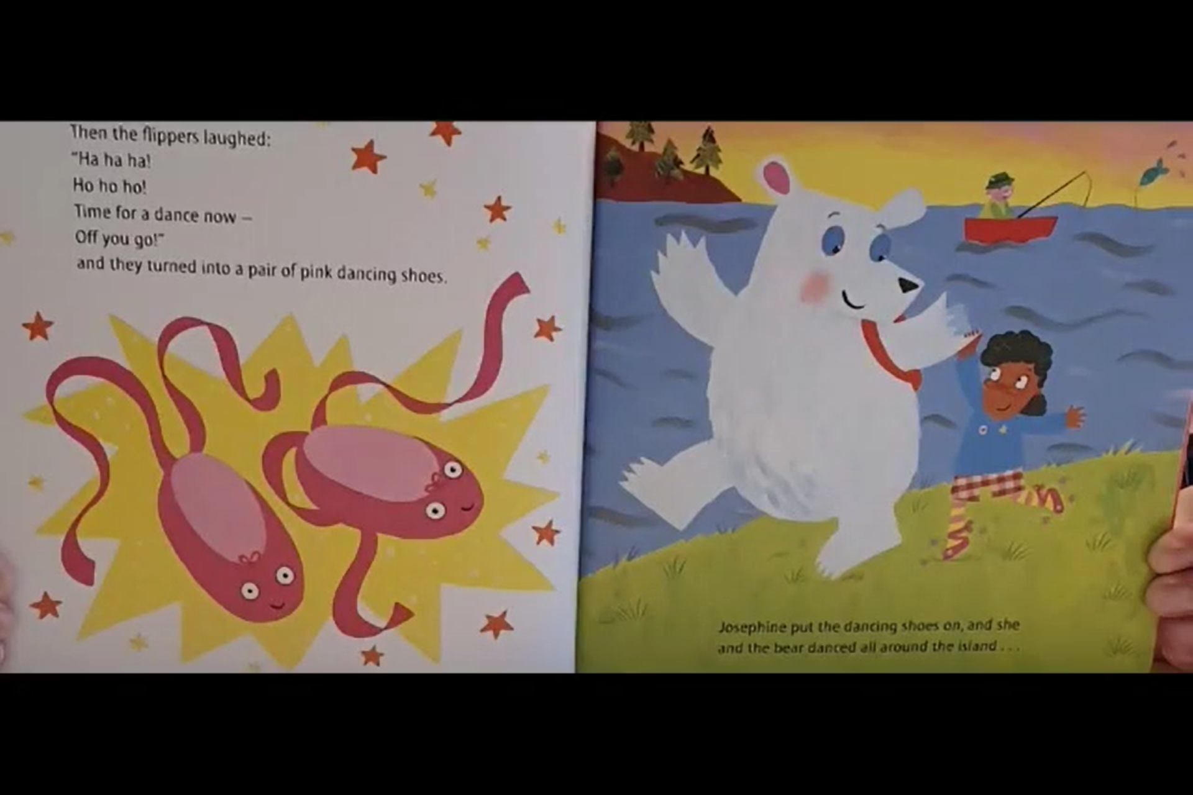
Then the flippers laughed;
“Ha ha ha!
Ho ho ho!
Time for a dance now –
Off you go!”
and they turned into a pair of pink dancing shoes.
Josephine put the dancing shoes on, and she
and the bear danced all around the island…

Slide 15
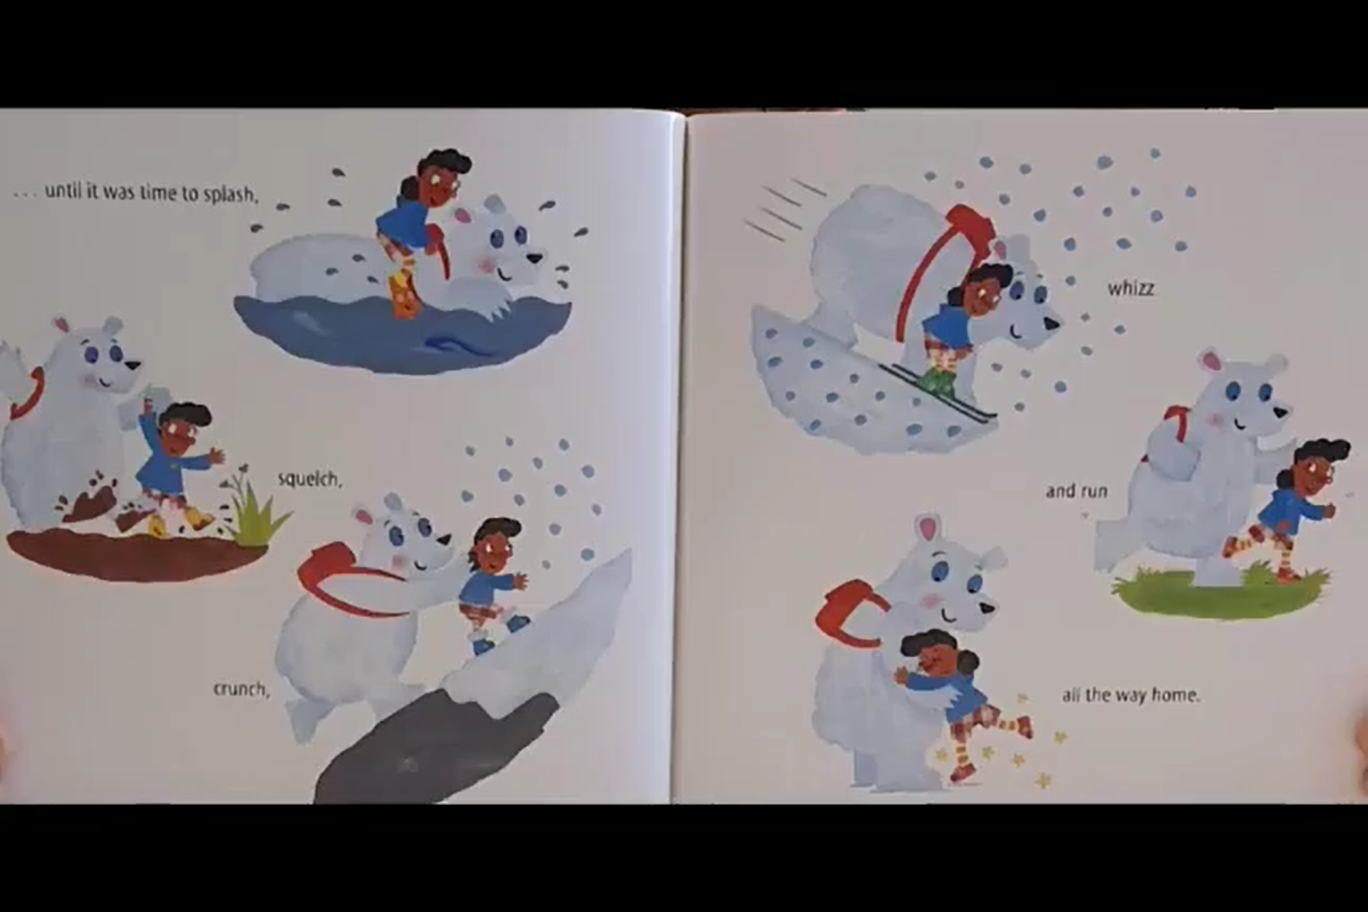
… until it was time to splash,
whizz
squelch
and run
crunch,
all the way home.

Slide 16
The End

